Slide 1
Molekularno-biološke tehnike u staničnoj kulturi

Slide 2
Jedan od načina istraživanja funkcije gena je proučavanje stanica kojima nedostaje funkcija pojedinog gena ili je povećana
klasična i reverzna genetika
poznavanje sekvence gena; sekvenciranje genoma
spontane i inducirane mutacije
ciljana inaktivacija funkcije gena – „reverzna genetika”

Slide 3
Metode unošenja strane DNA/RNA u eukariotske stanice/ nastanka rekombinantne stanice
Transfekcija stanica:
unošenje plazmida u stanicu (ekspresijski vektori – eukariotski promotori; univerzalni i tkivno specifični)
kemijska transfekcija i elektroporacija; kombinacija
trajna i kratkotrajna; konstitutivna i inducibilna
selekcija otpornošću na antibiotik (G418, higromicin, puromicin)
kotransfekcija (unos plazmida koji nosi ciljnu sekvencu i koji je bez gena za otpornost na antibiotik uz plazmid s genom za selekciju)
Infekcija retrovirusnim (lentivirusi) ili DNA-virusnim vektorom (npr. adenovirusi ili virusi asocirani s adenovirusima) - transdukcija
Mikroinjiciranje plazmida, RNA…
Notes:
geneticin, puromicin, higromicin -ubija sve

Slide 4
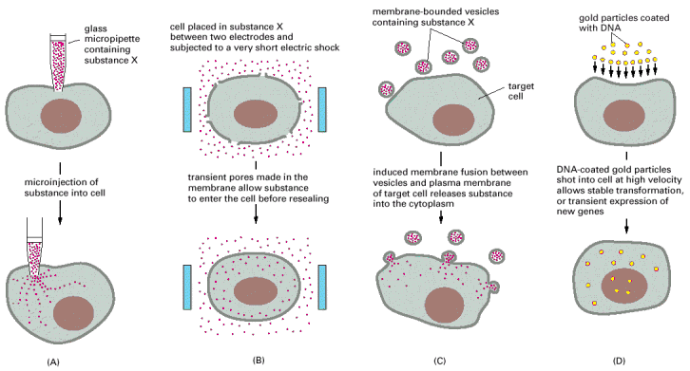
mikroinjiciranje
elektroporacija
transfekcija
liposomima
“upucavanje” DNA na zlatnim kuglicama
-posebni uređaji
Unošenje tvari u stanicu: proteina, DNA, RNA
Notes:
posebni uređaji
citotoksičnost

Slide 5
Prednosti i nedostaci pojedinih metoda:
posebni uređaji i oprema
citotoksičnost (elektroporacija)
priprema virusa i razine sigurnosti laboratorija
efikasnost transfekcije (veličina plazmida, vrsta stanica npr.)
„brzina” selekcije
potrebne količine stanica

Slide 6
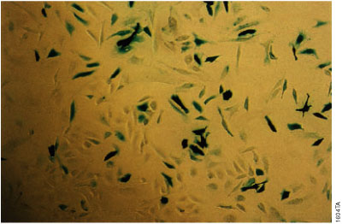
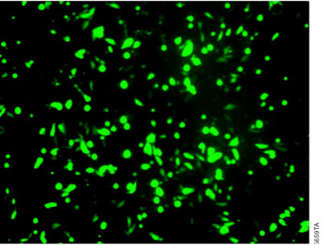
-
Stanice HeLa “obojane” beta galaktozidaznom reakcijom
Stanice CHO s unešenim plazmidom za
zeleni fluorescentni protein
-kontrolni plazmidi koji se mogu detektirati kao mjera uspješnosti transfekcije (transficirane/ukupni broj stanica)

Slide 7
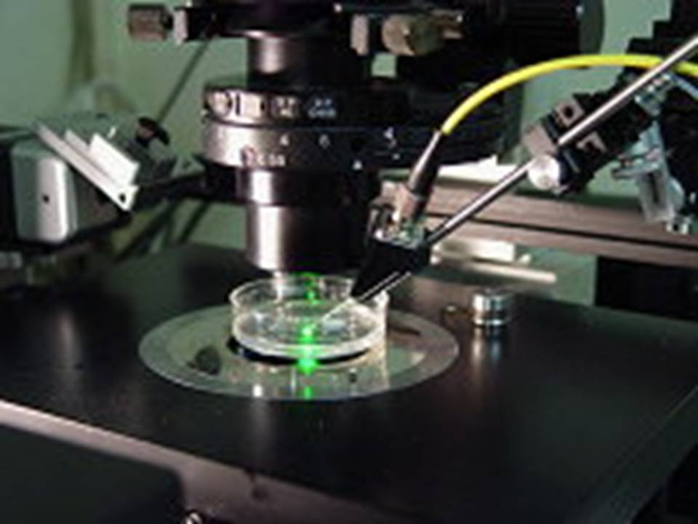
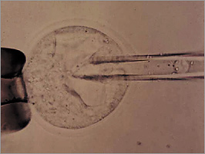
Mikroinjiciranje DNA

Slide 8
Metode utišavanja funkcije gena
„dominantno negativni mutanti” (za pojedine gene, plazmidi s mutiranom sekvencom, p53 npr.)
unos plazmida koji kodira antisens siRNA (shRNA) komplementarnu ciljanoj sekvenci
transfekcija siRNA (sekvence RNA) - kratkotrajno
metoda CRISPR-Cas9 koja specifično izaziva lom/deleciju/mutaciju u blizini mjesta koje veže komplementarnu RNA (specifične nukleaze)
moguće i utišavanje promotora
homologna rekombinacija između staničnog gena i plazmida s homolognim bočnim sekvencama – za transgenične organizme
sustav „Cre-Lox” za inducibilnu rekombinaciju
proteinski inhibitori signalnih molekula
metode „reverzne genetike” (nužno poznavanje sekvence gena)
kod nastanka transgeničnih organizama – manipulacija stanicama u kulturi
Notes:
siRNA: kratki oligonukleotidi
shRNA: kloniranje kratkih odsječaka DNA, posebni promotori

Slide 9
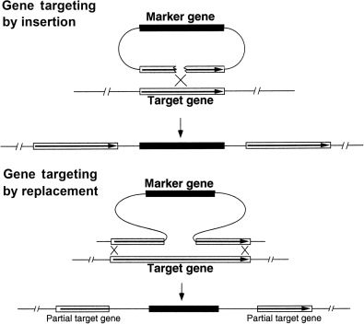
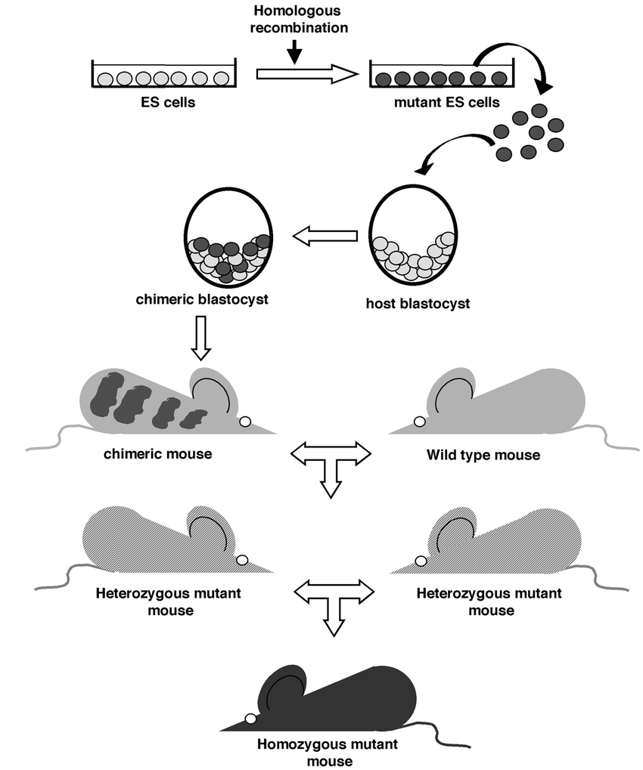
Homologna rekombinacija
https://www.nobelprize.org/prizes/medicine/2007/advanced-information/
Gauthier et al. Methods in mol. biol. 2002
Notes:
Homologous recombination: from ES cells to mutant mice. Normal ES cells (figured light gray) are electroporated with the HR vector and selected for its integration at the right locus (cells in dark gray). Cells harboring the mutation on one of the two alleles of the targeted locus are injected into E 2.5 host blastocysts, which are then reimplanted in pseudopregnant females. The injected mutant ES cells participate to the development of the embryo, giving birth to chimeric mice composed of mutant and normal cells. Since ES cells and host blastocysts belong to two mouse strains recognizable by their hair color, the chimera can be easily identified. These chimera, usually males (because the ES cells used have a male genotype), are then crossed with wild-type females. Heterozygous animals are obtained and identified from their hair color. Heterozygous mice are intercrossed to generate homozygous animals in a mendelian ratio (1/4), provided that the mutation is not deleterious for embryonic development.

Slide 10
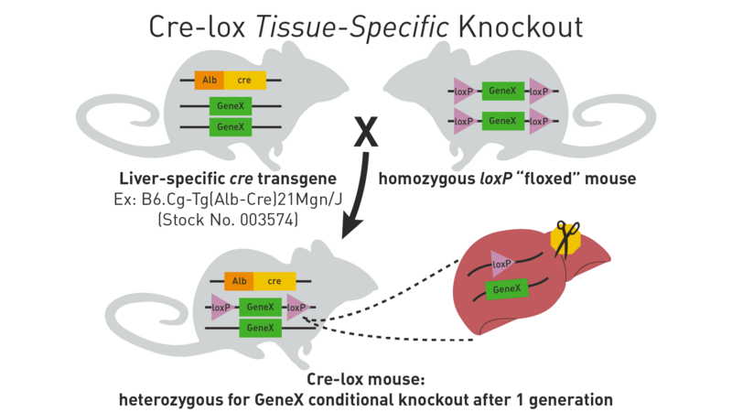
Sustav Cre-lox omogućava indukciju rekombinacije u vrijeme i u tkivu po odabiru
homozigot za mutaciju u drugog generaciji
https://www.jax.org/news-and-insights/jax-blog/2011/september/cre-lox-breeding

Slide 11
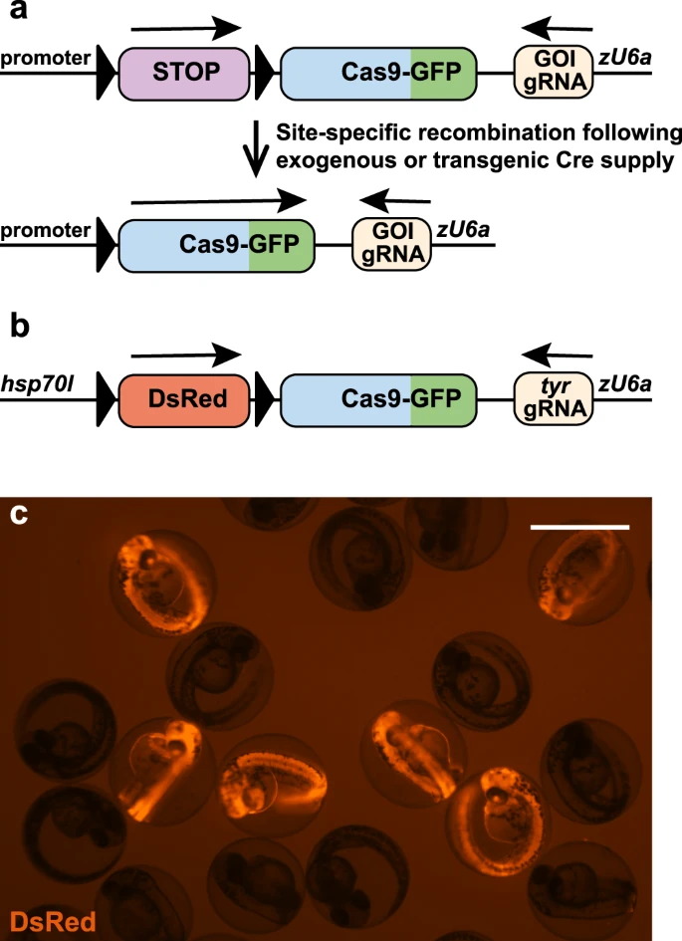
kombinacija metoda inducibilne rekombinacije i sustava Crispr-Cas
ribe zebrice
https://www.nature.com/articles/s41467-021-21427-6

Slide 12
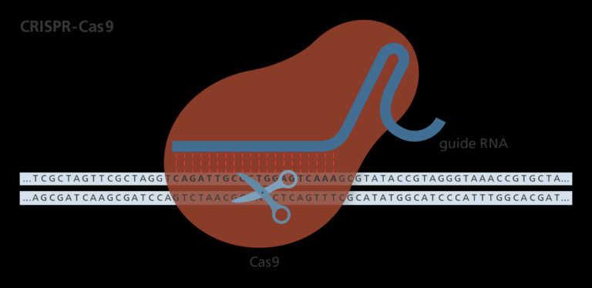
Model djelovanja sustava Crispr-Cas9
https://www.youtube.com/watch?v=4YKFw2KZA5o
- film
https://www.yourgenome.org/theme/how-do-we-use-crispr-gene-editing-to-study-diseases/

Slide 13
unošenje “gena” (nespecifična lokalizacija na kromosomu) i povećana ekspresija sekvence
  - reverzija svojstava kao potvrda hipoteze ili praćenje svojstava stanice inducibilni vektori: indukcija ekspresije kontrolirana dodatkom antibiotika, temperaturom ili sl. preko specifičnog promotora
  tkivno-specifični vektori
lokalizacija proteina (unošenje plazmida koji kodira za protein čija je sekvenca fuzionirana sa sekvencom za fluorescentni protein
lokalizacija pod mikroskopom)
kolokalizacija proteina – analiza ekspresije dva fluorescentna proteina,
markeri organela
konfokalni mikroskop

Slide 14
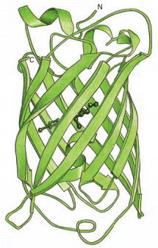
Lokalizacija u stanici:
obilježeni proteini (npr. zeleni fluorescentni protein)
- mogućnost promatranja in vivo i u funkciji vremena
fluorescencijskim mikroskopom
- u gotovo svim organelima stanice
- ekspresija i lokalizacija fuzijskih proteina
- “dinamična lokalizacija”:
citoskelet, sekretorni putevi, citokineza, protein “trafficking”
promjene tokom diferencijacije
zeleni fluorescentni protein
iz meduze Aequorea victoria
- fluorescencija pod UV svjetlom: veća osjetljivost
od običnog svjetlosnog mikroskopa
-fuzionirana sekvenca ne smije interferirati s funkcijom proteina
Notes:
drugi protein vezanjem Ca emitira Uv/plavu svjetlost koja pobudi GFP

Slide 15
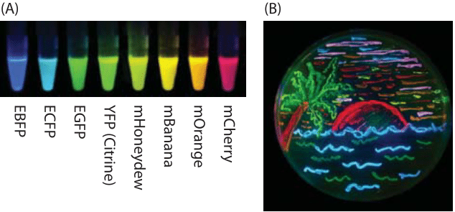
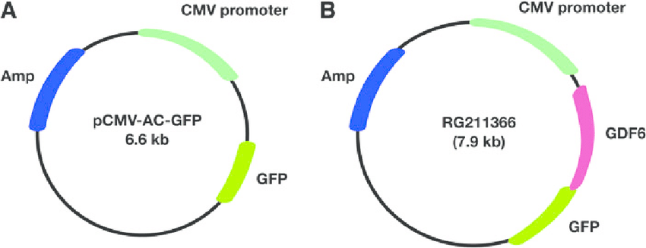
različite valne duljine i fluorescencija proteina
konstrukcija fuzijskog gena
https://book.bionumbers.org/what-is-the-maturation-time-for-fluorescent-proteins/

Slide 16
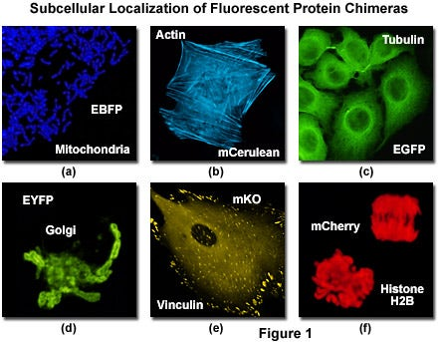
Unutarstanična lokalizacija fuzijskih fluorescentnih proteina
https://evidentscientific.com/en/microscope-resource/knowledge-hub/techniques/confocal/applications/fpcolorpalette
Notes:
https://evidentscientific.com/en/microscope-resource/knowledge-hub/techniques

Slide 17
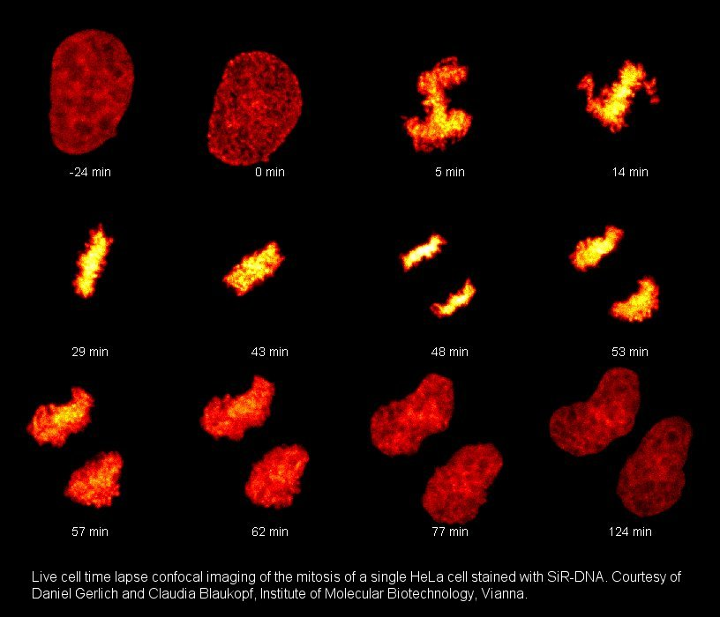
fluorescentne boje koje bojaju DNA u živim stanicama
siR-DNA

Slide 18
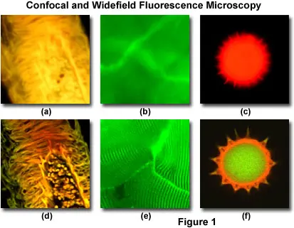
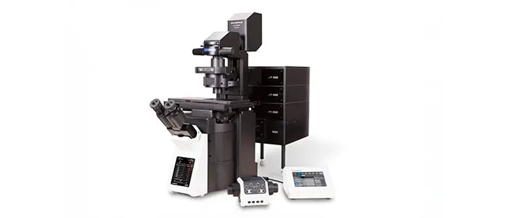
Konfokalni mikroskop ima mogućnost kontrole dubine vidnog polja, reducira pozadinske informacije iz fokusa te sakuplja seriju optičkih rezova. Koristi mogućnost filtriranja da se ukloni svjetlo izvan fokusa
-3D slike
- laserski skenirajući mikroskop
Notes:
Laser scanning microscopy is used in biological and materials science research to obtain high-resolution, high-contrast images of a sample. Laser microscopes can scan samples point by point, resulting in optical sectioning that can be used to construct precise 3D images.
Confocal microscopy offers several advantages over conventional widefield optical microscopy, including the ability to control depth of field, elimination or reduction of background information away from the focal plane (that leads to image degradation), and the capability to collect serial optical sections from thick specimens. The basic key to the confocal approach is the use of spatial filtering techniques to eliminate out-of-focus light or glare in specimens whose thickness exceeds the immediate plane of focus. There has been a tremendous explosion in the popularity of confocal microscopy in recent years, due in part to the relative ease with which extremely high-quality images can be obtained from specimens prepared for conventional fluorescence microscopy, and the growing number of applications in cell biology that rely on imaging both fixed and living cells and tissues. In fact, confocal technology is proving to be one of the most important advances ever achieved in optical microscopy.
https://evidentscientific.com/en/microscope-resource/knowledge-hub/techniques/confocal/confocalintro

Slide 19
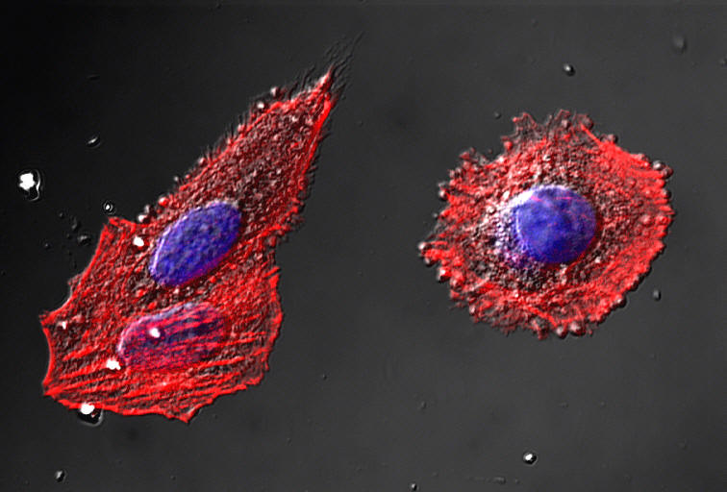
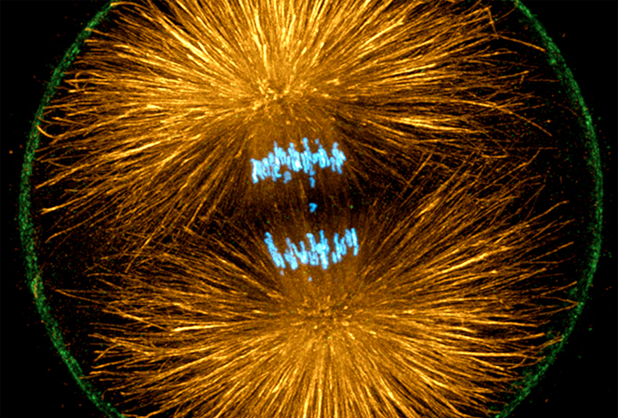
Konfokalni mikroskop
omogućuje rekonstrukciju trodimenzionalnih struktura
kolokalizacija pojedinih struktura
Notes:
Confocal microscopy is an optical imaging technique used to increase optical resolution and contrast of a micrograph by using point illumination and a spatial pinhole to eliminate out-of-focus light in specimens that are thicker than the focal plane.^{[1]} It enables the reconstruction of three-dimensional structures from the obtained images. This technique has gained popularity in the scientific and industrial communities and typical applications are in life sciences, semiconductor inspection and materials science.

Slide 20
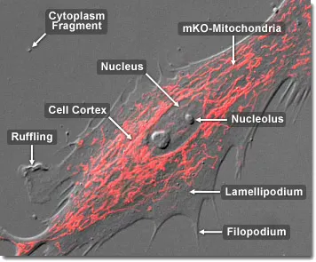
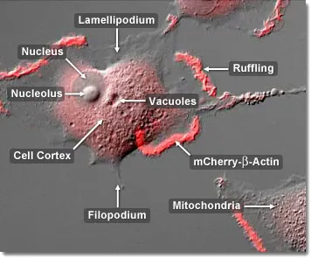
mogućnost praćenja promjene lokalizacije
mitohondriji u fibroblastu
mobilnost aktina u epitelnoj stanici
https://www.youtube.com/watch?v=AsJVk83eRmQ - film
https://evidentscientific.com/en/microscope-resource/video-gallery/confocal
Notes:
Actin Mobility in Epithelial Cells
Actin Mobility in Epithelial Cells
Actin Mobility in Epithelial Cells
Found in virtually all eukaryotic cells, actin is a highly conserved globular protein that differs in amino acid sequence by less than 20 percent in species ranging from algae to humans. Actin is one of three major components of the cytoskeleton (along with tubulin and intermediate filaments) and is involved in a variety of important cellular functions, including muscle contraction, cell motility, division, organelle tranlation, signaling, and the establishment of "communication" junctions between cells. The confocal digital video presented above captures several rabbit kidney epithelial cells (RK-13 line) as they progress across the glass coverslip, extruding and contracting the leading edges of their lamellipodia, a process that mimics ocean waves crashing onto the beach. The actin in this specimen is labeled with mCherry fluorescent protein.

Slide 21
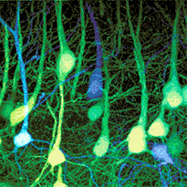
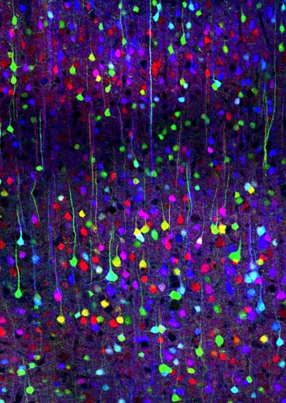
Mišji neuroni
“Brainbow”: stanice mozga različito obojane zbog raznih omjera ekspresije triju varijanti fluorescentnih proteina – in vivo praćenje pojedinih stanica – 90 varijanti
mogućnost praćenja veza između živčanih stanica
poremećaja u neurodegenerativnim bolestima
Notes:
Brainbow Never before has a brain been so beautiful. Jeff Lichtman and Joshua Sanes, researchers at the Harvard Brain Center, have created transgenic mice with fluorescent multicolored neurons. The photographs of the mouse brains that appear in the November 1, 2007 issue of Nature could be housed in the Museum of Modern Art or could be used to decorate Joseph's technicolored dream coat. But it is not their colorful splendor that makes these genetically modified mice so amazing. It is their potential to revolutionize neurobiology that excites scientists like myself and has our neurons firing away, creating oodles of endorphins.
The mice created by a genetic strategy termed "brainbow" will have a similar effect on neuroscience as Google Earth had on cartography. Using a brainbow of colors, researchers will now be able to map the neural circuits of the brain. The individually colored neurons will help define the complex tangle of neurons that comprise the brain and nervous system. By creating a wiring diagram of the brain, researchers hope to help identify the defective wiring found in neurodegenerative diseases such as Altzheimer's and Parkinson's disease.
In the Brainbow mice, the Harvard researchers have introduced genetic machinery that randomly mixes green, cyan and yellow fluorescent proteins in individual neurons thereby creating a palette of ninety distinctive hues and colors. "The technique drives the cell to switch on fluorescent protein genes in neurons more or less at random," says Jean Livet, the postdoctoral researcher responsible for most of the laboratory work that resulted in the Brainbow mice. "You can think of Brainbow almost like a slot machine in its generation of random outcomes."
I can't wait for a three dimensional multicolored atlas of the brain or a Google Brain site that is as beautiful as it is useful.
This is a photograph of the cerebral cortex. It's hard to believe, but in non-living preserved brains, the outerlayers of this portion of the brain are gray, which is why the brain is sometimes called "gray matter". (Confocal image by Tamily Weissman. Mouse by Jean Livet and Ryan Draft.)
Brainbow is a process by which individual neurons in the brain can be distinguished from neighboring neurons using fluorescent proteins. By randomly expressing different ratios of red, green, and blue derivatives of green fluorescent protein in individual neurons, it is possible to flag each neuron with a distinctive color. This process has been a major contribution to the field of neural connectomics.
The technique was originally developed in 2007 by a team led by Jeff W. Lichtman and Joshua R. Sanes, both at Harvard University.^{[1]} The original technique has been adapted for use with other model research organisms including the fruit fly (Drosophila melanogaster), zebrafish (Danio rerio^{[2]}), and Arabidopsis thaliana.^{[3]}
While earlier labeling techniques allowed for the mapping of only a few neurons, this new method allows more than 100 differently mapped neurons to be simultaneously and differentially illuminated in this manner. This leads to its characteristic multicolored appearance on imaging, earning its name and winning awards in science photography competitions.^{[citation needed]}
Cre-LoxP sustav

Slide 22
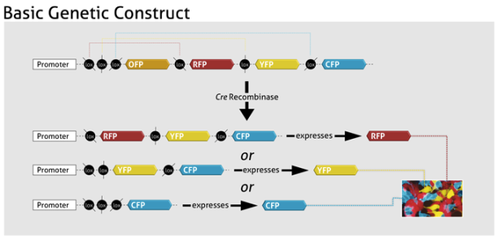
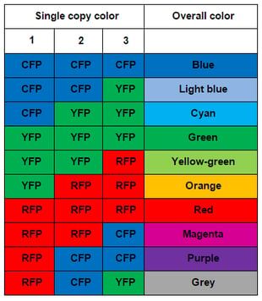
„slučajne” varijante rekombinacije

Slide 23
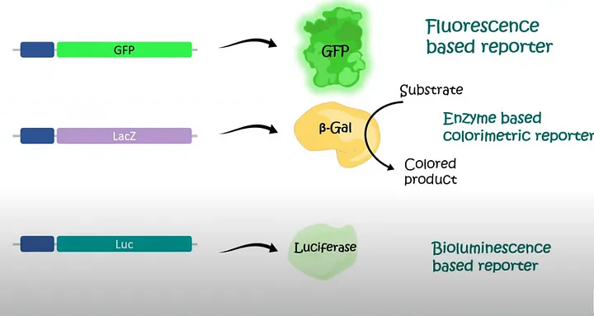
● regulacija aktivacije promotora ciljnog gena (različite metode detekcije)
-plazmidi s “genom reporterom” koji daje produkt ovisno o aktivaciji
ispitivanog promotora: kvantizacija ekspresije
promotor gena u plazmidu
kvantizacija
spektrofotometrom
luminometrom
mjerenjem
fluorescencije
https://medium.com/insights-of-nature/transcriptional-and-translational-reporter-genes-7538d0f23bfd
Notes:
luciferaza + luciferin + ATP – svjetlost
kromatografija: CAT gen koramfenikol acetiltransferaza

Slide 24
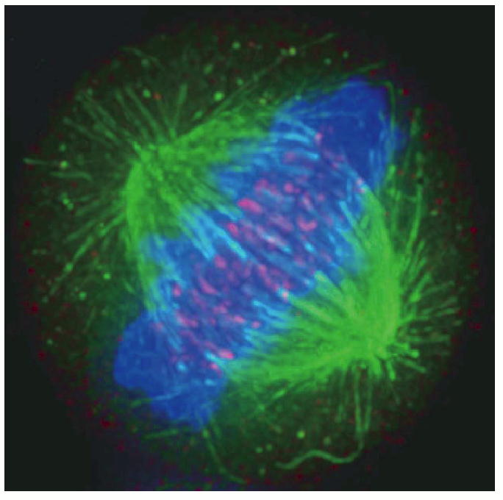
imunobojanje:
fiksacija stanica
antitijela obilježena fluorescentnom bojom
fluorescencijska mikroskopija
Stanica u mitozi “obojena” antitijelima s fluorescentnim biljegom:
kromosomi plavi (interkalirajuće boje za DNA)
tubulin: zeleno
centromere: crveno
“in vitro” – fiksirane stanice
Notes:
fluorescein zeleno
rodamin crveno

Slide 25
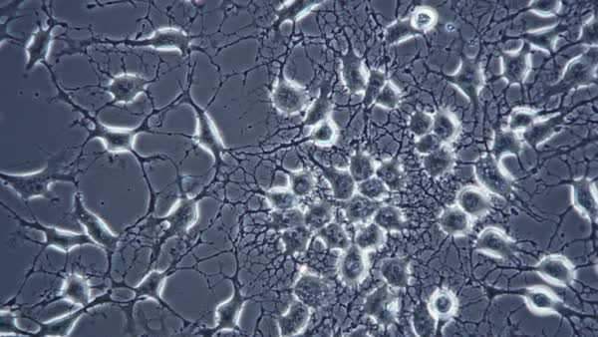
-praćenje stanica tijekom vremena „time-lapse”
https://www.leica-microsystems.com/science-lab/life-science/how-to-perform-dynamic-multicolor-time-lapse-imaging/ - mitotracker
https://www.youtube.com/watch?app=desktop&v=Cah674gKmCk
https://www.youtube.com/watch?v=o57arcKLgU4
sva tri
Notes:
Time-lapse microscopy is used for the study of live specimens, such as cell cultures, acute tissue samples, and model organisms as they grow and develop over time, to gain more insights about biological processes

Slide 26
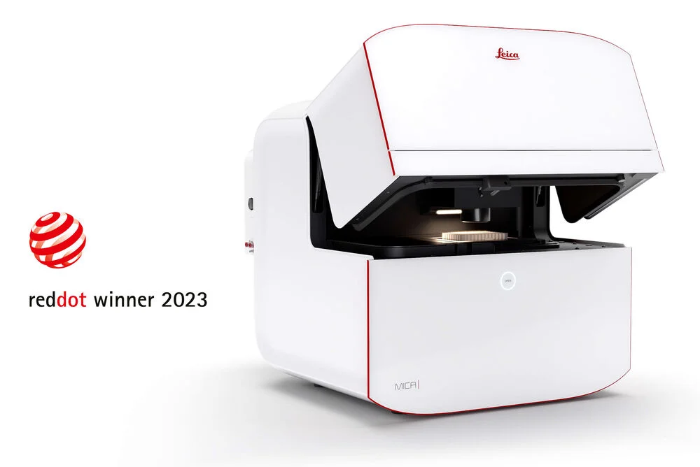
Posebni mikroskopi i kompjutorski programi (automatska analiza slike, poništavanje pozadine, povećanje kontrasta,) snimaju stanice u uvjetima inkubatora kroz duže vrijeme (stavi se u inkubator ili je samostalan)
mogućnost praćenja migracije i pokretanja, proliferacije, rasta sferoida, nastanak međustaničnih veza, diferencijacije, apoptoze, mitoze, starenja,
sekrecije, fagocitoze
intracelularne dinamike, kod analize pokretljivosti spermija
https://www.youtube.com/watch?v=BD11n55pnE0
kompilacija od 26 min. – bar početak
https://www.intechopen.com/chapters/64047

Slide 27
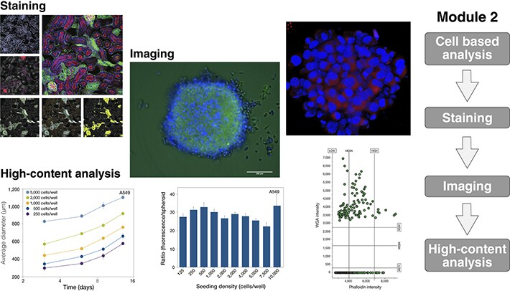
„High-content analysis” (HCA) analiza trodimenzionalnih sustava poput sferoida ili organoida
priprema uzoraka, fiksacija, „oslikavanje” fluorescentnim antitijelima ili vizualizacija, analiza slike i podataka
https://www.thermofisher.com/hr/en/home/life-science/cell-analysis/cell-analysis-learning-center/cell-analysis-resource-library/cell-analysis-guided-learning/cancer-spheroid-organoid-elearning-course.html
-AI
Notes:
https://www.thermofisher.com/hr/en/home/life-science/cell-analysis/cell-analysis-learning-center/cell-analysis-resource-library/cell-analysis-educational-videos-webinars.html

Slide 28


Posebne vrste fluorescencijske mikroskopije
A
B
A
FRAP: Fluorescence recovery after photobleaching
optička tehnika za kvantizaciju dvodimenzionalne lateralne difuzije
-laserska zraka “izbijeli” fluorescenciju, npr. GFP i prati se vrijeme ponovnog pojavljivanja fluorescencije zbog difuzije drugih neoštećenih molekula
B
subcelularno izrezivanje organela laserskom zrakom
Notes:
Fluorescence recovery after photobleaching (FRAP) denotes an optical technique capable of quantifying the two dimensional lateral diffusion of a molecularly thin film containing fluorescently labeled probes, or to examine single cells. This technique is very useful in biological studies of cell membrane diffusion and protein binding. In addition, surface deposition of a fluorescing phospholipid bilayer (or monolayer) allows the characterization of hydrophilic (or hydrophobic) surfaces in terms of surface structure and free energy.
This technique is commonly used in conjunction with green fluorescent protein (GFP) fusion proteins, where the studied protein is fused to a GFP. When excited by a specific wavelength of light, the protein will fluoresce. When the protein that is being studied is produced with the GFP, then the fluorescence can be tracked. Photodestroying the GFP, and then watching the repopulation into the bleached area can reveal information about protein interaction partners, organelle continuity and protein trafficking.
If after some time the fluorescence doesn't reach the initial level anymore, then some part of the fluorescence is caused by an immobile fraction (that cannot be replenished by diffusion). Similarly, if the fluorescent proteins bind to static cell receptors, the rate of recovery will be retarded by a factor related to the association and disassociation coefficients of binding. This observation has most recently been exploited to investigate protein binding

Slide 29
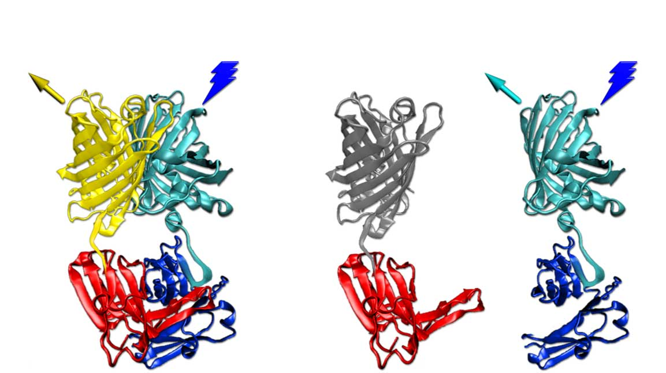
FRET
Forster resonance energy transfer
kolokalizacija proteina u fluorescentnom mikroskopu – proteini su nekoliko stotina puta manji od mogućnosti rezolucije fluorescentnog mikroskopa
fluorofori apsorbiraju svjetlost na jednoj valnog duljini (ekscitacija) i emitiraju je na drugoj, duljoj.
FRET se javlja samo ako su fluorofori udaljeni 8-10 nm ili manje
440 nm
ekscitacija
440 nm
ekscitacija
527 nm
emisija
475 nm
emisija
FRET
eYFP
eCFP

Slide 30
Stanična fuzija

Slide 31
Fuzija (hibridizacija) stanica:
"spajanje" dviju ili više stanica u jednu
prirodni proces tijekom diferencijacije i razvoja
metoda u kulturi animalnih stanica

Slide 32
Primjeri fuzije u procesu razvoja
sparivanje kvasaca
razvoj Caenorabditis elegans
fuzija mišićnih stanica
fuzija stanica leće
oplodnja jajne stanice
fuzija stanica trofoblasta

Slide 33
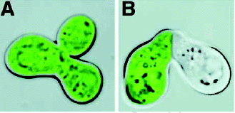
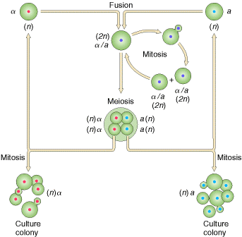
Normalni (A) i mutirani (B)
kvasac poremećene fuzije
Sparivanje kvasaca (a i α haplotip)

Slide 34
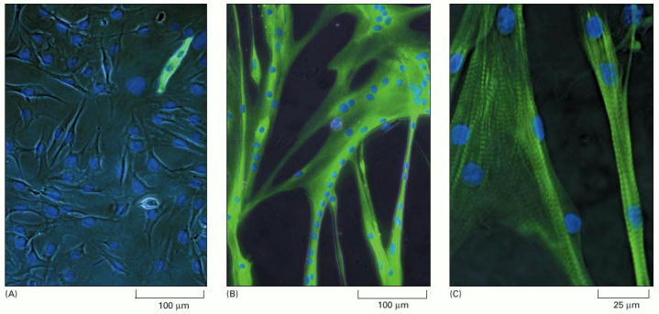
Fuzija mišićnih stanica

Slide 35
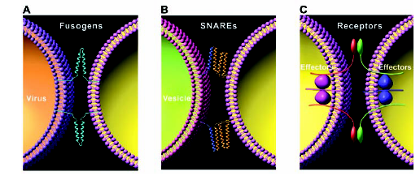
virusi
vezikule
stanice: receptori
Membranske molekule u fuziji membrana

Slide 36
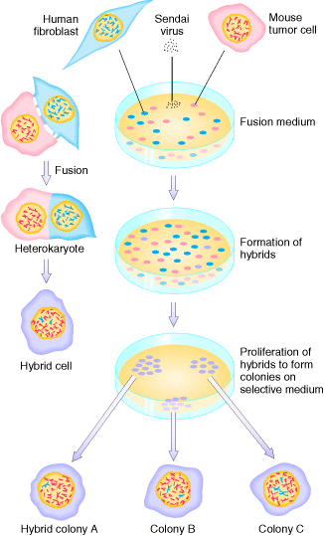
fuzija
heterokarion
hibridna jezgra
Eksperimentalna fuzija:
Sendai virus
polietilenglikol - PEG
lizolecitin
selektivni
medij
Notes:
1%

Slide 37
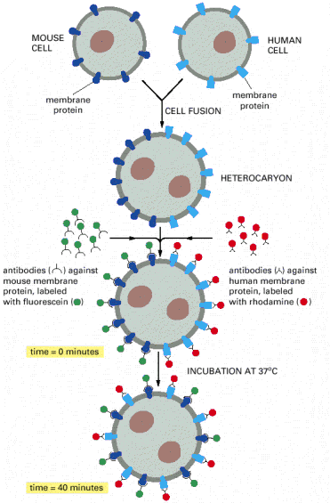
Primjer miješanja receptora
na površini hibridne stanice

Slide 38
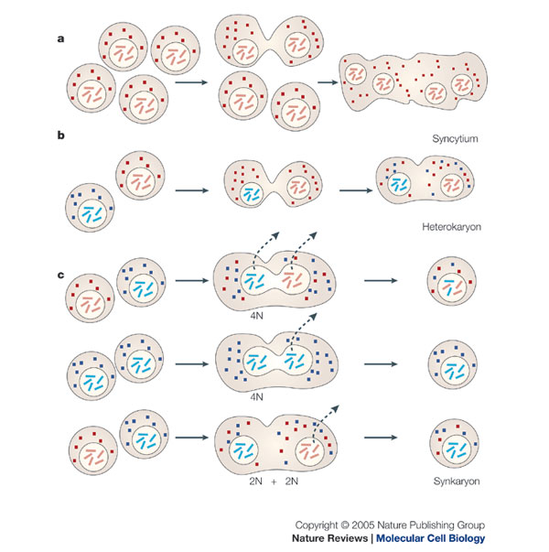
sincicij
(fuzija više stanica)
heterokarion
-homokarion
(dvije jezgre, istog ili
različitih tipova stanica)
sinkarion
(fuzionirane jezgre)
gubitak kromosoma
(humanih kod fuzije
mišjih i humanih stanica)
Notes:
stanice s jednim humanim kromosomom - genetika

Slide 39
Fuzija stanica u kulturi
može poslužiti za istraživanja tema:
tumorigeničnost stanica
starenje
procesi mitoze (kondenzacija kromosoma)
uloga pojedinih kromosoma i položaj gena
proizvodnja monoklonskih antitijela

Slide 40
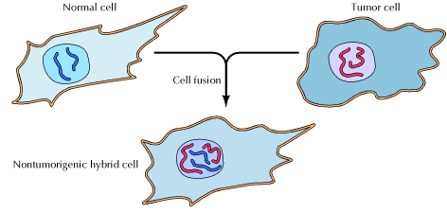
Istraživanje tumorskih supresorskih gena:
fuzija tumorske i normalne stanice može dati mortalnu hibridnu stanicu (ovisno o soju tumorske stanice)

Slide 41
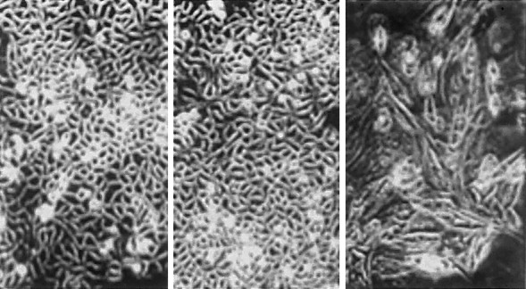
HeLa
HeLa + 11
kromosom
(imortalne)
HeLa + 4
kromosom
(mortalne)
Unošenje pojedinih kromosoma u stanice može uzrokovati
starenje
Notes:
pojedini kromosomi mogu uzrokovati starenje

Slide 42
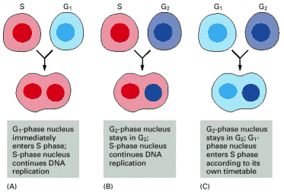
Fuzija stanica s
S + G1 jezgrama:
G1 jezgra ulazi u
sintezu
Fuzija stanica s
G2 i S jezgrama
G2 jezgra ne ulazi u sintezu
Fuzija stanica s
G2 + G1 jezgrama
G2 ostaje u G2
G1 ulazi u S kad
joj dođe vrijeme
Eksperimenti pokazuju ovisnost S faze o M fazi:
citoplazmatski G1 faktori i jezgreni G2 faktori
-mehanizam koji onemogućava ponovnu duplikaciju već novosintetizirane DNA u jezgri
-citoplazmatski procesi u G1 koji omogućuju prijelaz R točke

Slide 43
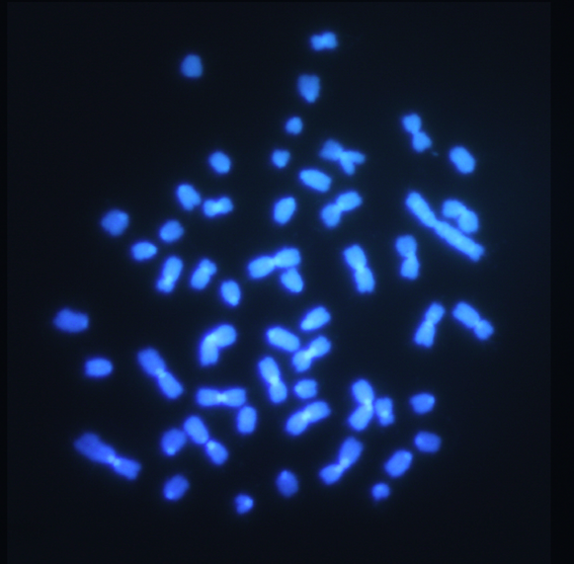
-istraživanje gena
“starenja”
A9+1 stanice: mišji fibroblasti + humani kromosom 1:
metoda "microcell fusion": fuzija stanica s mikrostanicama s jednim kromosomom + selekcija na kromosomski marker
fuzija mišjih i humanih stanica: gube se humani kromosomi
Notes:
„Mikrostanice” se dobiju inhibicijom aktinskog citoskeleta tako da se posebnom metodom dobiju pojedini kromosomi koji su obavijeni staničnom membranom (moguće ih je izolirati protočnom citometrijom) i zatim se fuzioniraju sa stanicom
Pojedini kromosomi, nakon fuzije s pojedinim tumorskim staničnim linijama izazivaju starenje-

Slide 44
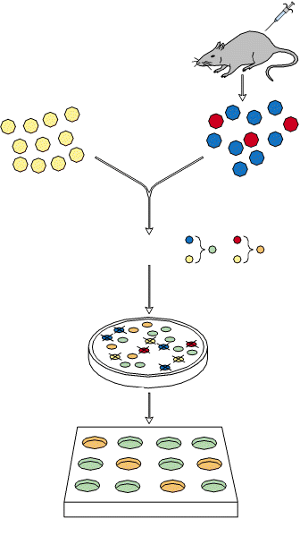
stanice mijeloma:
imortalne
Sinteza monoklonskih protutijela
(iz B limfocita)
B limfociti iz slezene miša:
miš imuniziran na protein X
-konačne, ali specifične
FUZIJA
SELEKCIJA
selekcija: proizvodnja antitijela
selektivni medij
svaka se kolonija ispita na prisustvo
protutijela
metode detekcije proteina
monoklonskim antitijelima
-liječenje tumora
-industrijska proizvodnja
Nastanak hibridoma – hibridnih stanica koje proizvode antitijela
Notes:
Hibridomi su stanice dobivene fuzijom stanica mijeloma miša, koje su tumorske hematopoetske stanice, imortalne, i B limfocita iz miša kojem je uštrcan neki antigen na koji se trebaju proizvesti antitijela. Fuzionirane stanice bi trebale proizvoditi ciljna antitijela kao B limfociti i biti imortalne kao stanice mijeloma.

Slide 45
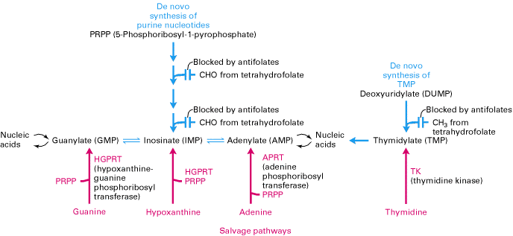
- proizvodnja monoklonskih antitijela
sinteza nukleotida de novo
ametopterin ┤
(metotreksat)
putevi spašavanja
Princip djelovanja medija HAT(selektivni medij)
(hipoksantin-ametopterin (antifolat)-timidin):
TK- i HGPRT- stanice ne mogu preživjeti
Notes:
Stanice imaju put de novo za proizvodnju nukleotida ili ih mogu koristiti iz medija putevima spašavanja. Ako se stanicama blokira de novo sinteza s metotreksatom, ovise o putu spašavanja. Mogu se uzgojiti mutanti TK- i HGPRT- koji ne mogu preživjeti u mediju s metotreksatom, međutim, njihovi hibridi tj. fuzionirana stanica od TK- + HGPRT- stanice, može. Zato je HAT medij selektivni medij za hibridne stanice.
Hipoksantin i timidin u HAT su izvori nukleotida.

Slide 46
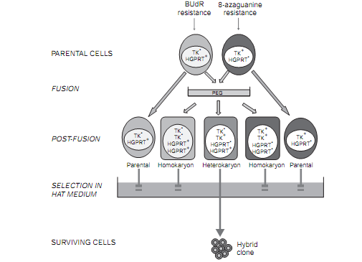
selekcija TK- i HGPRT-
klonova
Selekcija stanica hibrida
Notes:
Freshney
Klonovi rezistentni na BUdR su oni koji su TK.-, a oni koji su rezistentni na 8 aza guanin su oni koji su HGPRT-. Znači preživjeli klonovi su rezistentni.

Slide 47
Rekombinantna antitijela
monoklonska, proizvedena in vitro pomoću „sintetiziranih gena”
geni za antitijela se kloniraju iz ishodišnih stanica, ugrade u vektor
moguća manipulacija regijama antitijela
sintetska antitijela koja nisu dobivena od imunoglobulina
stanice proizvode antitijela
za molekularno-biološke metode
za liječenje i dijagnostiku
Notes:
Aptamers are oligomers of artificial ssDNA, RNA, XNA, or peptide that bind a specific target molecule, or family of target molecules. They exhibit a range of affinities (K_{D} in the pM to μM range),^{[1][2]} with variable levels of off-target binding^{[3]} and are sometimes classified as chemical antibodies. Aptamers and antibodies can be used in many of the same applications, but the nucleic acid-based structure of aptamers, which are mostly oligonucleotides, is very different from the amino acid-based structure of antibodies, which are proteins. This difference can make aptamers a better choice than antibodies for some purposes (see antibody replacement).

Slide 48
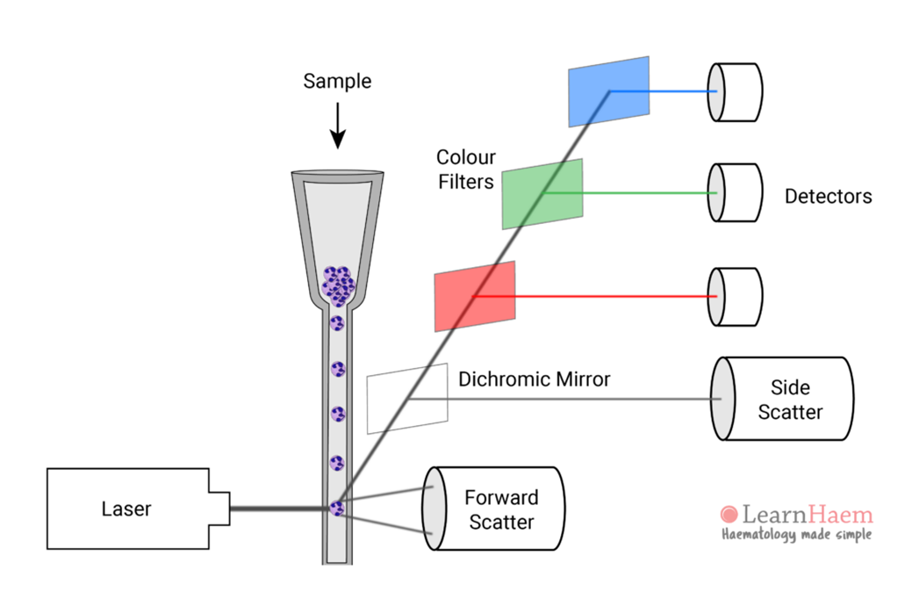
Protočna citometrija
osnovni dijelovi sustava

Slide 49
Protočna citometrija
analiza stanične morfologije
analiza stanične vijabilnosti i apoptoze
ekspresija proteina – detekcija fluorescentnim antitijelima
analiza staničnog ciklusa
mogućnost sakupljanja staničnih frakcija
https://www.thermofisher.com/hr/en/home/life-science/cell-analysis/flow-cytometry/flow-cytometry-learning-center/flow-cytometry-resource-library/flow-cytometry-educational-videos-webinars.html

Slide 50
Metode u istraživanju stanica u kulturi
transfekcija stanica
metode fluorescencijske mikroskopije
stanična fuzija

Slide 51
Stanična kultura:
istraživanje staničnih funkcija i struktura - mikroskopija
procesa: mehanizama diferencijacije/nastanka matičnih stanica
apoptoze, starenja
proliferacije, migracije, invazije, adhezije, metabolizma…
uloge pojedinih gena u tim procesima i u ekspresiji gena/proteina
djelovanje različitih tvari, metabolita, lijekova, uvjeta uzgoja
molekularna razina procesa –
DNA, RNA, proteini, molekularne interakcije
primjena u biotehnologiji, dijagnostici, medicini itd.

