Slide 1
Diferencijacija

Slide 2
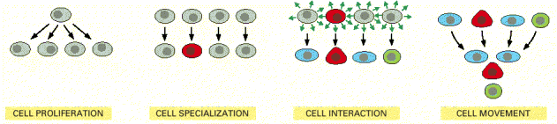
Osnovni procesi kojima nastaje višestanični organizam: stanična proliferacija, specijalizacija, interakcije stanica i njihovo kretanje

Slide 3
totipotentna jajna stanica
višestanični organizam:
specijalizirane stanice čine tkiva i organe
proliferacija u ravnoteži s ugibanjem stanica
(“istrošenost”, ozljede, ugibanje)
embrionalni razvoj

Slide 4
Diferencijacija:
proces kojim pra-stanice prelaze u zrele stanice sa
specifičnom funkcijom.
"commitment" - "usmjerenost":
tendencija razvoja u određenom smjeru
terminalno diferencirana stanica:
ireverzibilno zaustavljen stanični ciklus
nikakvi utjecaji je ne mogu vratiti u ciklus
Notes:
u kulturi: adaptacija i dediferencijacija

Slide 5
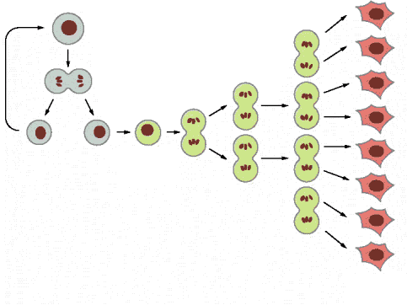
pra-stanica, matična ili stem stanica
kratkotrajno
amplificirajuće stanice
progenitorske stanice
terminalno
diferencirane
diferencijacija
sazrijevanje bez diobe
proliferacija
funkcionalne stanice s ograničenim
vremenom života
Notes:
recipročne mogućnosti

Slide 6
-dio diferenciranih stanica se ne može dijeliti:
srčane mišićne stanice, živčane stanice (terminalno diferencirane)
-”mirujuće” stanice u G₀ i dijele se po potrebi:
kožni fibroblasti
glatki mišići
endotelne stanice krvih žila
epitelne stanice unutarnjih organa (jetra, gušterača, pluća, prostata, dojka)
-matične stanice (nediferencirane “ishodišne” stanice):
krvne stanice
epitel kože i probavnog sustava
germinativne stanice

Slide 7
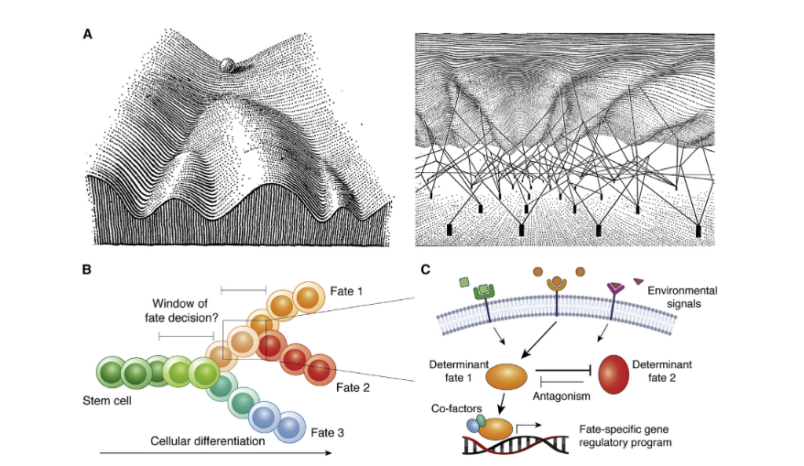
„Waddingtonov krajobraz” i putevi diferencijacije
Hahverdi i Ludwig 2023
Notes:
igure 1. Waddington’s landscape and cell fates during cellular differentiation
(A) Waddington’s landscape with the marble representing a cell to take on a set of alternative developmental paths, with the three basins
at the base of the hill, representing the alternative differentiated cell fates (left). The shape of the landscape is thereby determined by
interacting gene products that pave the path toward the cell attaining a particular differentiated cell fate (right). Figure from Waddington
(1957).
(B) Schematic depiction of stem cells undergoing cellular differentiation to obtain one of three cell fates, upon which multiple cell fate
decisions may have to be made. The window in which the fate decision is being made and during which the process may be altered or
antagonized may thereby currently not be well defined.
(C) Cell fate determination involves the integration of environmental signals and the current cellular state, upon which fate determinants
may act or also antagonize each other, before executing a particular fate-specific gene regulatory program

Slide 8
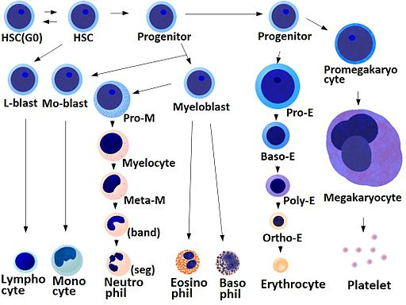
Diferencijacija krvnih stanica

Slide 9
Signalna mreža koja upravlja diferencijacijom
„Gene Regulatory Network GRN”
upravlja staničnim razvojem od nespecijaliziranog stanja prema specifičnom, zrelom tipu stanice.
Diferencijacijom upravljaju složeni molekularni regulacijski krugovi koji usmjeravaju stanicu prema njenoj sudbini
Osnovni čimbenici:
transkripcijski faktori, često krovni/master regulacijski proteini
epigenetski modifikatori: mijenjuju dostupnost kromatina transkripcijskim faktorima
signalne molekule i putevi koji okidaju kaskadu događaja, faktori utjecaja iz mikrookoliša

Slide 10
Principi djelovanja signalne mreže
hijerarhijska kontrola koja može i ne mora postojati (često antagonistički faktori)
mehanizmi povratne sprege, pozitivni „učvršćuju stanični identitet” - otpornost
vremenska dinamika; kaskada događaja koji međusobno djeluju i mijenjaju „unutarstanični krajolik”
modularnost

Slide 11
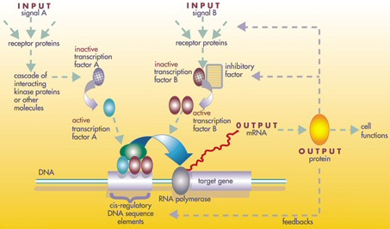
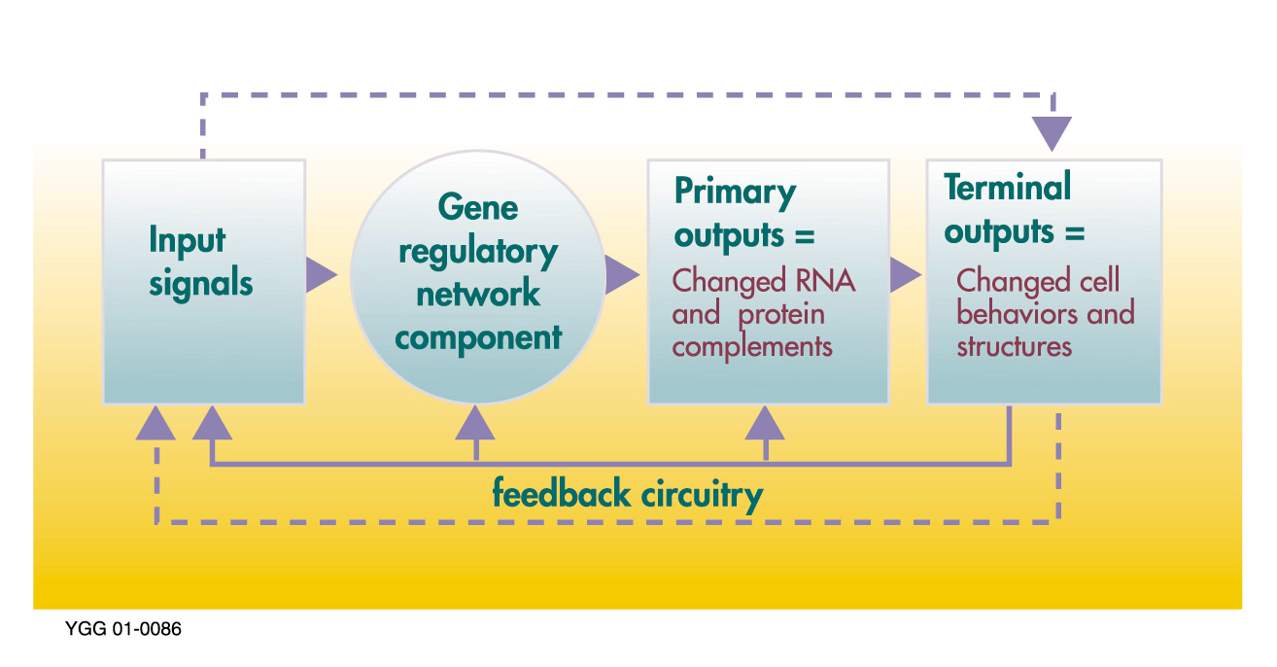
Genska regulacijska mreža

Slide 12
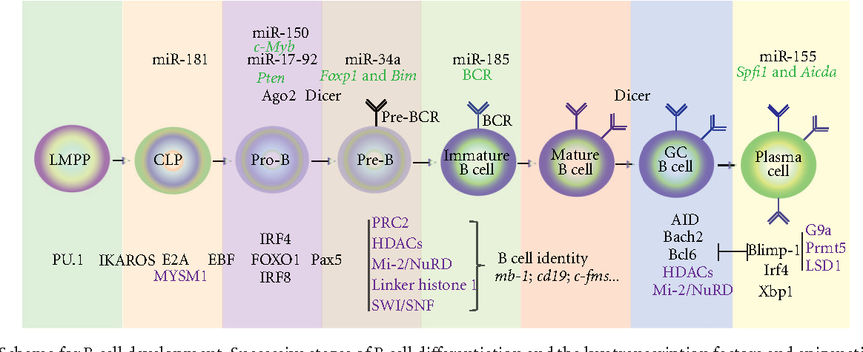
Diferencijacija B limfocita

Slide 13
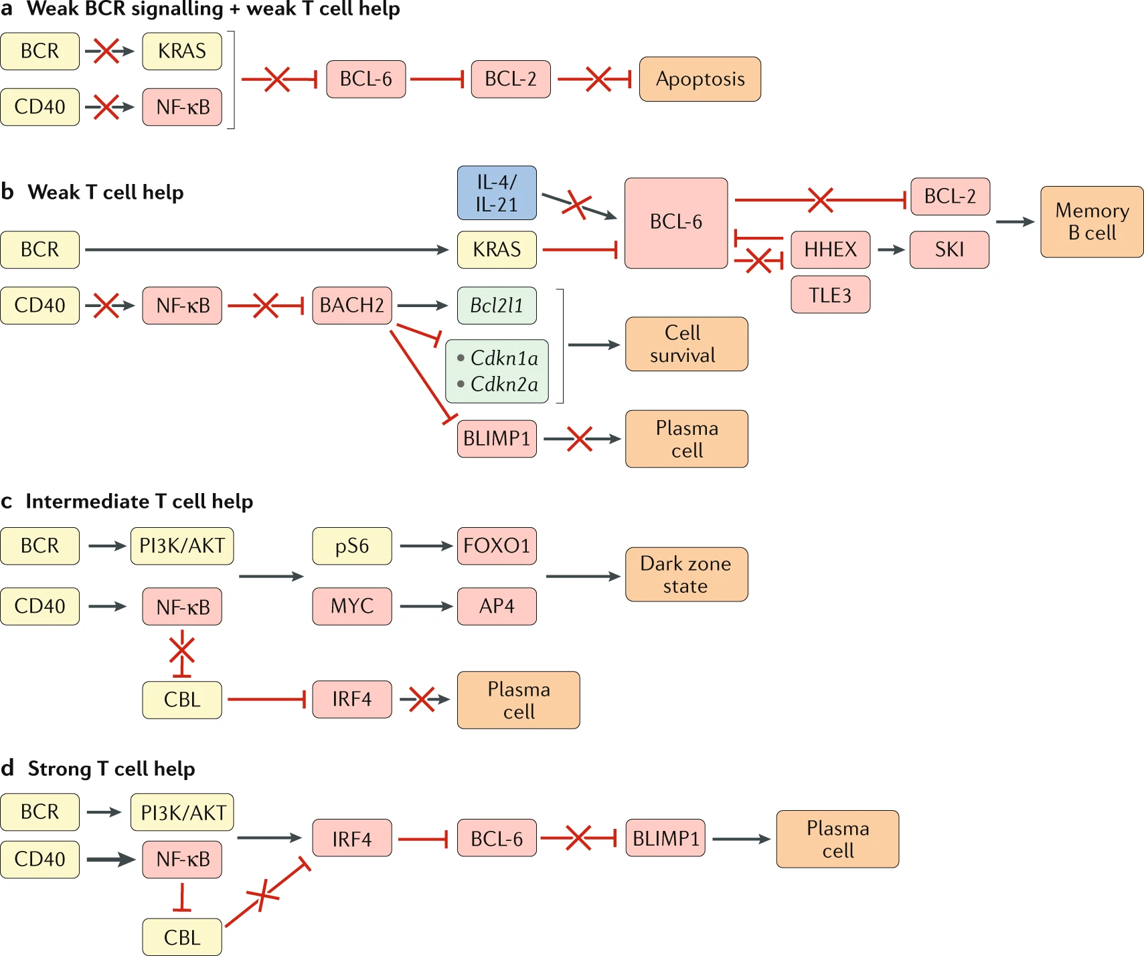
signalna mreža nastanka memorijskih B limfocita

Slide 14
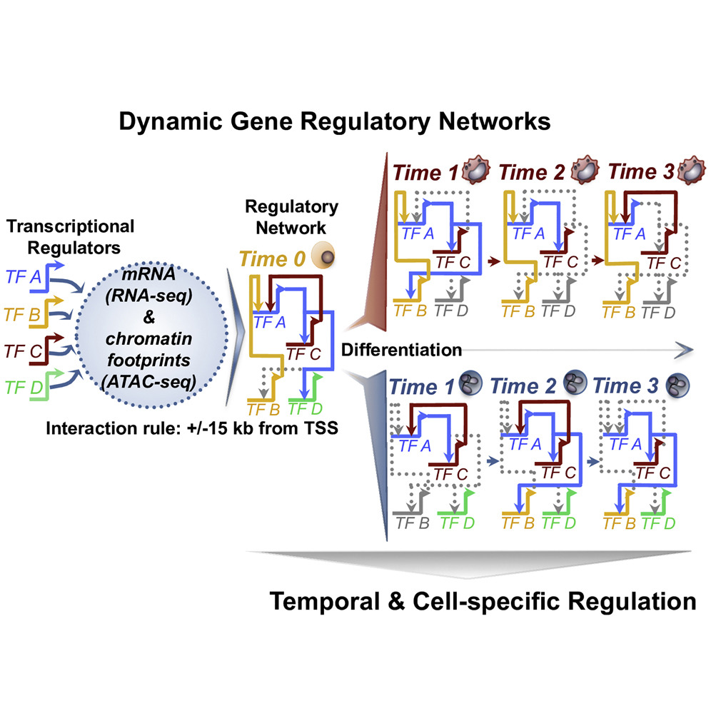
kompjutorsko modeliranje pomoću podataka sekvenciranja RNA pojedinačnih stanica

Slide 15
u kulturi je moguća:
diferencijacija progenitorskih stanica
matičnih stanica: embrionalnih – u različite tipove stanica
somatskih – jednu ili nekoliko vrsta stanica
embrionalne stanice ≠ embrionalne matične stanice
induciranih matičnih stanica („reprogramiranih” stanica)
nekih tumorskih staničnih linija (mali broj)

Slide 16
interakcije između stanica:
homologne , heterologne,
topivi parakrini faktori
pritisak kisika
oblik i polarnost stanica:
sekrecija, receptori
membranski transport
položaj jezgre
interakcije s matriksom
topivi faktori:
hormoni, citokini, Ca
planarne molekule, vitamini
Utjecaj stanične okoline na diferencijaciju in vitro
diferencijacija: utjecaj okoline i intrinzičnih faktora (unutarstanični milje – set eksprimiranih gena/ proteina koji odgovara na podražaj i oblikuje kromatin)

Slide 17
Diferencijacija u kulturi stanica:
diferencijacija tumorskih stanica: mogućnost liječenja i biologija procesa
diferencijacija iz progenitorskih/matičnih stanica: biologija razvoja
-mogućnost uzgoja „zamjenskog tkiva” i ispitivanje mehanizama bolesti i njihovog liječenja
Notes:
makrofagi: fagocitoza netopivi formazan

Slide 18
Prvi primjeri indukcije diferencijacije – stanično specifični procesi
induktor tip stanice
DMSO neuroblastom, mijelom
natrij butirat eritroleukemija, karcinom kolona
modifikatori prijenosa signala
forbol esteri epitel dojke, kolon
eritroleukemija (K562)
neuroblastoma
retinoična kiselina melanom, glioblastom
hidrokortizon
steroidni hormoni
citokini i faktori rasta: NGF, TGF beta
vitamin D, E
kalcij
neki citostatici
zaustavljanje ciklusa
utjecaj na strukturu kromatina
-ovisno o koncentraciji i tipu stanica
Notes:
planarni spojevi: membrana-signalni putevi
modifikacija kromatina

Slide 19
Primjeri diferencijacije
F9 mišji teratokarcinom
primitivni endoderm → parijetalni endoderm (retinoična kiselina)
K562 stanice eritroleukemije → zreli eritrociti (hemoglobin)
HL60 stanice: mijeloidna leukemija →
granulocitna linija uz dimetilsulfoksid, retinoičnu kiselinu...liječenje!
monociti/makrofagi uz forbol estere, vitamin D3, butirat
hranidbeni sloj fibroblasta – diferencijacija limfocita iz
hematopoetskih matičnih stanica (aktivacija signalnog puta Notch)
OTC: organotipska kultura: diferencijacija keratinocita

Slide 20
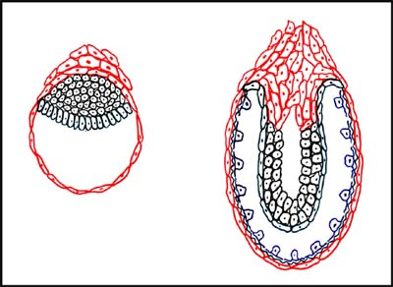
Diferencijacija stanica F9
F9 stanice: mišji teratokarcinom (karcinomi nastali od nediferenciranih “zaostalih” matičnih stanica)
unesene u blastocistu daju normalni embrio
EC – embrionalni karcinom
ES – embrionalne matične (stem) stanice
primitivni
endoderm
ES →primitivni endoderm (unutrašnji sloj stanica)
↓
parijetalni i visceralni endoderm

Slide 21
Strickland (1978):
diferencijacija F9 stanica u kulturi pomoću retinoične kiseline i cAMP:
-proces kroz više dana
promjena morfologije (nastanak granulirane citoplazme)
povećanje sekrecije tkivnog plazminogenskog aktivatora (tPA)
komponenti ekstracelularnog matriksa:
kolagena IV i laminina
svojstva F9 F9 + RK + dbcAMP parijetalni endoderm
PA - + +
laminin - + +
kolagen - + +
alkalna
fosfataza + - -
laktat
dehidrogenaza + - -
Notes:
visceralni endoderm: agregacija stanica

Slide 22
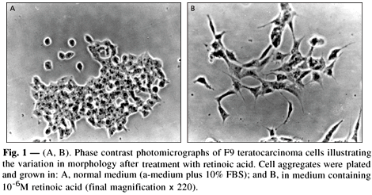
F9 stanice tretirane retinoičnom kiselinom mijenjaju izgled

Slide 23
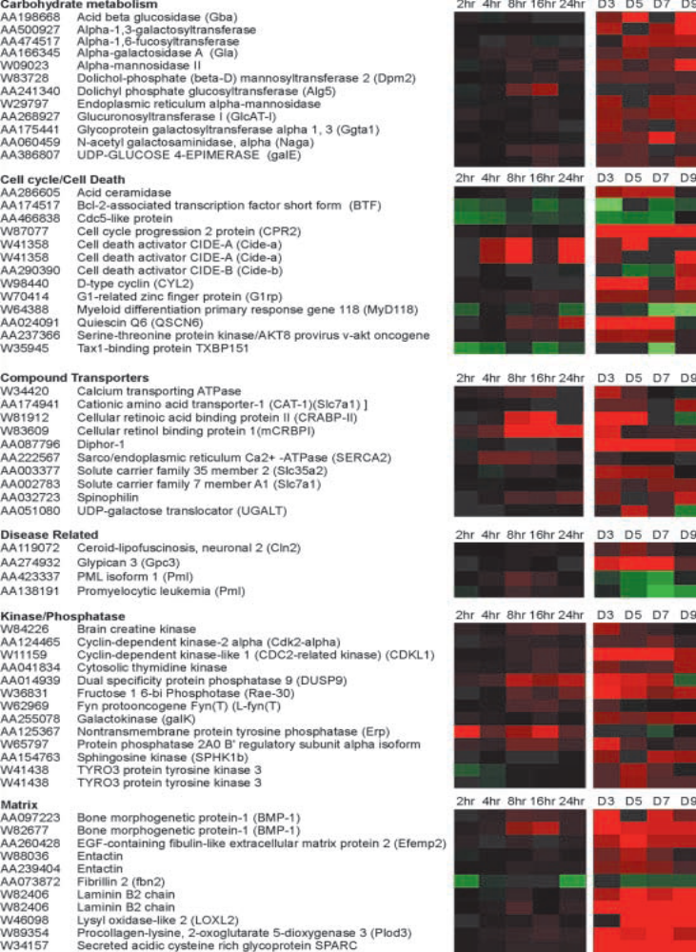
Skupine gena promijenjene
F9 diferencijacijom –
microarray analiza
-diferencijalna ekspresija gena
109 gena promijenjeno nakon 6 sati
516 gena promijenjeno nakon 9 dana
(Harris 2002)
“ekstremno složen set međusobno reagirajućih signala koji odlučuju između smrti, diferencijacije, povlačenja iz ciklusa i terminalne diferencijacije”

Slide 24
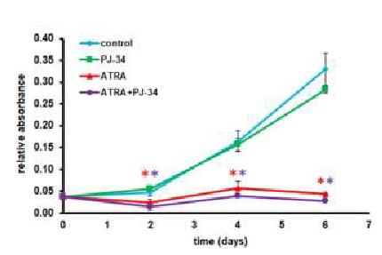
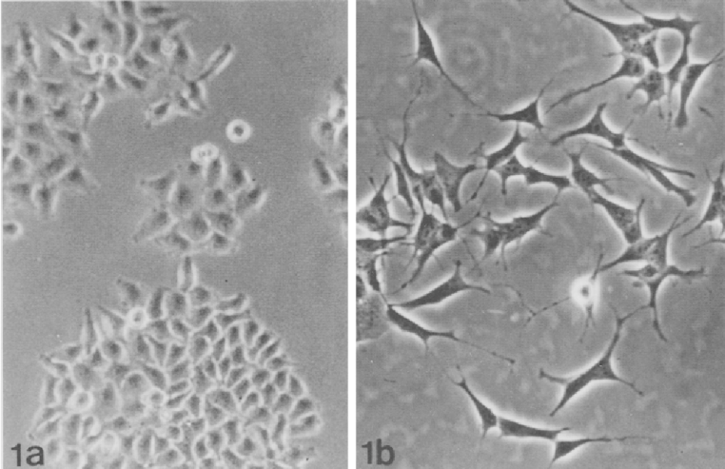
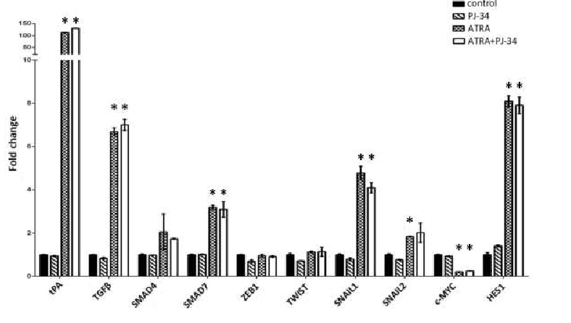
Diferencijacija stanica neuroblastoma retinoičnom kiselinom
promjena fenotipa, izrast neurita
promjena staničnog rasta
promjena ekspresije gena
https://www.youtube.com/watch?v=4CVIE6BM-E0 ++

Slide 25
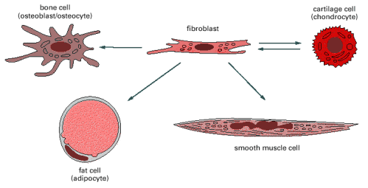
Diferencijacija fibroblasta
-diferencijacija fibroblasta u specijalizirane vrste vezivnog tkiva:
https://www.youtube.com/watch?v=-oxWnKDHuYo jove, komentar
u kulturi ovisno o uvjetima rasta,
podlozi, 3D strukturi, faktorima rasta
Notes:
u kulturi ovisi o prisutnosti određenih GF, elemenata ECM, 3D strukturi
plastičnost matičnih stanica odraslih

Slide 26
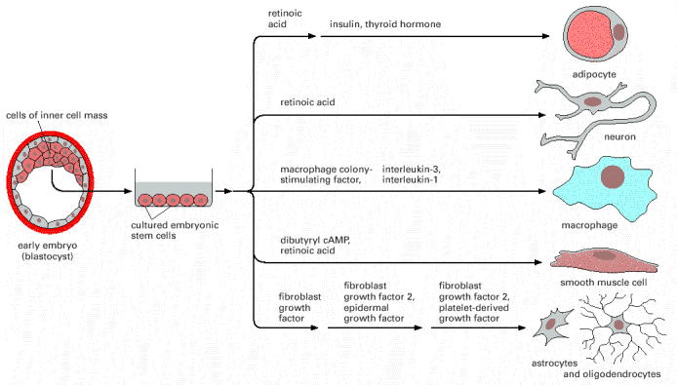
↓ različiti faktori rasta i induktori diferencijacije
embrionalne
matične
ES
u kulturi
pluripotentne
blastocista
- faktori rasta kao faktori diferencijacije
različiti stanični tipovi ↑
embrionalne matične stanice omogućuju diferencijaciju u različite tipove stanica, etičko pitanje kod humanih embrionalnih matičnih stanica

Slide 27
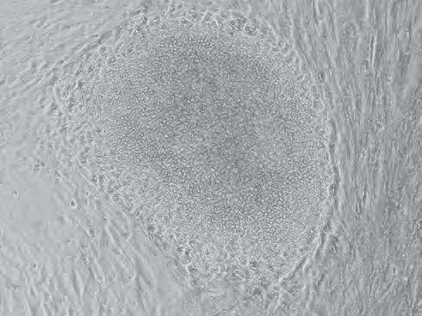
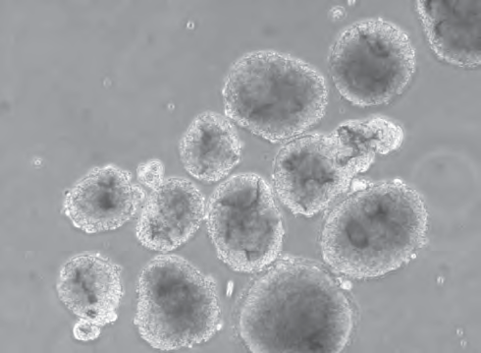
A
Kulture humanih embrionalnih matičnih stanica (hES)
A: kolonija hES na hranidbenom sloju:
nediferencirane stanice uz rub kolonije i više diferencirane, tamnije, u središtu
kolonija je okružena mišjim stanicama
hranidbenog sloja
B: Plivajuća embrioidna tjelešca, skupine od 300-500 stanica nastalih iz
jednoslojne kulture, u uvjetima u kojima se ne prihvaćaju za podlogu
B
Cooke & Minger, 2007 (iz Freshney, 6. iz)
Notes:
Fig. 23.2. Human Embryonic Stem Cells. (a) Colony of hES cells
on feeder layer. Undifferentiated cells around the edge of the colony
surround more differentiated cells with a brownish appearance in
the center. The colony is surrounded by growth-inactivated mouse
embryo feeder cells (see also Plate 25c). (b) Free-floating embryoid
bodies (EBs), typically 300 to 500 cells per cluster, generated
by detaching colonies from feeder layer and preventing further
reattachment (see also Plate 25d). (From Cooke & Minger, 2007).

Slide 28
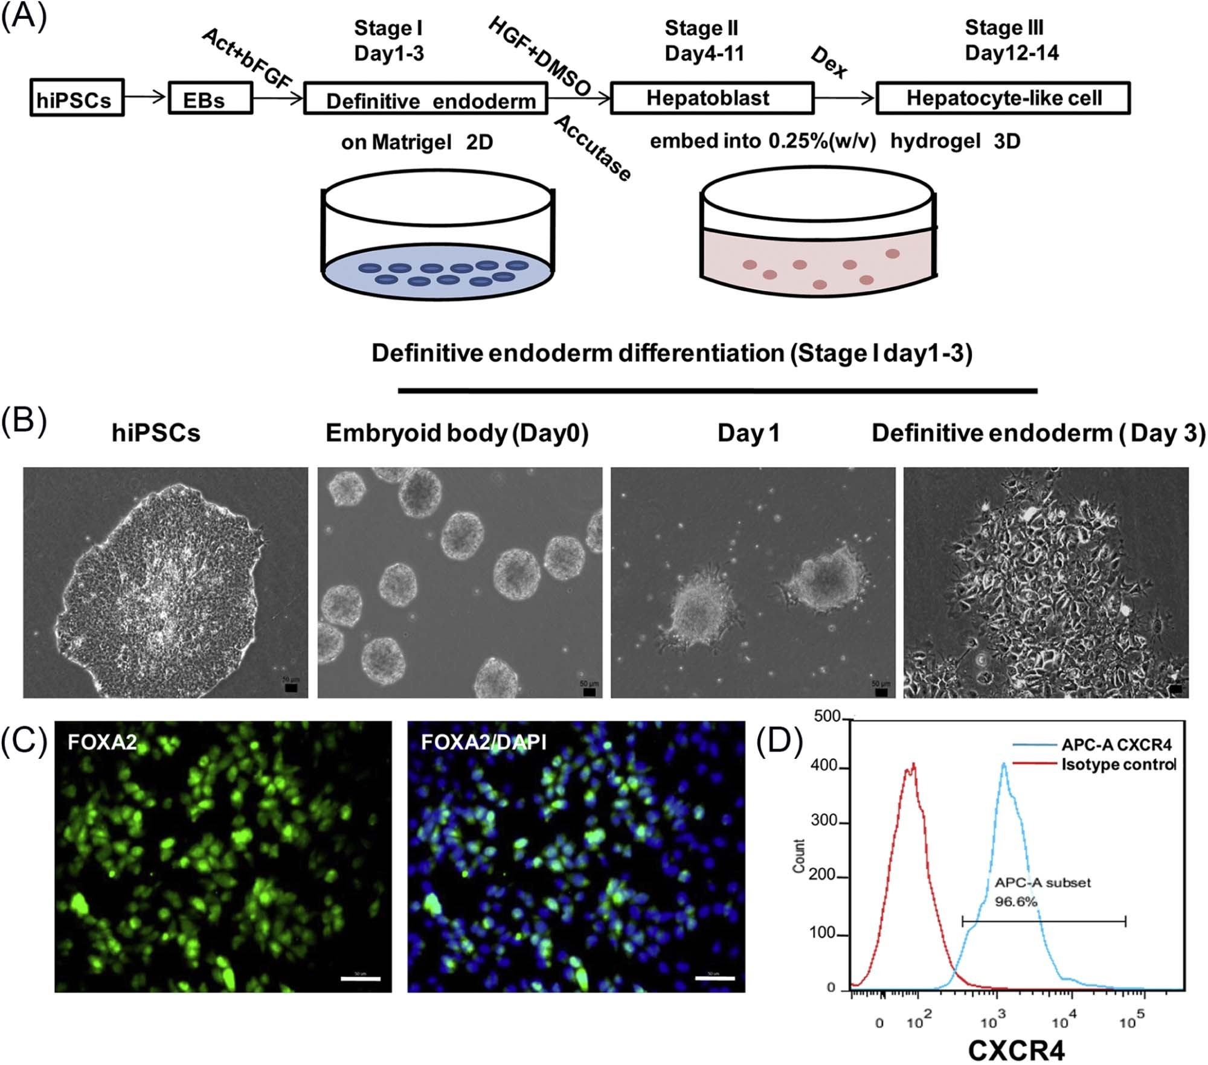
složeni uvjeti - FR
vrijeme
dokaz diferencijacije
Protokol diferencijacije endoderma
https://www.isct-cytotherapy.org/article/S1465-3249(17)30667-9/fulltext

Slide 29
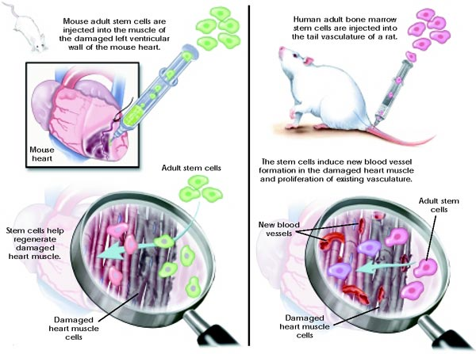
Moguća “upotreba” somatskih matičnih stanica u regeneraciji srčanog mišića i krvnih žila srca

Slide 30
kulture organa: složen uzgoj
-ponašanje i regulacija genske ekspresije kod integriranog tkiva,
model multicelularnog organizma
histotipska kultura:
uzgoj iste vrste stanica u velikoj gustoći, na posebnim podlogama i skelama (dermatoglifi, kapilarni tubuli, sferoidi)
organotipska kultura (OTK)
-reagregacija raznih tipova stanica, u 3D strukturu uz skelu nalik ekstracelularnom matriksu

Slide 31
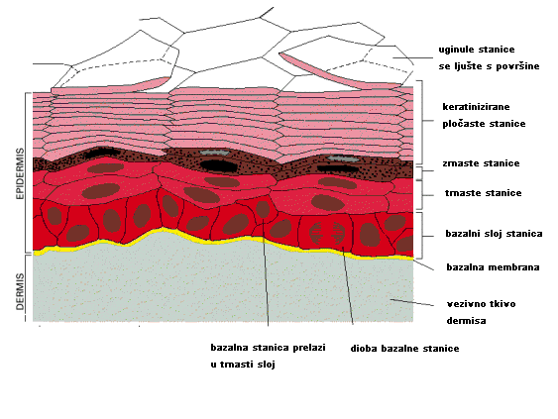
Diferencijacija stanica kože
diferencijacija keratinocita
sloj fibroblasta u kolagenom matriksu
keratinocitni faktor rasta i odgovarajući medij
“splav”
ako se nasade na hranidbeni sloj fibroblasta ostaje samo jedan sloj keratinocita

Slide 32
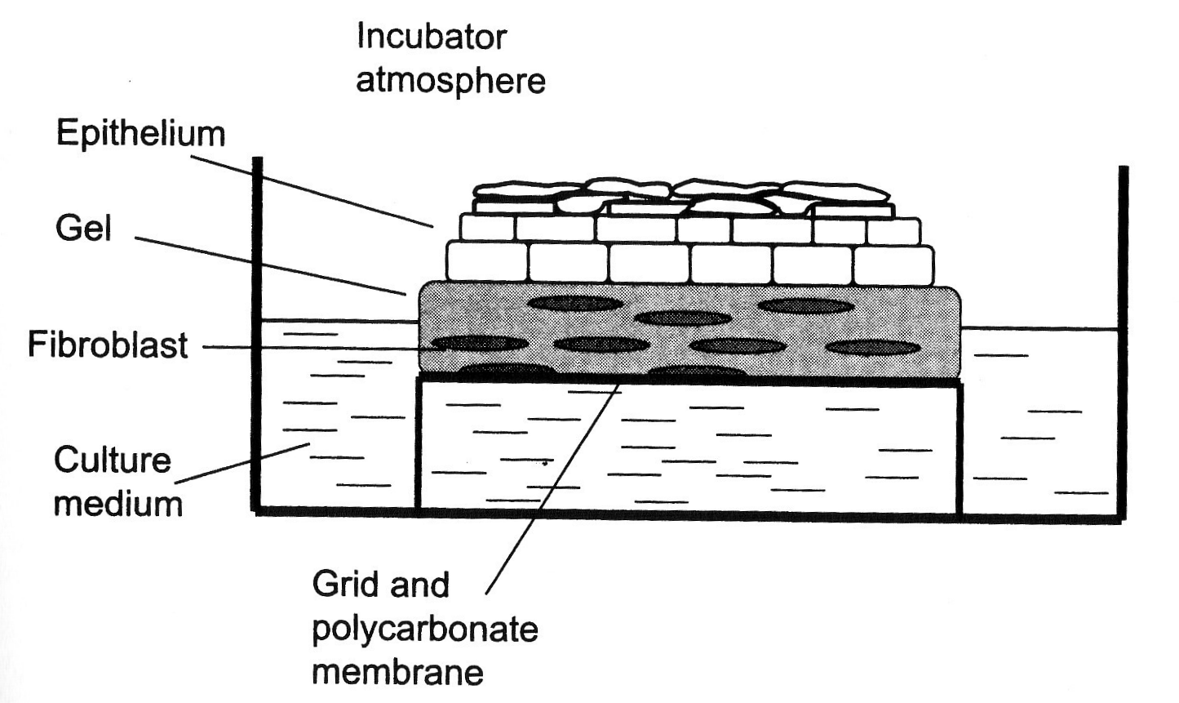
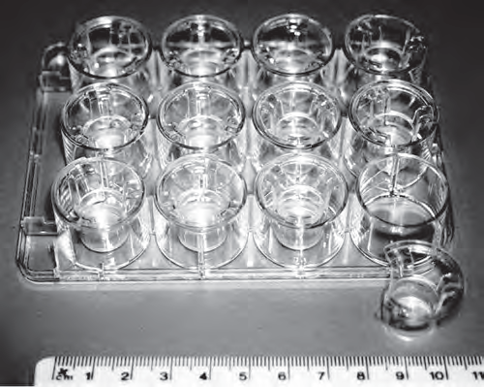
Uzgoj keratinocita na “splavi”
“Transwell” – umetci (Freshney, 6. iz)

Slide 33
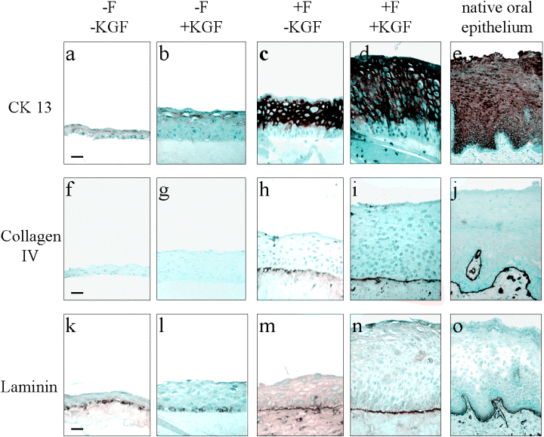
citokeratin
kolagen
laminin
Organotipska kultura keratinocita: fibroblasti u kolagenu
specifični ekstracelularni matriks i faktori rasta
KGF: keratinocitni faktor rasta, F: sloj fibroblasta
hranidbeni sloj fibroblasta: jednoslojna kultura
ako nema svih uvjeta stanice čine jedan sloj i ne diferenciraju se
Notes:
Kad se stanice keratinocita uzgajaju samo na plastičnoj podlozi i bez faktora KGF, nema diferencijacije, ostaju u jednom sloju, kad se uzgajaju uz KGF i na sloju fibroblasta, daju višeslojnu strukturu nalik višeslojnom pločastom epitelu.

Slide 34
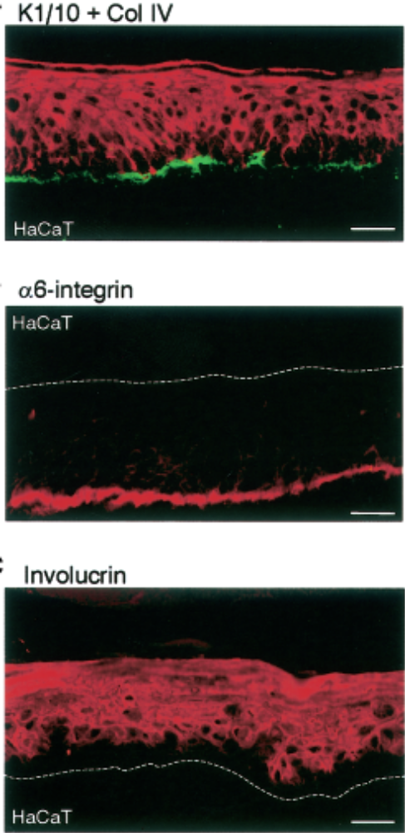
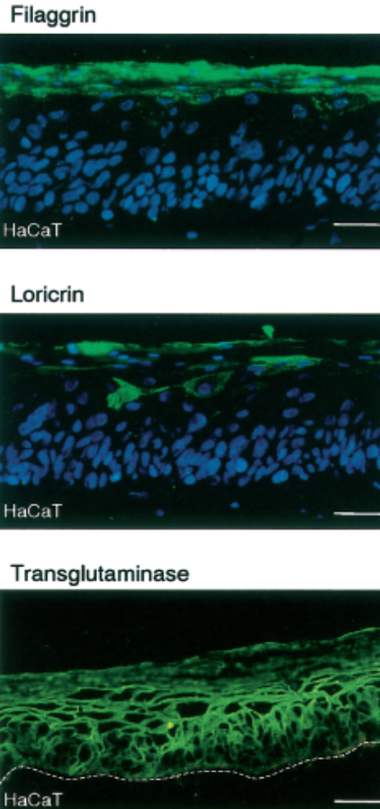
Markeri pojedinih slojeva kod organotipske kulture kože
karakterizacija stanica

Slide 35
3D kulture mogu sadržavati agregate iste vrste stanica ili nastati diferencijacijom iz jedne stanice u uvjetima koji onemogućuju adheriranje za podlogu
sferoidi – jednostavni agregati istovrsnih stanica različitih vrsta
ne zahtijevaju potporu (skelu), nastaju međusobnom adhezijom
organoidi – složeni agregati stanica specifičnih za organ, nastaju od matičnih ili progenitorskih stanica i samoorganiziraju se na potpornoj tvari nalik ekstracelularnom matriksu
„mikroskopske verzije roditeljskih organa”
Notes:
Organoid Applications
Organoid technology has been used to great success in personalized medicine — in disease modeling as well as optimizing drug discovery and regenerative medicine. The applications of organoids in CRISPR research could similarly help scientists better study organ development within the context of gene editing.
Specific to cancer research, 3D organoids can provide insight into the mutational signatures of selected cancers because they can mimic the pathophysiology of human tumors.
Organoids can also function as a self-assembling miniature manifestation of a parent organ, which can be of particular benefit to researchers. For example, neural organoids are bringing us closer to understanding diseases in the brain.
Spheroid Applications
Perhaps most notably, tumor spheroids can help scientists understand the in vivo microenvironments of tumors, which can help researchers predict drug efficacy in cancer research.
One research team recently screened a natural product library against non-small cell lung cancer spheroids in 1536-well plates and identified several compounds active against the cancer cells. Another team used spheroids with macrophage infiltrates to model how macrophages interact with tumors and anti-cancer drugs in the human body.
Spheroids can also be used in stem cell research to develop embryoid bodies from induced pluripotent stem cells, which can then be turned into high-purity neural stem cells for studying neural diseases and their related treatments.
Spheroid Culture Techniques
In scaffold methods, researchers use an artificial hydrogel, an extracellular matrix, or a solid scaffold to shape cell growth and encourage spheroid formation.
Anti-adherence methods rely on preventing cell adherence to a surface so cells are forced to clump together. Growing cells in a bioreactor with constantly flowing media, thus preventing them from adhering to the vessel, is one such method. The use of low-attachment coatings in plates so cells clump and form spheroids is another.
In the hanging-drop culture method, cells are seeded in media, which is used to form hanging droplets below a surface. With no surface to attach to, cells clump together by gravity, forming one spheroid inside each drop.
Spheroid Analysis Techniques
To analyze spheroid experiments, researchers use plate readers, various microscopy techniques, or flow cytometry.
Transwell migration and invasion assays with tumor spheroids can be analyzed using microscopy with image capture, microscopy with direct counting, a plate reader, or flow cytometry.
Viability assays rely on differences between dead or dying and viable cells, such as the presence of apoptotic markers or the ability of live cells to metabolize certain molecules into a fluorescent or colored product. The cells in spheroids may need to be disaggregated into single cells before analysis.
To evaluate the penetration of drug-carrying nanoparticles or other therapeutic products into tumor spheroids, researchers have used flow cytometry, confocal microscopy, and various other microscopy techniques. For example, a research team used two-photon microscopy to analyze the ability of drug-delivery nanoparticles with different properties to penetrate deeply into tumor spheroids.
Another group of researchers first treated colorectal cancer spheroids with drug-carrying nanoparticles, then stained the spheroids with Hoechst 33342 dye, which stains cells closer to the exterior of the spheroids more strongly. After staining, the team disaggregated the spheroids and analyzed their nanoparticle content and staining strength via flow cytometry, thus determining each cell's location in the spheroid and the depth of penetration of the nanoparticles.
Challenges and Future Directions in 3D Culture
Compared to 2D cultures, spheroids and organoids do come with greater complexity in analysis. It can be difficult to image the interior of spheroids or organoids without disaggregation or sectioning, and making histology sections is too labor-intensive for many applications. Another limitation is that certain cancer cell types are unable to form spheroids or have a tendency to form non-spherical aggregations.
Another challenge is that nutrient and oxygen diffusion limitations for cells in the spheroid interior increase as the size of spheroids increase, so larger spheroids develop a necrotic core.
Future directions and emerging trends in spheroid research include the use of spheroids as building blocks to create more complex tissue constructs, and the development of new biosensing methods (e.g., optical coherence tomography and electrochemical biosensing) that can analyze whole spheroids without damage.
To keep abreast of the latest developments in 3D technology, sign up for Corning's 3D culture updates, or visit our website to find products, guides, and protocols for spheroid and organoid culture.
Spheroids vs. Organoids Infographic
Learn more about the origin, model environments, applications and advantages of spheroids and organoids.
Download
Automating Your 3D Cell Cultures e-Book
Move your 3D cell cultures into a high throughput environment with expert insights and experiences.
Download
3D Model Systems: Spheroids, Organoids and Tissue Models
Spheroids, organoids and more complex 3D systems have been invaluable to research. Download this practical guide demystifying 3D models with helpful tips and techniques to set your 3D culture up for success.
Download

Slide 36
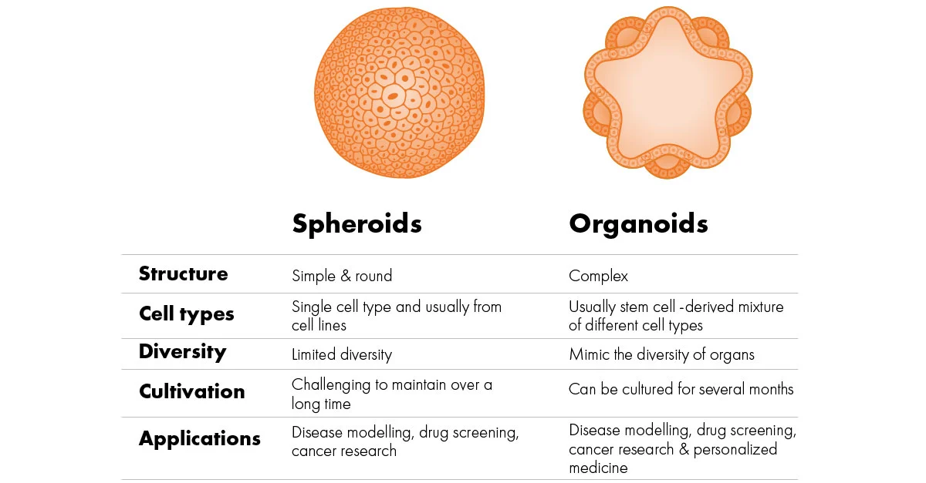
modeli bolesti
probir lijekova
istraživanje biologije tumora
+ personalizirana medicina

Slide 37
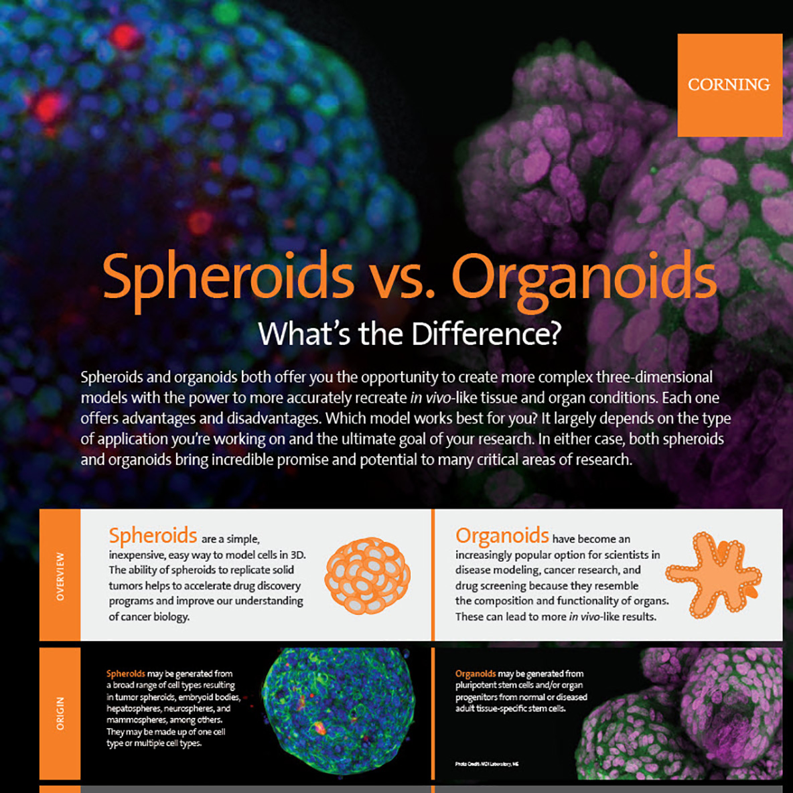

Slide 38
upotreba organoida:
personalizirana medicina: modeli bolesti,
istraživanje lijekova, regenerativna medicina
procesi razvoja organa i razumijevanje bolesti
organoidi tumora – patofiziologija
upotreba sferoida:
tumorski sferoidi: razumijevanje uvjeta mikrookoliša tumora i djelovanja terapije
interakcije s imunološkim sustavom
ispitivanje potencijalnih lijekova

Slide 39
Nastanak sferoida:
metoda viseće kapi – uvjet – neadherentna podloga
hidrogel i drugi materijali
podloge nalik ekstracelularnom matriksu
analiza: bioloških svojstava:
migracija i invazija – transwell i mikroskopija
vijabilnost u pojedinim dijelovima sferoida
utjecaj citostatika
nastanak kolonija iz jedne stanice u gelu (imobilizirajućem sredstvu)
- kod tumora test tzv. tumorskih matičnih stanica,

Slide 40
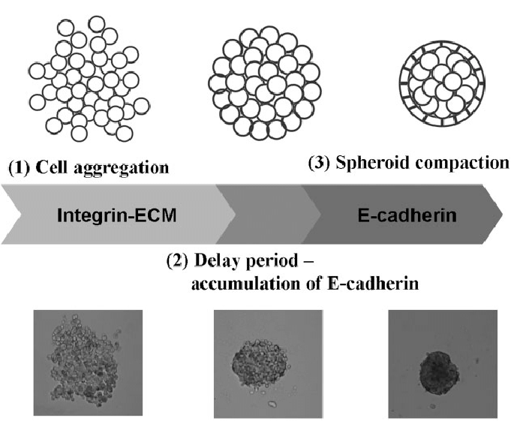
Sferoidi
Lin et al. 2008.

Slide 41
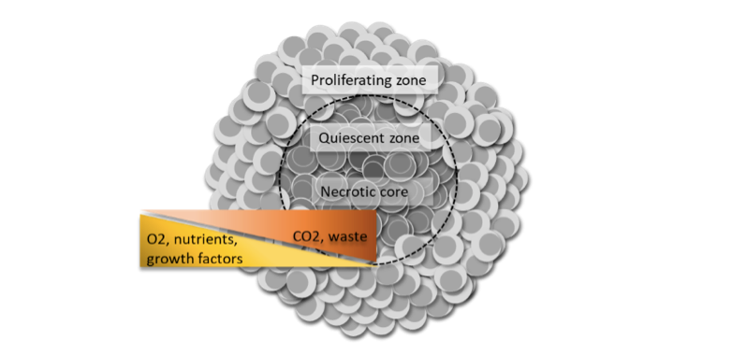
„model” tumora
gradijent dostupnosti kisika i nutrijenata, pojava nekroze

Slide 42
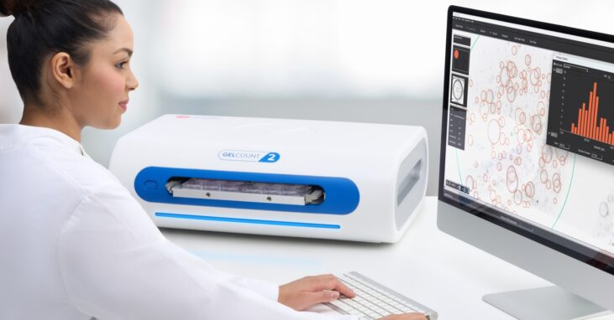
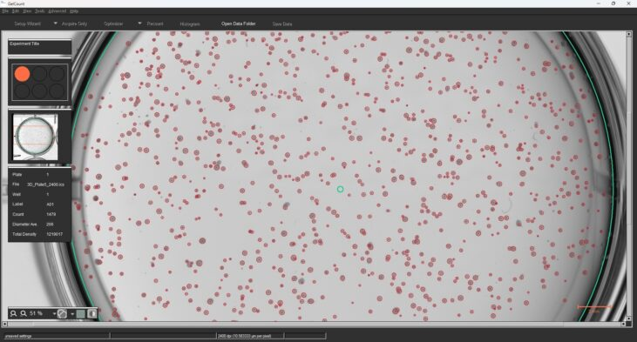
automatska analiza
mikroskopi za analizu veličine sferoida

Slide 43
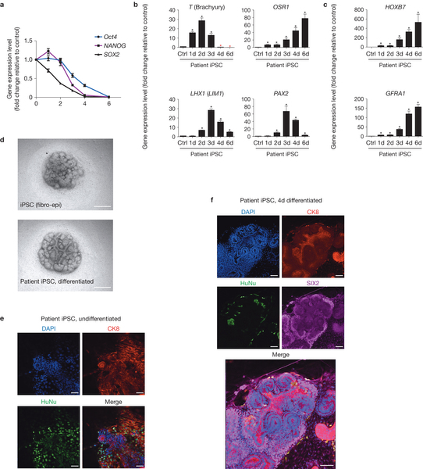
Xia i sur. : Directed differentiation of human pluripotent cells to ureteric bud kidney progenitor-like cells
Nature Cell Biology,
2013
Organoidi ili 3D kulture postaju osnovni modeli za istraživanje lijekova, kod personalne medicine i upoznavanje razvoja organa. Organoidi nastaju iz pluripotentnih matičnih stanica ili progenitorskih stanica koje se diferenciraju i samoorganiziraju u strukture koje nalikuju organima sisavaca, obično na matriksu koji može biti od prirodnih ili umjetnih tvari koje nalikuju prirodnim

Slide 44
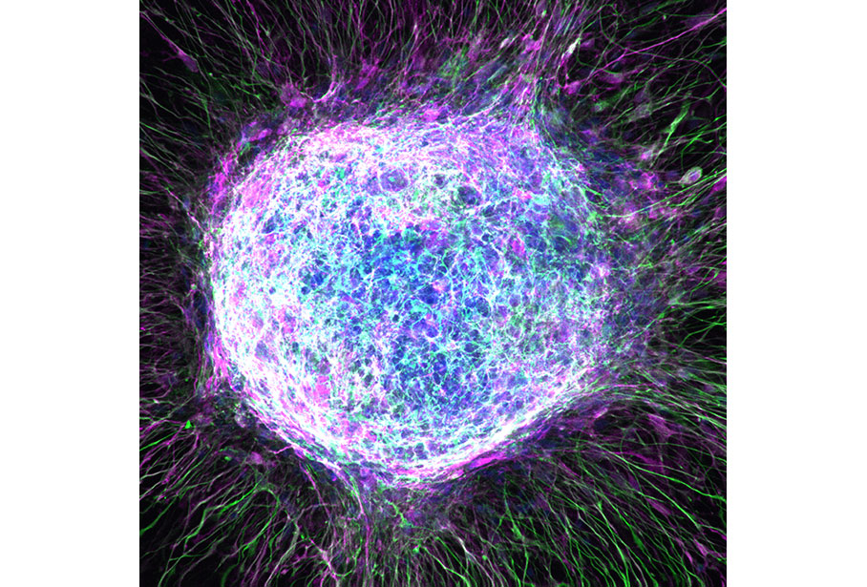
Neuralna sfera iz humane pluripotentne stanice
A Sphere Culture of Influence
Caroline Cvetkovic, Morgan Anderson, Nupur Basu, Robert Krencik, Rajan Patel, and Arya Shetty
Houston Methodist Research Institute, Baylor College of Medicine, and Rice University
Engineered human neural sphere cultures can be used as relevant, high-throughput models for drug discovery and research of neurodegenerative diseases. This maximum projection image of 3D neural sphere is comprised of astrocytes differentiated from human pluripotent stem cells (hPSCs). Images were taken on a confocal microscope at 20× magnification. The sphere was stained with S100 (magenta), GFAP (green), and DAPI (blue).

Slide 45
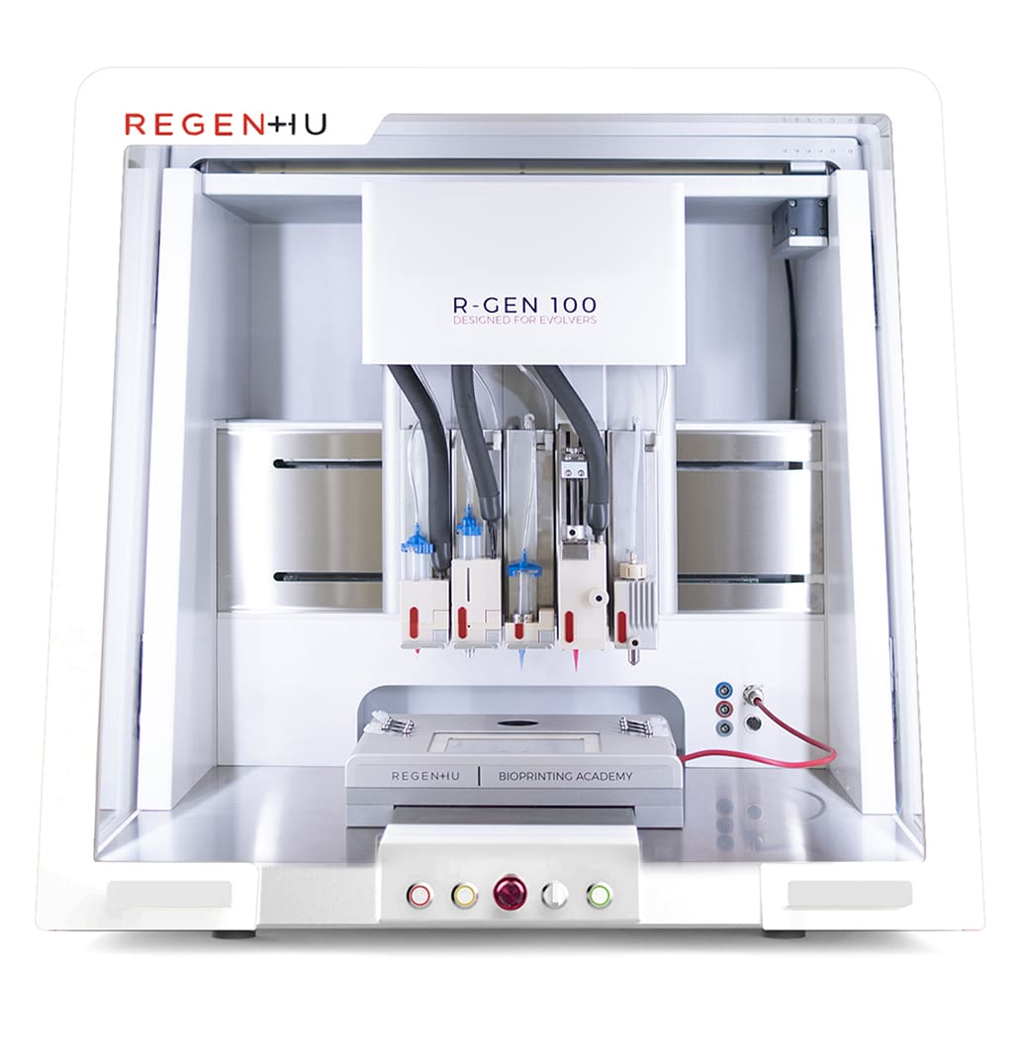
Bioprinting
3D „printing” stanica: bioboje i biomaterijali, pomiješani sa stanicama se tiskaju u 3 dimenzije, sloj po sloj
istraživanje lijekova,
kozmetika
personalizirana i regenerativna medicina
tkivno inžinjerstvo
https://www.youtube.com/watch?v=jSWwDCNNtrE +
Notes:
https://www.cellink.com/blog/the-ultimate-user-guide-to-bioprinting-neural-tissue/
Bioprinting – explained simply!
Bioprinting is a technology where bioinks and biomaterials, mixed with cells, are 3D printed, often to construct living tissue models. The process of 3D bioprinting follows that of additive manufacturing, where a digital file acts as a blueprint to print an object layer-by-layer. Although bioprinting is a new technology, it has already shown huge benefits within the applications of regenerative and personalized medicine, tissue engineering, drug discovery and cosmetics.
How bioprinting works
3D bioprinting, built on the foundations of 3D printing, comes with a lot of freedom. Bioprinting’s freedom makes it an excellent tool in biological research applications, which means there isn’t one easy method which can explain how bioprinting works. The technology is constantly evolving and shifting, and the steps in the workflow will change over time. Today, we view the workflow in three distinct stages:
Pre-bioprinting:
This step first involves creating a digital file, or 3D model, for the printers to read. The application determines whether the 3D model is built from scratch, based on a scan, if it is as simple as a droplet, or something else. Some bioprinting software, like our DNA Studio, gives researchers the ability to design simple 3D geometries directly on the printer. Other bioprinters will require the use of external software and 3D modeling, or CAD, skills.
In this step, you also prepare the printing material. For cellular applications with cells embedded into the bioink, researchers will need to prepare their cells and mix them with the bioink. Note that some cellular applications require the researcher to seed the cells onto the printed construct in step 3. If the application is acellular, the researcher will only need to prepare their material appropriately.
Bioprinting:
For extrusion-based bioprinting, researchers will load the cell-laden bioink into cartridges and load these into one or multiple printheads. The researcher sets the parameters on the printer, and starts the print. The bioink will be extruded into the desired shape. For light-based bioprinting, researchers will put a photosensitive bioink, such as a photoink, in a vat. The structure is then built by projecting a patterned light onto the bioink, which will form the desired shape by moving the print arm. Developing different types of 3D tissue models requires researchers to use different types of cells, bioinks and equipment.
Post-bioprinting:
Most 3D bioprinted structures need to be crosslinked to become fully stable. Crosslinking is usually done by treating the construct with either ionic solution or UV light. The construct’s composition helps researchers determine what kind of crosslinking to use. Typically, you will now proceed with covering the 3D tissue models with the relevant cell medium, and place it in an incubator for cultivation.
hin the applications of regenerative and personalized medicine, tissue engineering, drug discovery and cosmetics.

Slide 46
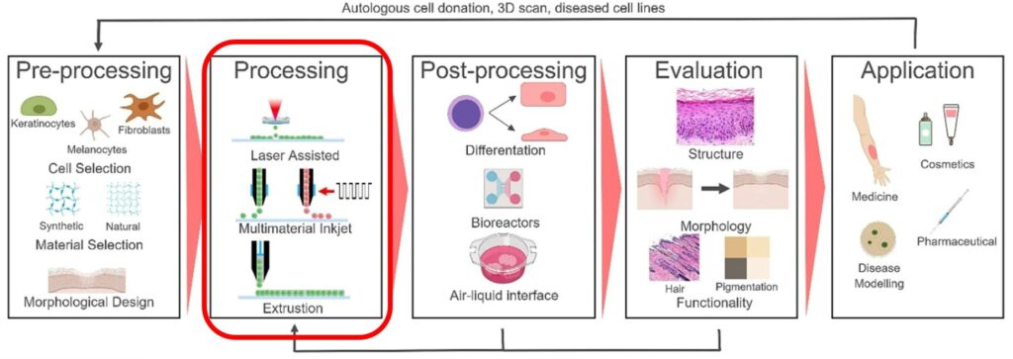
Proces 3D biotiskanja tkiva
-polimerizacija s UV ili svjetlosti ili ionima

Slide 47
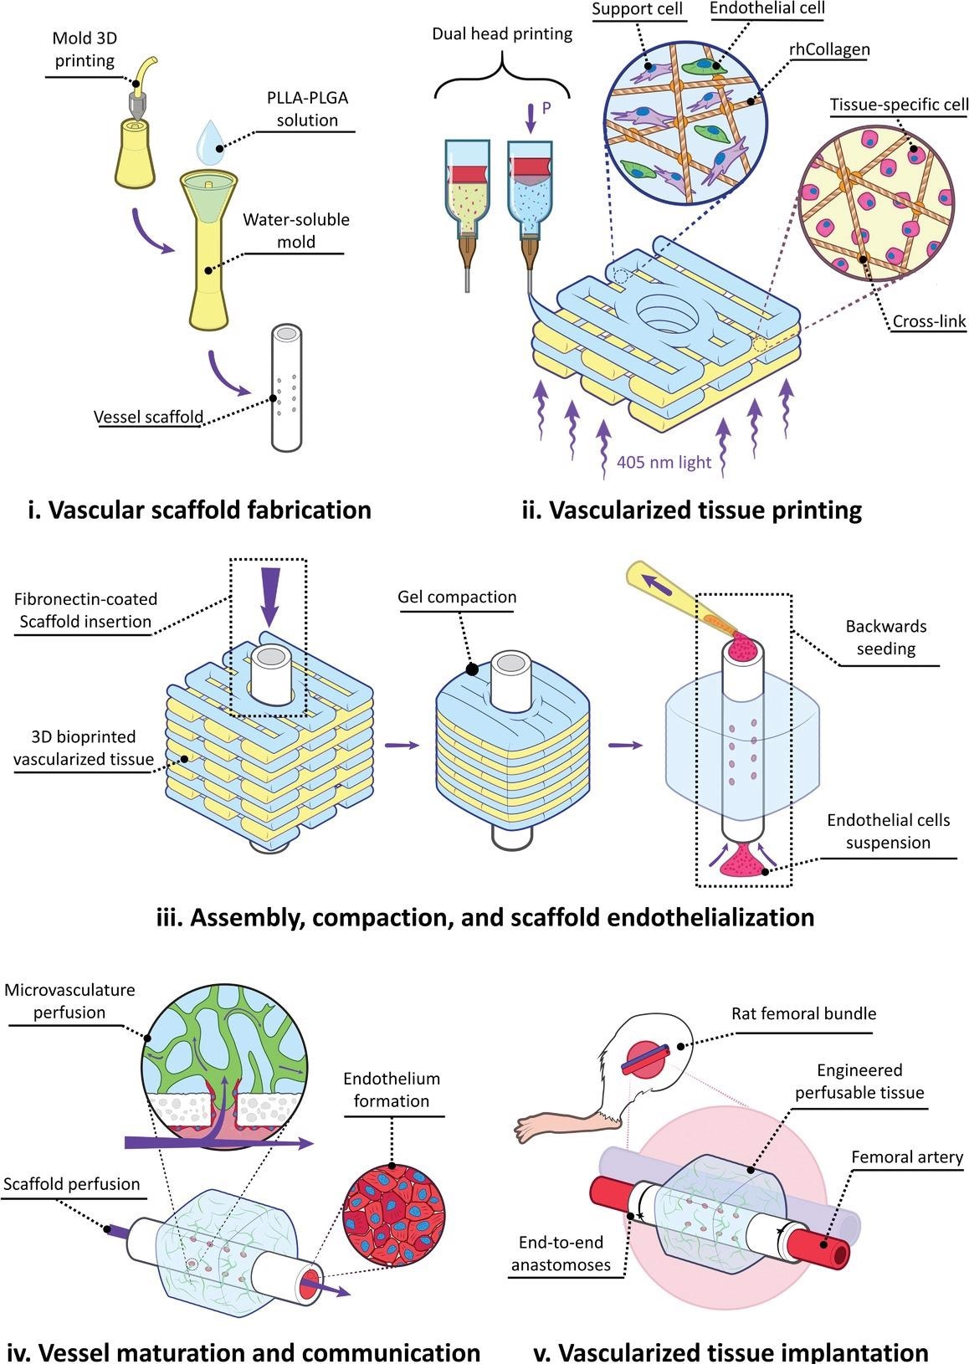
mage
„Tiskanje krvnih žila za vaskularizaciju implantata”
https://3dprintingindustry.com/news/technion-researchers-3d-print-blood-vessel-networks-for-tissue-implants-197078/
- filmić
Hanaphy, P., Everett, H. and Sertoglu, K. (2021) Technion researchers 3D print blood vessel networks for tissue implants, 3Dprintingindustry.com. https://3dprintingindustry.com/news/technion-researchers-3d-print-blood-vessel-networks-for-tissue-implants-197078 https://www.azom.com/news.aspx?newsID=56909
Notes:
Image Credit: Hanaphy, P., Everett, H. and Sertoglu, K. (2021) Technion researchers 3D print blood vessel networks for tissue implants, 3Dprintingindustry.com. Available at: https://3dprintingindustry.com/news/technion-researchers-3d-print-blood-vessel-networks-for-tissue-implants-197078
prvo povežu strukturu s organizmom da ga prokrvi i „prihvati”, da bi zatim poslužio za ugradnju implantata

Slide 48
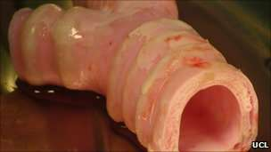
Prvi umjetni dušnik: na umjetni 3D matriks nasađene matične stanice
iz koštane srži samog pacijenta
-za dva tjedna
utvrđeno da nije prošlo klinička ispitivanja
ljudi teško oštećeni!!!!! – nefunkcionalne stanice (problem izbacivanja sluzi)
Notes:
Surgeons in Sweden have carried out the world's first synthetic organ transplant.
Scientists in London created an artificial windpipe which was then coated in stem cells from the patient.
Crucially, the technique does not need a donor, and there is no risk of the organ being rejected. The surgeons stress a windpipe can also be made within days.
The 36-year-old cancer patient is doing well a month after the operation.
Professor Paolo Macchiarini from Italy led the pioneering surgery, which took place at the Karolinska University Hospital.
In an interview with the BBC, he said he now hopes to use the technique to treat a nine-month-old child in Korea who was born with a malformed windpipe or trachea.
Professor Macchiarini already has 10 other windpipe transplants under his belt - most notably the world's first tissue-engineered tracheal transplant in 2008 on 30-year-old Spanish woman Claudia Costillo - but all required a donor.
Indistinguishable
The key to the latest technique is modelling a structure or scaffold that is an exact replica of the patient's own windpipe, removing the need for a donor organ.
To do this he enlisted the help of UK experts who were given 3D scans of the 36-year-old African patient, Andemariam Teklesenbet Beyene. The geology student currently lives in Iceland where he is studying for a PhD.
Using these images, the scientists at University College London were able to craft a perfect copy of Mr Beyene's trachea and two main bronchi out of glass.
This was then flown to Sweden and soaked in a solution of stem cells taken from the patient's bone marrow.
After two days, the millions of holes in the porous windpipe had been seeded with the patient's own tissue.
Dr Alex Seifalian and his team used this fragile structure to create a replacement for the patient, whose own windpipe was ravaged by an inoperable tumour.
Despite aggressive chemotherapy and radiotherapy, the cancer had grown to the size of a golf ball and was blocking his breathing. Without a transplant he would have died.
During a 12-hour operation Professor Macchiarini removed all of the tumour and the diseased windpipe and replaced it with the tailor-made replica.
The bone marrow cells and lining cells taken from his nose, which were also implanted during the operation, were able to divide and grow, turning the inert windpipe scaffold into an organ indistinguishable from a normal healthy one.
And, importantly, Mr Beyene's body will accept it as its own, meaning he will not need to take the strong anti-rejection drugs that other transplant patients have to.
Professor Macchiarini said this was the real breakthrough.
"Thanks to nanotechnology, this new branch of regenerative medicine, we are now able to produce a custom-made windpipe within two days or one week.

Slide 49
Diferencijacija – nastanak specijaliziranih stanica iz matičnih ili progenitorskih stanica
mogućnosti liječenja „nediferenciranih tumorskih stanica”
mogućnosti „zamjene” organa (autologno?)
mogućnosti istraživanja lijekova koji bi „popravili” oštećene/nefunkcionalne stanice

Slide 50
dokazivanje tumorskih ili somatskih matičnih stanica:
ekspresija specifičnih gena
proliferacija – imortalnost
migracija
mogućnost diferencijacije u različite tipove stanica
nastanak sferoida

Slide 51
https://www.nanolive.ch/idorsia-drug-discovery/
https://www.cell.com/pictureshow/3d-imaging
https://www.youtube.com/watch?v=IOo2WA6EcOA – 1 sat predavanje organoids, sferoids
https://www.youtube.com/watch?v=KOxZemvYoos – 1 sat
https://www.youtube.com/watch?v=SuthgBZqBk0 – 1 sat
https://www.youtube.com/watch?v=KOxZemvYoos !! 1 sat
https://www.youtube.com/watch?v=SvnX9NJ1Zuo – neural organoids 9 min !!+
https://www.youtube.com/watch?v=DH9m-4bRYOc – organoidi u liječenju tumora
https://www.youtube.com/watch?v=mqt-8qdoDj0 – iPS, za liječenje
https://www.youtube.com/watch?v=2SG5ivm6jkw – organoidi, teorija
https://www.youtube.com/watch?v=XddaxQcFOs8
https://www.youtube.com/watch?v=jSWwDCNNtrE – 3D print +++
https://www.youtube.com/watch?v=r4Fj_CwEhvk
https://www.youtube.com/watch?v=8l6ib9HitJ0 - ++
https://www.youtube.com/watch?v=m0rHZ_RDdyQ

