Slide 1
Diferencijacija B limfocita

Slide 2
B limfociti prepoznaju strane antigene i proizvode specifična antitijela za borbu protiv njih
razvoj počinje u koštanoj srži kod sisavaca i Bursa Fabricius kod ptica
stepenice razvoja:
nastanak B limfocita koji su „naivni”, nisu još bili u dodiru s antigenom u koštanoj srži
nakon dodira s antigenom proliferacija specifičnog klona B limfocita i nastanak plazma stanica u sekundarnim limfnim organima

Slide 3
nastanak prekursora B limfocita u koštanoj srži:
-ekspresija receptora antigena putem rearanžmana gena
-eliminacija stanica koje su reaktivne na vlastite antigene (anti-self) u koštanoj srži i sekundarnim limfnim organima – negativna selekcija
-pozitivna selekcija B limfocita koji eksprimiraju receptore za patogene u sekundarnim limfoidnim organima
-zreli B limfociti cirkuliraju limfom i krvlju do limfnih tkiva u potrazi za patogenima
-nakon susreta sa specifičnim patogenom, proliferacija i klonalna ekspanzija u sekundarnim limfoidnim tkivima
-sazrijevanje u:
plazma stanice koje ostaju u sekundarnim organima i proizvode velike količine specifičnih antitijela
memorijski B limfociti koji cirkuliraju i brzo mogu početi proizvoditi antitijela u slučaju ponovne infekcije istim patogenom
-B1 i B2

Slide 4
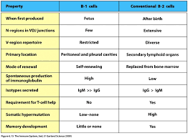
Pored B2 limfocita, postoji mala populacija B1 limfocita, s CD5 markerom
niski afinitet antitijela i polispecifičnost
porijeklo iz matičnih stanica aktivnih u prenatalnom periodu
povezani s kroničnom limfocitnom leukemijom

Slide 5
Procesi u koštanoj srži
nastanak i rearanžman teških lanaca antitijela
nastanak lakih lanaca antitijela
kontrolne točke
B1 i B2 limfociti
negativna selekcija na autoreaktivnost

Slide 6
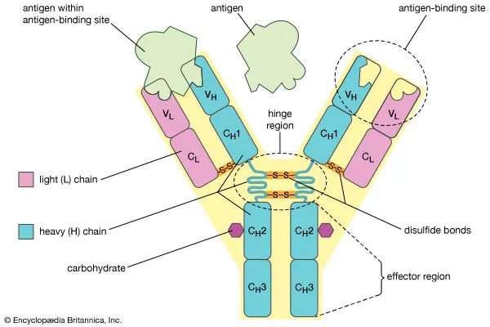
10¹¹ različitih antitijela ukupno (u različitim vremenima) = imunoglobulinski repertoar
različite hipoteze: nasljedna (različiti geni)
teorija somatske diversifikacije: ograničen broj gena koji prolaze kroz promjene
rearanžman DNA tijekom diferencijacije B limfocita
rekombinacija relativno malenog broja genskih segmenata
hipermutacija za nastanak visokoafinitetnih antitijela
5 klasa, 2 teška i 2 laka lanca; afinitet i aviditet
Encyclopaedia Britannica
Notes:
tek razvojem metode Southern blot i restrikcijske analize i usporedbom sekvenci nelimfoidnog tkiva i B limfocita primijećene su razlike u udaljenosti fragmenata

Slide 7
Struktura genskih lokusa na 2, 22 i 14 kromosomu
pored većeg broja segmenata varijabilnih dijelova lakih i teških lanaca koji se rekombiniraju, konstantne regije također imaju više regija koje se kombiniraju s istim varijabilnim kod promjene izotipova
V domena je kodirana s dva ili tri segmenta DNA, V i kraćim odsječkom J (joining)

Slide 8
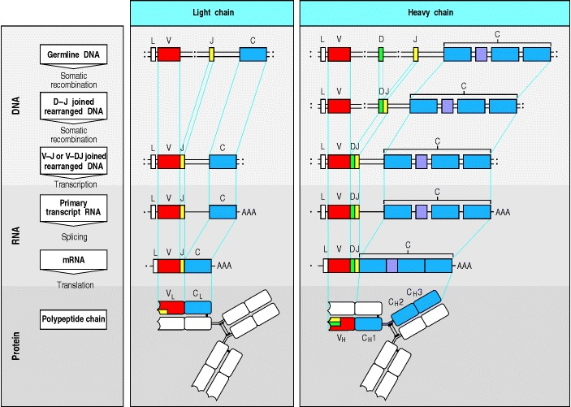
D-J (oba lanca)
V-DJ teškog lanca
provjera efikasnosti slaganjem sa surogatnim lakim lancima proV i λ5
prvo se slaže jedan alel, ako je dobro prestaje proces i slijedi sljedeća stepenica, ako ne, slaže se drugi alel
slaganje lakog lanca
VJ: prvo kappa, ako je neuspjelo onda uzvodnije i nizvodnije, zatim drugi alel, a onda drugi lanac lambda
Redoslijed rekombinacija varijabilnih dijelova teškog i lakog lanca Ig
Notes:
velike pre B s rearanžiranim teškim lancem stvore oko 100 stanica po B klonu (istog VDJ)
prvo kapa pa lambda, samo V i J pa je veći uspjeh
ako prva rekombinacija ne uspije, druga V regija uzvodne pozicije se rekombinira s nizvodnijom
ako ne uspije, rekombinira se drugi alel kappa
85 % preB daje produktivni rearanžman lakog lanca

Slide 9
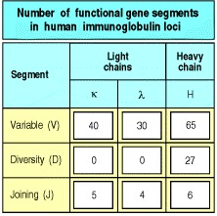
Brojevi teoretskih mogućnosti slaganja odsječaka: kako je moguće da dođe do promjene okvira čitanja nisu sve varijante funkcionalne

Slide 10
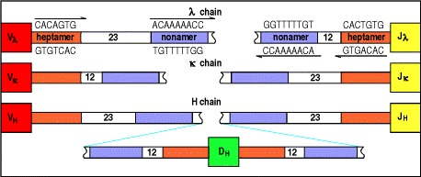
Bočne sekvence fragmenata V i J imaju karakteristične sljedove (heptamer i nonamer), dok su između sekvence od 12 ili 23 nukleotida (duljina heliksa). Takva sekvenca koja se sastoji od bočnih i središnjeg spacera zove se RSS ili recombination signal sequence. Potreba za točnim udaljenostima služi i za sprječavanje krivog vezanja koje prepoznaju enzimi RAG1 i RAG2

Slide 11
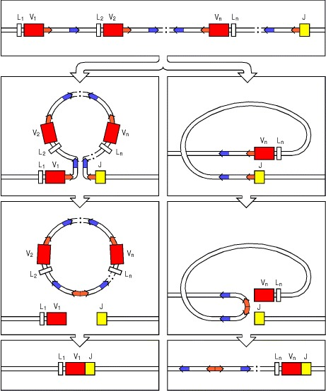
Nastanak rekombinacijske petlje koja vodi isijecanju središnjeg dijela zbog bočnih sekvenci istog smjera. Druga varijanta pretpostavlja nastanak petlje , a ne vodi izrezivanju, ali može stvoriti kodirajuću regiju.

Slide 12
Nukleaze RAG 1 i RAG2 prepoznaju bočne sekvence i odcijepaju petlju, a stanične ligaze i drugi enzimi spajaju DNA, DNA PK. RAG su eksprimirane samo u određenoj fazi razvoja limfocita.
terminalna deoksinukleotidil transferaza može na krajeve kodirajuće regije dodati nukleotide i tako povećati raznovrsnost, kao i egzonukleaza izrezati

Slide 13
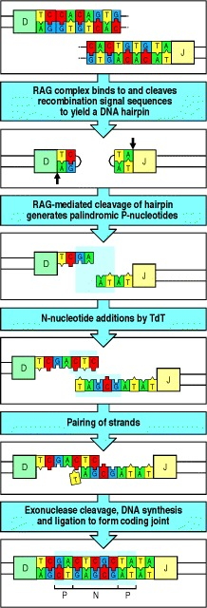
Dodavanje P i N nukleotida na mjestu vezanja kodirajućih sekvenci
P: palindromski krajevi
N: dodani nukleotidi
kako se moguće promijeni okvir čitanja, mnoge rekombinacije nisu funkcionalne
Notes:
Figure 4.8The introduction of P- and N-nucleotides at the joints between gene segments during immunoglobulin gene rearrangement
The process is illustrated for a D_{H} to J_{H} rearrangement; however, the same steps occur in V_{H} to D_{H} and in V_{L} to J_{L} rearrangements. After formation of the DNA hairpins (see Fig. 4.7), the two heptamer sequences, as indicated by the outline, are ligated to form the signal joint (not shown here), while RAG proteins cleave the DNA hairpin at a random site to yield a single-stranded DNA end. Depending on the site of cleavage, this single-stranded DNA may contain nucleotides that were originally complementary in the double-stranded DNA and which therefore form short DNA palindromes, as indicated by the shaded box in the third panel. Such stretches of nucleotides that originate from the complementary strand are known as P-nucleotides. For example, the sequence GA at the end of the D segment shown is complementary to the preceding sequence TC. Where the enzyme terminal deoxynucleotidyl transferase (TdT) is present, nucleotides are added at random to the ends of the single-stranded segments (fourth panel), indicated by the shaded box surrounding these nontemplated, or N, nucleotides. The two single-stranded ends then pair (fifth panel). Exonuclease trimming of unpaired nucleotides and repair of the coding joint by DNA synthesis and ligation leaves both the P- and N-nucleotides present in the final coding joint (indicated by shading in the bottom panel). The randomness of insertion of P- and N-nucleotides makes an individual P-N region a valuable marker for following an individual B-cell clone as it develops, for instance in studies of somatic hypermutation

Slide 14
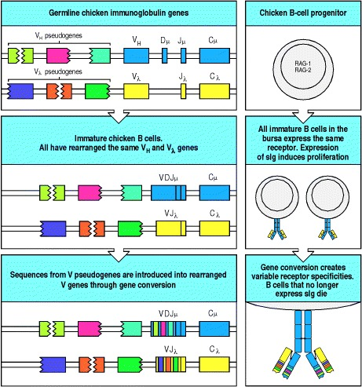
Nastanak raznolikosti kod ptica putem genske konverzije odsječaka pseudogena

Slide 15
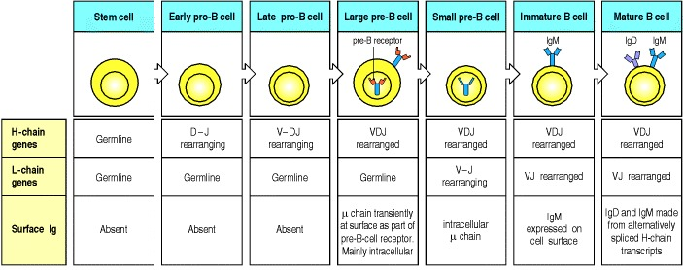
Slijed rearanžmana sekvenci DNA koje kodiraju za antitijela
Notes:
The stem cell has not yet begun to rearrange its immunoglobulin (Ig) gene segments; they are in the germline configuration as found in all nonlymphoid cells. The heavy-chain (H-chain) locus rearranges first. Rearrangement of a D gene segment to a J_{H} gene segment occurs in early pro-B cells, generating late pro-B cells in which V_{H} to DJ_{H} rearrangement occurs. A successful VDJ_{H} rearrangement leads to the expression of a complete immunoglobulin heavy chain as part of the pre-B-cell receptor, which is found mainly in the cytoplasm and to some degree on the surface of the cell. Once this occurs the cell is stimulated to become a large pre-B cell which actively divides. Large pre-B cells then cease dividing and become small resting pre-B cells, at which point they cease expression of the surrogate light chains and express the μ heavy chain alone in the cytoplasm. When the cells are again small, they reexpress the RAG proteins and start to rearrange the light-chain (L-chain) genes. Upon successfully assembling a light-chain gene, a cell becomes an immature B cell that expresses a complete IgM molecule at the cell surface. Mature B cells produce a δ heavy chain as well as a μ heavy chain, by a mechanism of alternative mRNA splicing, and are marked by the additional appearance of IgD on the cell surface.

Slide 16
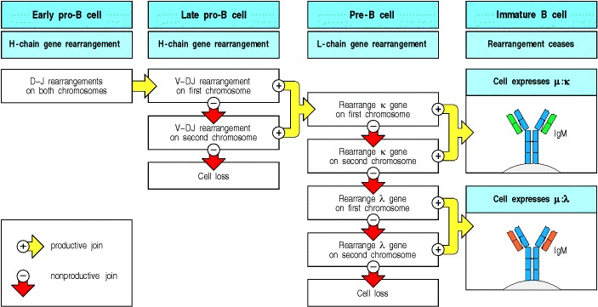
Redoslijed procesa rekombinacija i kontrolnih točaka razvoja
Notes:
Once a light-chain gene is assembled and a complete IgM molecule is expressed on the cell surface, the cell is defined as an immature B cell. The expression of the immunoglobulin heavy and light chains are key milestones in this differentiation pathway. These events do more than simply delineate stages of the pathway; the expression of an intact heavy chain, and later of a complete immunoglobulin molecule, actively regulates progression from one stage to the next.
All development up to this point has taken place in the bone marrow and is independent of antigen. Immature B cells now undergo selection for self-tolerance and subsequently for the ability to survive in the peripheral lymphoid tissues. B cells that survive in the periphery undergo further differentiation to become mature B cells that express IgD in addition to IgM. These cells, also called naive B cells until they encounter their specific antigen, recirculate through peripheral lymphoid tissues, where they may encounter and be activated by the appropriate foreign antigen.
In this part of the chapter we look in more detail at the steps that lead to a mature lymphocyte expressing a unique antigen receptor on its surface. The binding site of this receptor is formed from the variable regions of two different receptor chains and, in general, lymphocyte development is regulated so that each mature cell produces only one of each of these (for example, one immunoglobulin heavy chain and one light chain in B cells), and thus bears receptors of a single specificity. Production of a complete antigen receptor thus entails two series of gene segment rearrangements, one for each receptor-chain locus. Each series of rearrangements continues until a protein product is made, at which point the cell moves on to the next stage of development. This process is guided by signals that regulate the expression of the transcription factors and enzymes that control the rearrangement process. Such signals are generated by expression of a complete antigen receptor and also by expression of a pre-B- or pre-T-cell receptor in which the first receptor chain to be successfully rearranged is combined with a surrogate second chain; these receptors form complexes with accessory chains that have a signaling function.
The developmental program usually rearranges the heavy-chain (H-chain) locus first and then the light-chain (L-chain) loci. Cells are allowed to progress to the next stage when a productive rearrangement has been achieved. Each rearrangement has about a one in three chance of being successful, but if the first attempt is nonproductive, development is suspended and there is a chance for one or more further attempts. The scope for repeated rearrangements is greater at the light-chain loci (see Fig. 7.16), so that fewer cells are lost between the pre-B and immature B cell stages than in the pro-B to pre-B transition.

Slide 17
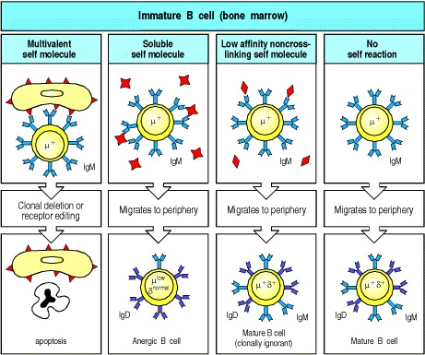
B limfociti s IgM antitijelima prolaze negativnu selekciju i oni koji reagiraju na vlastite antigene imaju različite sudbine:
završavaju apoptozom ako se ne poprave nakon editiranja receptora, ili opstaju kao anergični ili proizvođači niskoafinitetnih antitijela

Slide 18
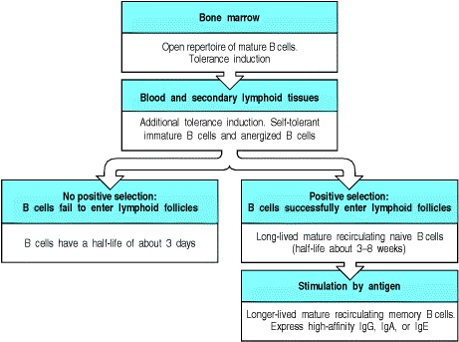
- ako ne uđu u limfni čvor B limfociti žive kratko. 90 % B limfocita su dugoživući koji prolaze kroz periferne organe i prolaze pozitivnu selekciju da bi postali zreli
Notes:
B cells are produced as receptor-positive immature B cells in the bone marrow. The most avidly self-reactive B cells are removed at this stage. B cells then migrate to the periphery where they enter the secondary lymphoid tissues. It is estimated that 10–20 × 10⁶ B cells are produced by the bone marrow and exported each day in a mouse, and an equal number is lost from the periphery. There seem to be two classes of peripheral B cell: long-lived B cells and short-lived B cells. The short-lived B cells are, by definition, recently formed B cells. Most of the turnover of short-lived B cells might result from B cells that fail to enter lymphoid follicles. In some cases this is a consequence of being rendered anergic by binding to soluble self antigen; for the remaining immature B cells, entry into lymphoid follicles is thought to entail some form of positive selection. Thus the remainder of the short-lived B cells fail to join the long-lived pool because they are not positively selected. About 90% of all peripheral B cells are relatively long-lived mature B cells that appear to have undergone positive selection in the periphery. These mature naive B cells recirculate through peripheral lymphoid tissues and have a half-life of 6–8 weeks in mice. Memory B cells, which have been activated previously by antigen and T cells, are thought to have a longer life.

Slide 19
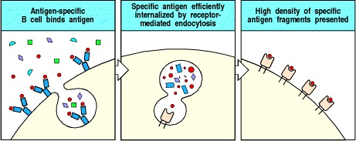
Prezentacija antigena na B limfocitu
B limfociti cirkuliraju kroz limfoidno tkivo i mogu endocitirati topive antigene kao što su bakterijski toksini, tako da ih vežu za svoje površinske imunoglobuline. Antigen se endocitira i nakon degradacije vraća na površinu kao kompleks s molekulama MHCII.

Slide 20
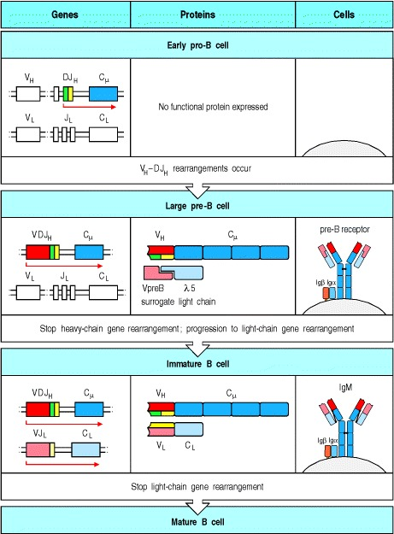
Kod pre B limfocita gotova je rekombinacija teškog lanca koji se sklapa sa surogatnim lakim lancem i skupa sa proteinima Ig alfa i Igbeta se asocira i zaustavlja daljnju rekombinaciju teškog, da bi započela rekombinacija lakog lanca,
veliki pre B limfociti se prvo dijele, a zatim prestaju te postaju mali pre B limfociti koji rekombiniraju laki lanac
Funkcionalni sklop igM na membrani (s izotipom mi teškog lanca) zaustavlja rekombinaciju lakog lanca
Notes:
In early pro-B cells, heavy-chain gene rearrangement is not yet complete and no functional μ protein is expressed, as shown in the top panel. As soon as a productive heavy-chain gene rearrangement has taken place, μ chains are expressed by the cell in a complex with two other chains, λ5 and VpreB, which together make up a surrogate light chain. The whole immunoglobulin-like complex is known as the pre-B-cell receptor (second panel). It is also associated with two other protein chains, Igα (CD79α) and Igβ (CD79β), in the cell. These associated chains signal the B cell to halt heavy-chain gene rearrangement, and drive the transition to the large pre-B cell stage by inducing proliferation. The progeny of large pre-B cells stop dividing and become small pre-B cells, in which light-chain gene rearrangements commence. Successful light-chain gene rearrangement results in the production of a light chain that binds the μ chain to form a complete IgM molecule, which is expressed together with Igα and Igβ at the cell surface, as shown in the third panel. Signaling via these surface IgM molecules is thought to trigger the cessation of light-chain gene rearrangement.

Slide 21
B limfociti cirkuliraju kroz limfoidno tkivo i mogu endocitirati topive antigene kao što su bakterijski toksini, tako da ih vežu za svoje površinske imunoglobuline. Antigen se endocitira i nakon degradacije vraća na površinu kao kompleks s molekulama MHCII. Takvi B limfociti mogu aktivirati naivne CD4 T limfocite, iako je mala vjerojatnost.

Slide 22
Nakon što se antigen predstavi pomoćničkom T limfocitu, uz njegovu pomoć odgovarajući B limfocit se diferencira u stanicu koja proizvodi ciljna antitijela.
Neki se limfociti B mogu aktivirati i direktno mikrobnim antigenima, bez posredništva T limfocita
Nakon aktivacije, uz pomoć T limfocita, B limfociti mogu proći somatsku hipermutaciju i prijelaz na određeni imunoglobulinski izotip:
aktivirani B limfocit →pomoćnički T limfocit → B limfocit koji proizvodi antitijela
reakciju potiče kompleks B receptora CD19-CD21-CD81
CD40 T limfocita se veže za CD40L B limfocita
-IL4 i drugi citokini

Slide 23
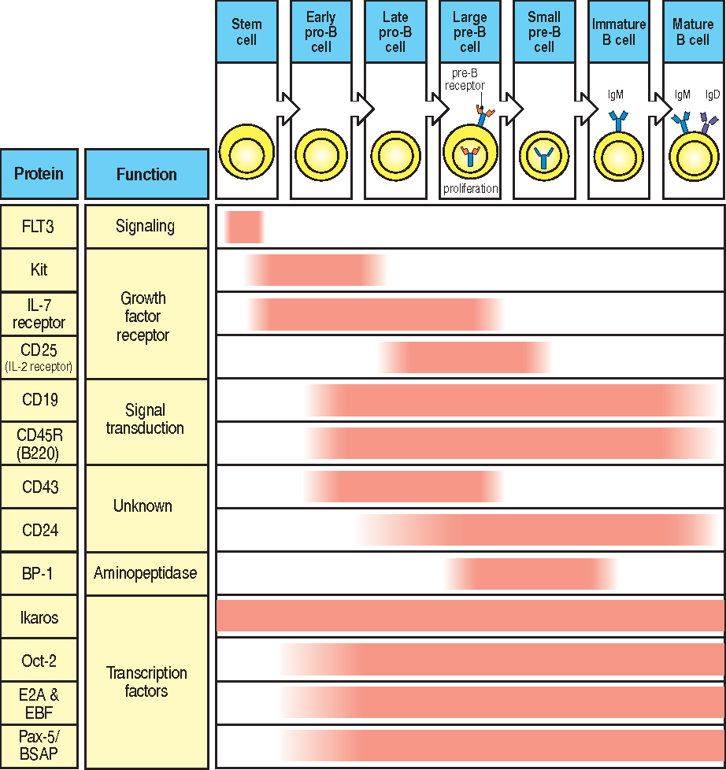
FTL3: receptorska kinaza, signal za diferencijaciju CLP
CD19: koreceptor u nastanku veze antigen – receptor BCR (B cell receptor)
CD45: receptorska fofsataze koja modulira signale od veze antigen – BCR kompleks
Regulacija ekspresije citokina i transkripcijskih faktora tijekom diferencijacije

Slide 24
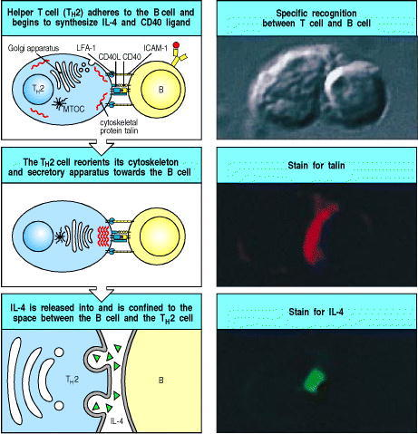

Slide 25
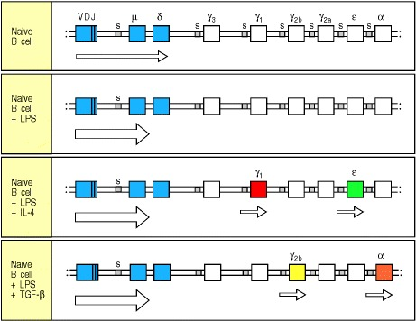
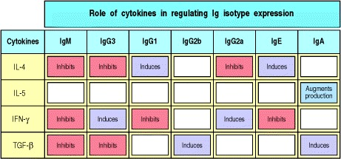
Malo B limfocita proizvodi IgM i IgD antitijela, a nakon aktivacije antigenom dolazi do promjene izotipa u IgG i IgA, pod utjecajem citokina

Slide 26
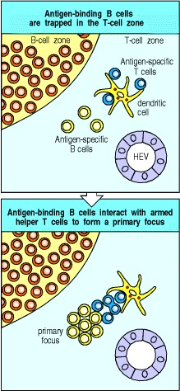
Teoretski je vrlo mala vjerojatnost da bi specifični B limfocit susreo specifičnog T limfocita
moguće se povećava vjerojatnost tzv. hvatanjem antigena (trapping)

Slide 27
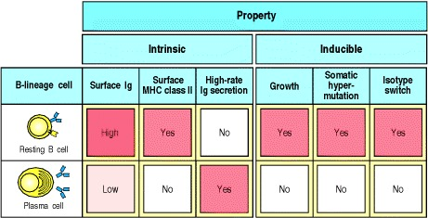
Nakon aktivacije, dio B limfocita umire, a dio postaje plazma stanicom koja ima veliki Golgi i proizvodi specifična antitijela. Ne može više prezentirati antigen na površini, niti prolaziti daljnje promjene. Obično nastaju nakon somatske hipermutacije čime se selektivno povećava afinitet prema antitijelu.

Slide 28
Aktivni B limfociti ulaze u sekundarni limfni organ gdje čine aktivne centre proliferacije, tzv. germinalne centre. Mirujuće B limfocite potiskuju na periferiju čineći zonu plašta („mantle”). Mirujuće B limfocite okružuje mreža folikularnih dendritičkih stanica koja privlači B limfocite kemokinima
u germinalnim centrima postoji 10 % antigen specifičnih T limfocita

Slide 29
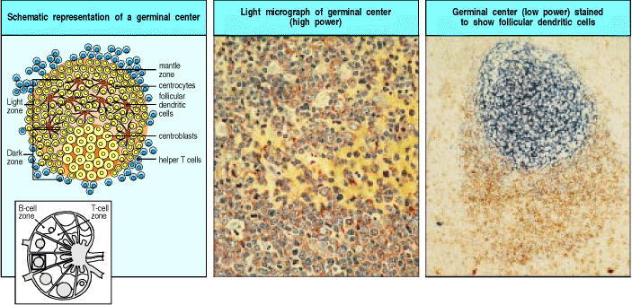
U germinalnom centru specifični B limfociti proliferiraju, prolaze somatsku hipermutaciju i selekciju na antigen
Plazma stanice napuštaju čvor, i odlaze u koštanu srž. Nastaju i memorijske stanice koje mogu biti zadržane u marginalnoj zoni
Nakon 6-8 sati proliferacije nastaju centroblasti koji diferenciraju u centrocite i moguće se prestaju dijeliti. Iz tamne zone proliferacije prelaze u svjetlu zonu germinalnog centra sa FDC
Za stanično preživljavanje nužni su CD40 i citokini T limfocita

Slide 30
Aktivni B limfociti ulaze u sekundarni limfni organ gdje čine aktivne centre proliferacije, tzv. germinalne centre. U germinalnom centru specifični B limfociti proliferiraju, prolaze somatsku hipermutaciju i selekciju na antigen
Plazma stanice napuštaju čvor i odlaze u koštanu srž gdje mogu biti izvor dugoživućih antitijela. Nastaju i memorijske stanice koje dugo žive, ali ne luče puno antitijela. Prošle su somatsku mutaciju

Slide 31
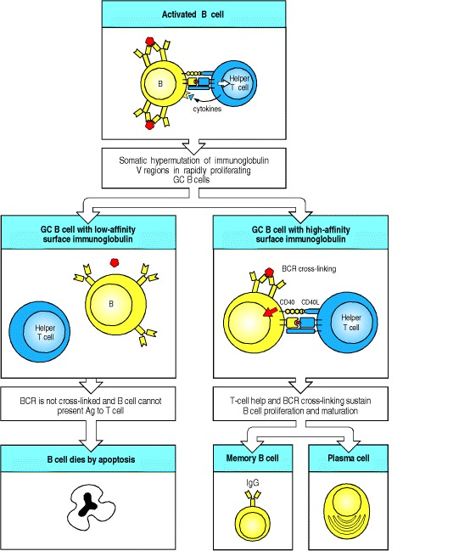
U germinativnim centrima B limfociti prolaze somatsku hipermutaciju. Nastaju mutacije DNA koje povećavaju varijabilnost antitijela i njegov afinitet, ali mogu i smanjiti afinitet ili onemogućiti proizvodnju antitijela. Tada stanice idu u apoptozu. Germinalni centri su puni apoptotskih stanica koje jedu makrofagi.
Nastaje 1-2 mutacije po generaciji. Pozitivno selektirane stanice mogu proći nekoliko ciklusa proliferacije i mutacije.

Slide 32
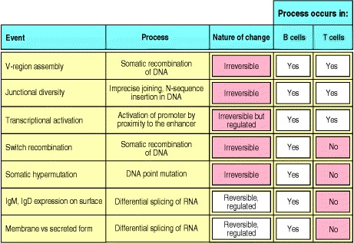

Slide 33
Plazma stanice su terminalno diferencirane stanice nastale iz plazmablasta. Proizvode antitijela, i ne dijele se. Neke migriraju u koštanu srž gdje mogu dugo živjeti kao izvor dugoživućih antitijela
Druge se diferenciraju u memorijske stanice, koje dugo žive, slabo se dijele, eksprimiraju površinski Ig ali ne luče puno antitijela. Prošle su somatsku mutaciju. Smatra se da je njihov nastanak ključan signal stanica FDC
Neki B limfociti se mogu aktivirati i bez posredstva T limfocita, npr. mitogenima B limfocita.

Slide 34
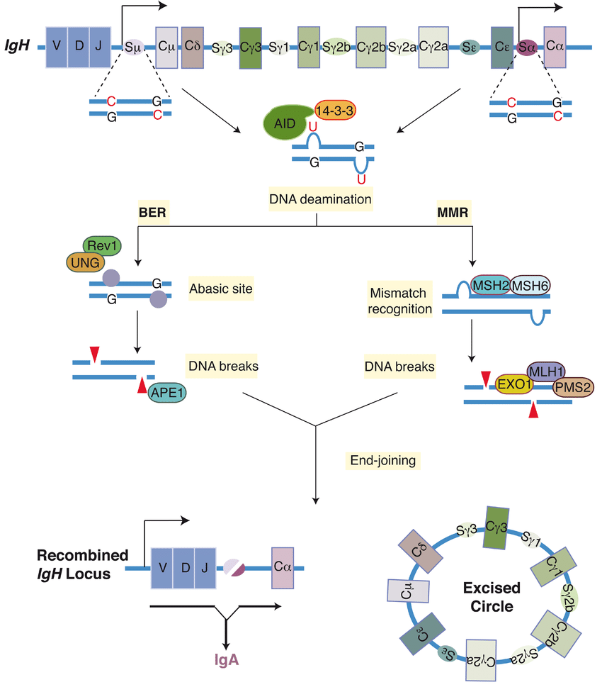
Mehanizam somatske hipermutacije pomoću enzima AID
te mehanizama popravka DNA
smatra se da se AID pozicionira na ciljno mjesto putem specifične RNA, te da je eksprimiran samo u ciljnim stanicama
-deaminacija C vodi do sparivanja U-G, te se „popravlja” mehanizmima BER i MMR
koji mogu biti „error prone” (DNA pol) i uvesti mutaciju
-moguć i sustav s ADAR i RT
F1000Research 2018
Notes:
Mature B lymphocytes undergo class switch recombination (CSR) to alter the expression of the immunoglobulin heavy chain constant region (CH). The figure depicts CSR between Sμ and Sα in the immunoglobulin heavy chain (IgH) locus. Activation-induced cytidine deaminase (AID) converts cytidines into uridines in S-region DNA. The dU:dG mismatch is converted into DNA double-strand breaks by either the base excision repair (BER) or the mismatch repair (MMR) pathway. In the BER pathway, uracil DNA glycosylase (UNG) removes the uracil base from the DNA to generate an abasic site, which is recognized and cleaved by the apurinic/apyrimidinic endonuclease 1 (APE1). During MMR, the dU:dG mismatch is recognized by mutS homologue 2 and mutS homologue 6 (MSH2 and MSH6), which recruit the complex of exonuclease 1 (EXO1), mutL homologue 1 (MLH1), and post-mitotic segregation 2 (PMS2) to excise a short patch of DNA that includes the dU:dG mismatch. The DNA breaks are ligated by classical or alternative non-homologous end-joining pathways to generate a recombined Igh locus and an excision circle. Rev1 and 14-3-3 are scaffolding proteins, which are necessary for the assembly of the protein complexes participating in CSR
The mechanism of SHM involves deamination of cytosine to uracil in DNA by the enzyme activation-induced cytidine deaminase, or AID.^{[10][11]} A cytosine:guanine pair is thus directly mutated to a uracil:guanine mismatch. Uracil residues are not normally found in DNA, therefore, to maintain the integrity of the genome, most of these mutations must be repaired by high-fidelity Base excision repair enzymes. The uracil bases are removed by the repair enzyme, uracil-DNA glycosylase.^{[11]} Error-prone DNA polymerases are then recruited to fill in the gap and create mutations.^{[10][12]}
The synthesis of this new DNA involves error-prone DNA polymerases, which often introduce mutations at the position of the deaminated cytosine itself or neighboring base pairs. During B cell division the immunoglobulin variable region DNA is transcribed and translated. The introduction of mutations in the rapidly proliferating population of B cells ultimately culminates in the production of thousands of B cells, possessing slightly different receptors and varying specificity for the antigen, from which the B cell with highest affinities for the antigen can be selected. The B cells with the greatest affinity will then be selected to differentiate into plasma cells producing antibody and long-lived memory B cells contributing to enhanced immune responses upon reinfection.^{[2]}
The hypermutation process also utilizes cells that auto-select against the 'signature' of an organism's own cells. It is hypothesized that failures of this auto-selection process may also lead to the development of an auto-immune response.

Slide 35
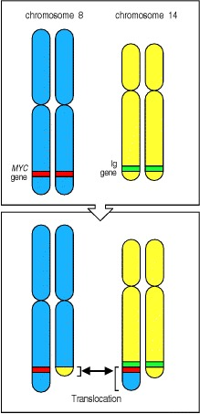
Prisutnost procesa somatske mutacije povezuje se s translokacijama gena Myc i drugim translokacijama čestim u B limfocitima, i vezanim za regije na 2, 14 i 22 kromosomu, gdje su klasteri teških i lakih lanaca Ig

Slide 36
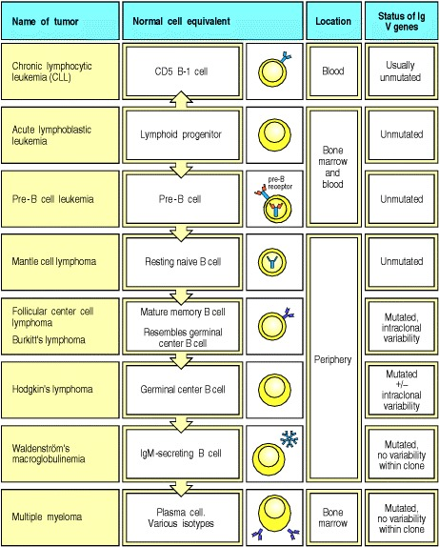
Pojedini tipovi leukemija odgovaraju poremećenim pojedinim stepenicama u razvoju B limfocita
pogreške u rearanžmanu mogu aktivirati onkogene
tumori su klonalni
razni stadiji razvoja B leukemija
tumori iz naivnih B leukocita rastu u folikulima limfnih čvorova – limfomi
tumori plazma stanica u koštanoj srži - mijelomi

Slide 37
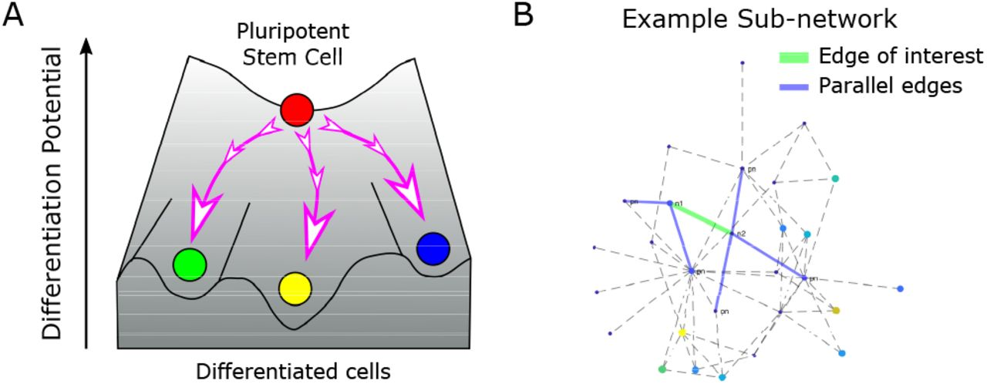
Cijeli je razvoj orkestriran signalizacijom iz staničnog okoliša koji utječe na unutarstanične promjene.

Slide 38
Sekvencijalna ekspresija krovnih/master transkripcijskih faktora: PU.1, Ikaros, E2A, EBF1, Pax5
Pax5 se veže za konstantnu regiju i otvara nižu razinu transkripciju D i J,
omogućava se pristup RAG za početak rekombinacije
omogućava rekombinaciju V s DJ
Nutt i Kee, Immunity 2007

Slide 39
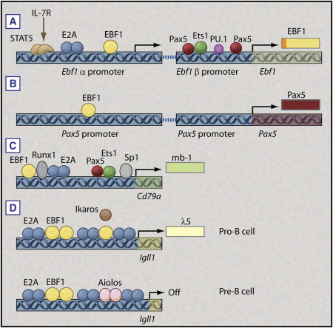
Kombinacija krovnih transkripcijskih faktora omogućuje regulaciju ekspresije ključnih gena
Nutt i Kee, Immunity 2007
Notes:
Figure 2Combinatorial Control of B Cell-Specific Gene Expression
(A) Regulation of the Ebf1 gene. The two promoters of Ebf1 along with the known regulators are indicated. The EBF1 protein is shown in yellow. The gene product of the two promoters differs by 11 amino acids in the N terminus (shown in orange). The IL-7R-STAT5 pathway has been shown to influence Ebf1α promoter activity, although direct DNA binding has not been demonstrated. Although Pax5 binds to the Ebf1β promoter, the functionality of individual Pax5-binding sites for Ebf1 expression has not been confirmed.
(B) Regulation of the Pax5 gene. Pax5, like Ebf1, has two independent promoters; however, beyond a role for EBF1, very little is known about the control of Pax5 transcription.
(C) Cd79a is regulated by the combinatorial inputs from E2A, EBF1, Pax5, Ets1, Sp1, and Runx1. Ets1 can only bind to a nonclassical site via cooperative interaction with Pax5 in the absence of DNA methylation (a process that requires E2A, EBF1, and Runx1 binding).
(D) The Igll1 promoter is regulated by competition between Ikaros family members (Ikaros and Aiolos) and EBF1 for overlapping binding sites. In pro-B cells, relatively higher levels of EBF1 favor Igll1 activation. However, at the pre-B cell stage, pre-BCR signaling leads to increased expression of Aiolos, which promotes gene silencing.
2/2Hide CaptionDownloadSee figure in article
Toggle Thumbstrip

Slide 40
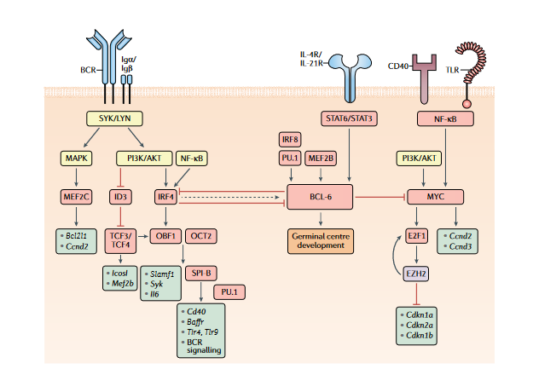
Diferencijacija B limfocita u germinativnom centru limfnog čvora
Regulacija ovisna o okolišnim faktorima: citokinima, aktivaciji receptora drugim limfocitima i stanicama koji omogućuju signale preživljenja ili apoptoze
Laidlaw i Cyster, Nature Reviews in Immunology 2021
Notes:
Fig. 1 | Transcriptional regulation of GC B cell commitment. Model for signalling pathways and transcription factors that regulate B cell commitment to the germinal centre (GC) fate. Boxes that indicate signalling molecules are coloured yellow, transcription regulators red, downstream gene targets turquoise and epigenetic modifiers purple. The B cell receptor (BCR), via its signalling subunits Igα and Igβ as well as downstream tyrosine kinases such as SYK and LYN, activates the mitogen-activated protein kinase (MAPK) and phosphoinositide 3-kinase (PI3K)/AKT pathways. MAPK signalling induces the expression of the transcriptional activator myocyte enhancer binding factor 2c (MEF2C), which promotes the transcription of B cell lymphoma-extra large (Bcl2l1) and cyclin D2 (Ccnd2). The expression of the transcriptional repressor inhibitor of DNA binding 3 (ID3) is reduced following B cell activation, allowing for transcription factor 3/4 (TCF3/4)-driven induction of Icosl and Mef2b transcription. PI3K/AKT and nuclear factor-κB (NF-κB) signalling also induce the expression of the transcription factor interferon regulatory factor 4 (IRF4). IRF4 and TCF3/4 induce the expression of the co-activator OBF1 (also known as POU class 2 homeobox associating factor 1 (POU2AF1)), which cooperates with OCT2 (also known as POU class 2 homeobox 2 (POU2F2)) to promote transcription of Slamf1, Syk and Il6. OBF1 and OCT2 can also induce the expression of the transcription factor SPI-B, which acts in a redundant fashion with PU.1 to enhance the transcription of genes encoding B cell surface receptors, such as Cd40, B cell activating factor receptor (Baffr), Toll-like receptor 4 (Tlr4) and Tlr9, and many components of the BCR signalling pathway, including Blnk and Btk. Although transiently elevated levels of IRF4 can induce the expression of B cell lymphoma 6 (BCL-6), sustained IRF4 levels will repress BCL-6 expression. BCL-6 expression is also induced by the transcription factors MEF2B and IRF8/ PU.1 as well as the cytokines IL-4 and IL-21, which bind to their respective receptors (IL-4R and IL-21R) and induce signal transducer and activator of transcription 6 (STAT6)/STAT3 signalling. CD40 and/or TLR-driven NF-κB signalling, alongside PI3K/AKT signalling, will induce the expression of the transcription factor MYC, which promotes cellular proliferation by inducing the transcription of Ccnd2/Ccnd3 and the expression of the transcription factor E2F transcription factor 1 (E2F1). E2F1 induces expression of Ezh2 that encodes a Polycomb repressive complex 2 (PRC2) enzymatic component. Enhancer of zeste homologue 2 (EZH2) promotes cell cycle progression by repressing the expression of Cdkn1a, Cdkn2a and Cdkn1b, which encode cyclin-dependent kinase inhibitors. EZH2 also promotes E2F1 release from the retinoblastoma (Rb) protein via phosphorylation of Rb, thereby enhancing E2F1 activation and further EZH2 expression. BCL-6 can directly repress MYC expression, thereby limiting the number of cell divisions that GC B cells undergo. BCL-6 promotes GC B cell development through regulation of numerous genes controlling cellular processes including the DNA damage response, B cell migration, apoptosis, BCR and CD40 signalling, plasma cell differentiation and T cell:B cell interactions. Together, these transcriptional regulators allow for the precise control of GC initiation that is necessary to balance the competing needs of the immune system to induce a protective response while limiting immunopathology.

Slide 41
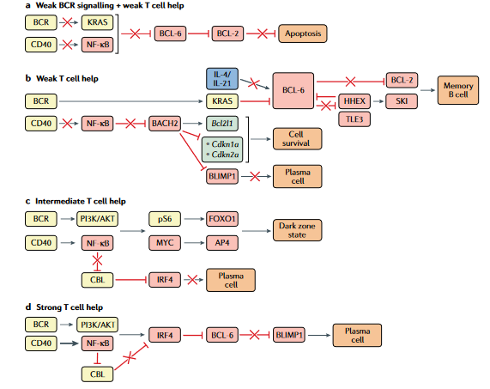
Transkripcijska regulacija diferencijacije B limfocita u germinalnom centru
Laidlaw i Cyster, Nature Reviews in Immunology 2021
Notes:
Fig. 3 | Transcriptional regulation of GC B cell differentiation. Germinal centre (GC) B cell differentiation is regulated by the extent of signals received by the B cell through the antigen-engaged B cell receptor (BCR) and CD40 (via CD40L- expressing T cells). Boxes indicating signalling molecules are coloured yellow, transcription factors red, cytokines blue and downstream gene targets turquoise. A red cross indicates a pathway that is not functional under the condition illustrated. a | Weak BCR signalling and weak T cell help results in a failure of GC B cells to receive sufficient signals through the BCR and CD40 to induce KRAS and nuclear factor-κB (NF-κB)-driven repression of B cell lymphoma 6 (BCL-6) expression. Repression of BCL-2 expression by BCL-6 in these cells will result in apoptosis owing to a failure to receive sufficient survival signals. b | GC B cells that receive weak T cell help (transmitted via CD40) will not receive sufficient CD40-induced NF-κB signals to indirectly repress BTB domain and CNC homology 2 (BACH2). BACH2 promotes GC B cell survival through induction of the anti-apoptotic gene Bcl2l1 and repression of cyclin-dependent kinase inhibitor family genes (Cdkn1a, Cdkn2a). BACH2 also represses B lymphocyte-induced maturation protein 1 (BLIMP1) and, accordingly, restricts plasma cell differentiation. The continued survival of B cells that receive weak T cell help is dependent on receiving sufficient BCR-driven KRAS signalling to repress BCL-6 expression. Exposure to T cell-derived IL-4 and IL-21 normally stabilizes BCL-6 expression in GC B cells. However, B cells that receive weak T cell-derived CD40 will also have low exposure to IL-4 and IL-21, resulting in impaired BCL-6 expression and induction of BCL-6-repressed genes such as haematopoietically expressed homeobox (Hhex) and Bcl2. HHEX interacts with the co-repressor transducin-like enhancer 3 (TLE3) to further repress BCL-6 expression and promote memory B cell development through the upregulation of BCL-2 and the transcription factor Sloan-Kettering Institute (SKI). c | GC B cells that receive intermediate T cell help receive both phosphoinositide 3-kinase (PI3K)/AKT and NF-κB signalling, resulting in phosphorylation of the ribosomal protein S6 (pS6) and expression of MYC. pS6 and MYC subsequently induce expression of forkhead box O1 (FOXO1) and activating enhancer binding protein 4 (AP4), respectively, ultimately leading to the adoption of the highly proliferative dark zone state. Intermediate levels of CD40 signalling do not drive sufficient NF-κB signalling to repress expression of the ubiquitin ligase CBL, allowing CBL to continue to repress interferon regulatory factor 4 (IRF4) expression and prevent plasma cell differentiation. d | GC B cells that receive strong T cell help receive both PI3K/AKT and NF-κB signalling. Strong NF-κB signalling represses CBL expression and allows for upregulation of IRF4. IRF4 represses BCL-6 expression and leads to expression of BLIMP1 and plasma cell differentiation.

Slide 42
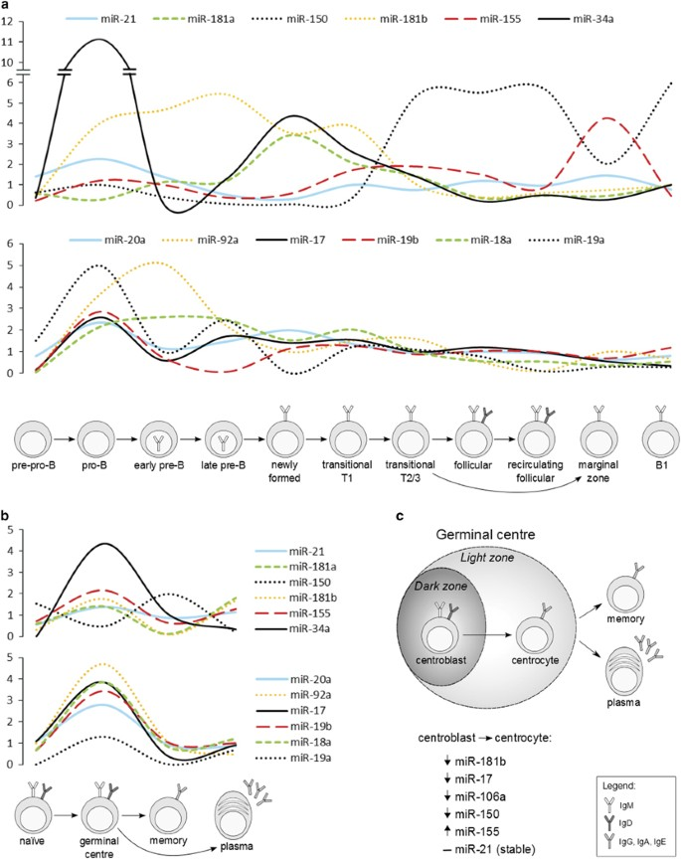
miRNA imaju svoju kaskadu ekspresije tijekom razvoja B limfocita
Musilova i Mraz, 2014

Slide 43
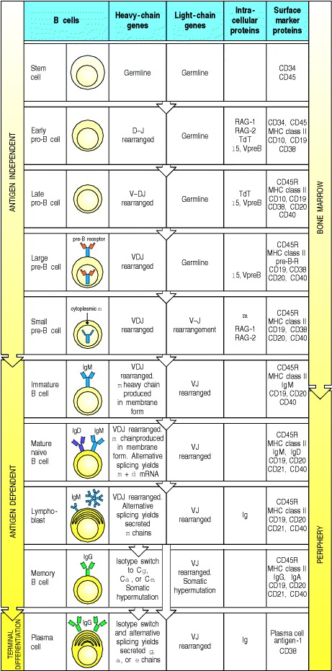
Razvoj B limfocita

