Slide 1
Računalne metode u istraživanju alosterije
Kemijski seminar 1
Zoe Jelić Matošević
prema radu
Greener, J. G. & Sternberg, M. J. Curr. Opin. Struct. Biol. 50, 1–8 (2018).
„Structure-based prediction of protein allostery“

Slide 2
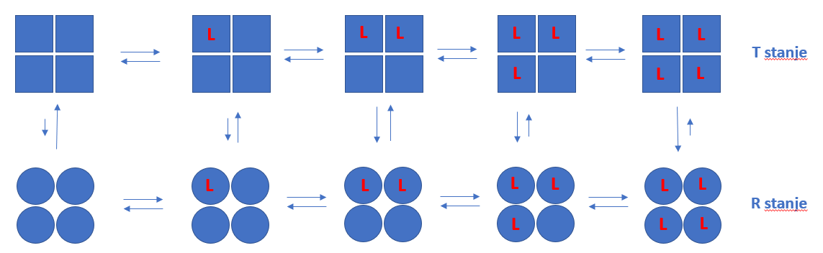
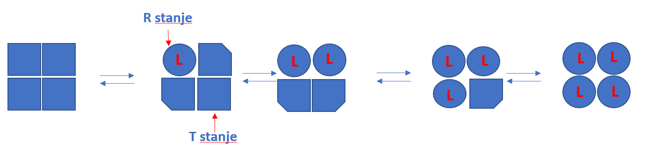
Definicija i objašnjenja alosterije
Bohrov efekt (hemoglobin)
MWC model alosterije
KNF model alosterije

Slide 3
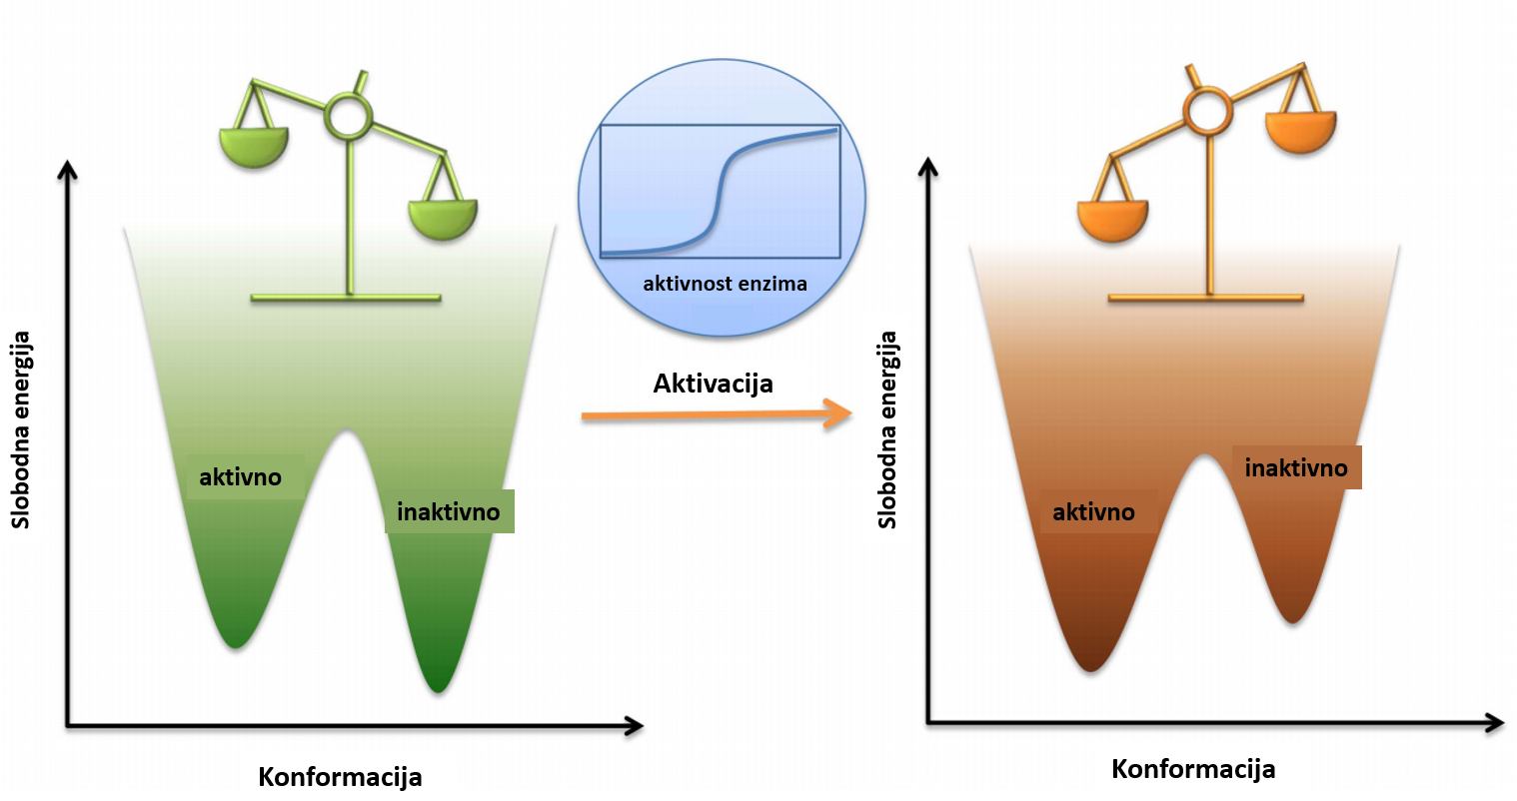
Suvremeno viđenje alosterije
Multimerni i monomerni proteini
Sa i bez konformacijske promjene
Pomak populacije konformacijskih ensembla
Alosteričke mreže

Slide 4

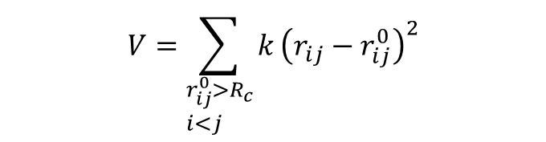
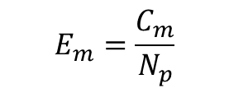

Allopred web server
Predviđanje alosteričkih džepova u protein
Razlika normalnih modova aktivnog mjesta zbog restrikcije alosteričkog džepa
$$V=\sum_{\begin{aligned}&r_{ij}^{0}>R_{c} \\ &i<j\end{aligned}}{k}{\left(r_{ij}−r_{ij}^{0}\right)}^{2}$$
$$C_{m}=\sum_{i=1}^{m}{\frac{ν_{i}}{ω_{i}}}$$
$$ν_{i}=\frac{1}{N_{a}}\sum_{j=1}^{N_{a}}{\left|p_{j}−u_{j}\right|}$$
$$E_{m}=\frac{C_{m}}{N_{p}}$$

Slide 5
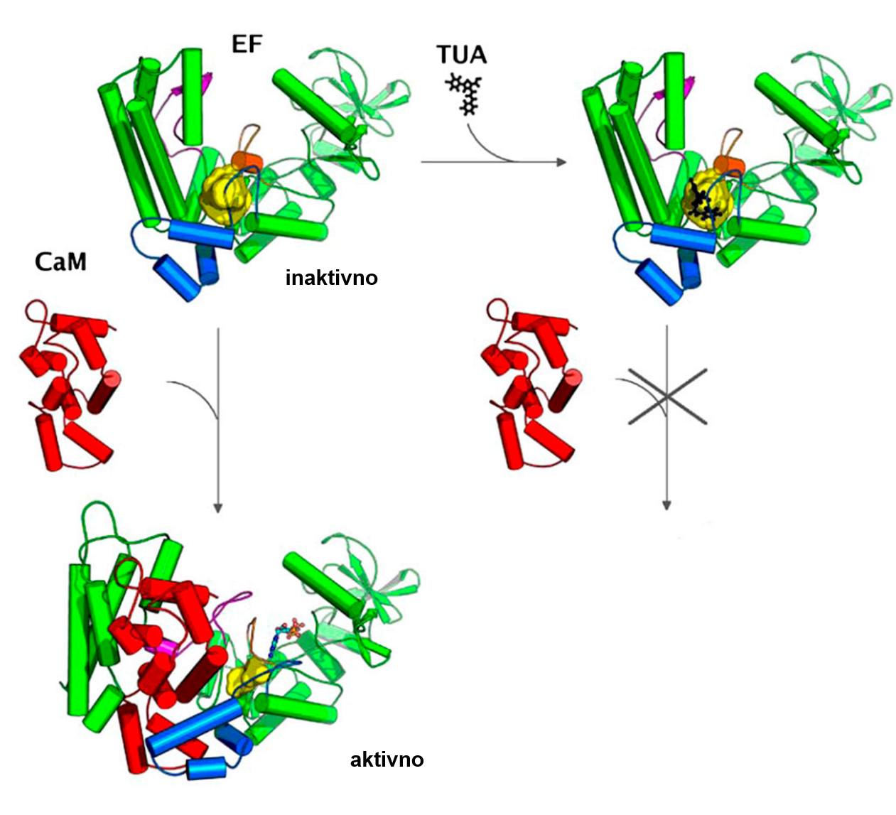
Usmjerene simulacija molekulske dinamike
DAH7PS protein iz B. anthracis
Vanjska sila ubrzava promjenu konformaciji
Identificiran in vitro aktivan modulator

Slide 6
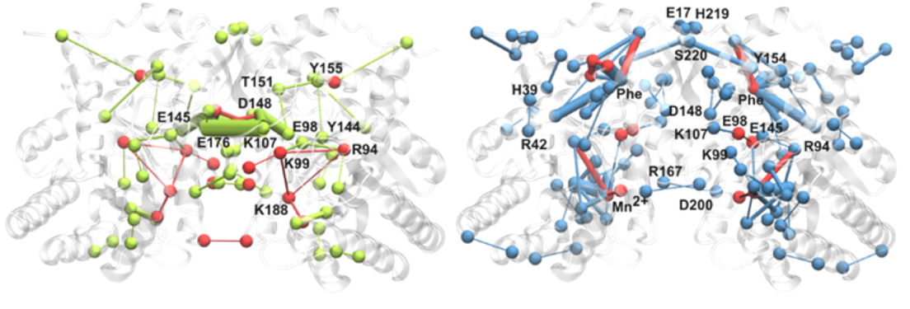
Promjene pK_{a} pomažu identifikaciji alosteričkih mreža
Razlike u prosječnim vrijednostim i fluktuacijama pK_{a} ukazuju na promjenu interakcija uslijed vezanja fenilalanina
Interakcija E176 eksperimentalno potvrđena kao važna za alosterički odgovor

Slide 7
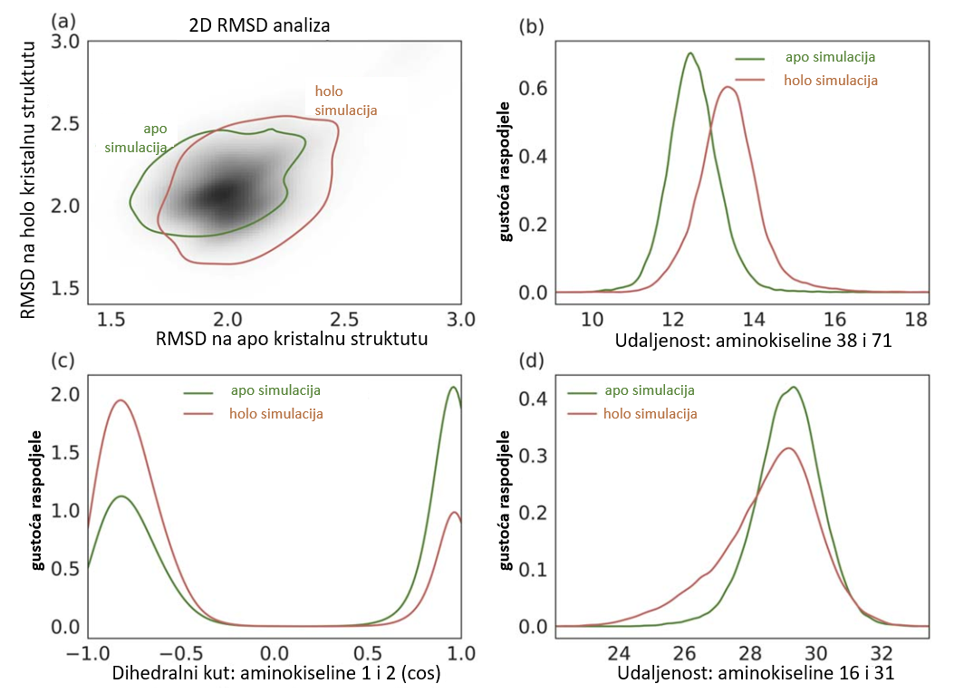
Metode strojnog učenja u istraživanju alosterije
Kod PDZ2 domene ne vidi se razlika između kristalnih struktura apo-proteina i kompleksa s peptidome
Udaljenosti parova atoma iz MD simulacija korištene kao značajke za treniranje modela strojnog učenja

Slide 8
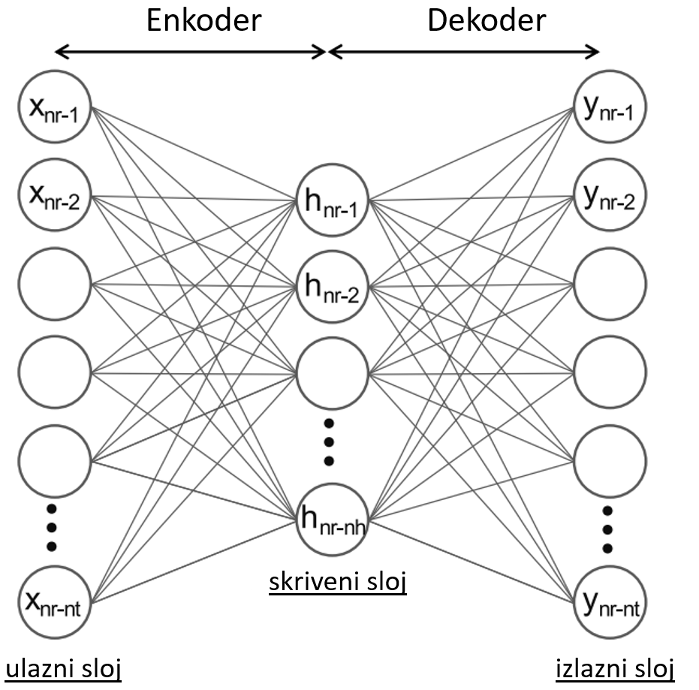
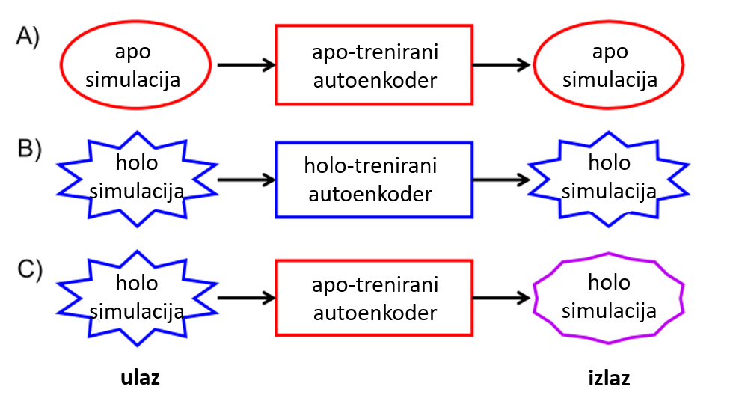
Metode strojnog učenja u istraživanju alosterije
Drugi pristup – enkoder-dekoder neuralna mreža

Slide 9
Literatura
1. Greener, J. G. & Sternberg, M. J. Structure-based prediction of protein allostery. Curr. Opin. Struct. Biol. 50, 1–8 (2018).
2. Selzentry (maraviroc) dosing, indications, interactions, adverse effects, and more. https://reference.medscape.com/drug/selzentry-maraviroc-342638.
3. Sensipar (cinacalcet) dosing, indications, interactions, adverse effects, and more. https://reference.medscape.com/drug/sensipar-cinacalcet-342879.
4. Amaro, R. E. Toward Understanding “the Ways” of Allosteric Drugs. ACS Cent. Sci. 3, 925–926 (2017).
5. Hertig, S., Latorraca, N. R. & Dror, R. O. Revealing Atomic-Level Mechanisms of Protein Allostery with Molecular Dynamics Simulations. PLOS Comput. Biol. 12, e1004746 (2016).
6. Liu, J. & Nussinov, R. Allostery: An Overview of Its History, Concepts, Methods, and Applications. PLOS Comput. Biol. 12, e1004966 (2016).
7. Ribeiro, A. A. S. T. & Ortiz, V. A Chemical Perspective on Allostery. Chem. Rev. 116, 6488–6502 (2016).
8. Tsai, C.-J. & Nussinov, R. A Unified View of “How Allostery Works”. PLOS Comput. Biol. 10, e1003394 (2014).
9. Laine, E. et al. Use of allostery to identify inhibitors of calmodulin-induced activation of Bacillus anthracis edema factor. Proc. Natl. Acad. Sci. 107, 11277–11282 (2010).
10. Skjaerven, L., Hollup, S. M. & Reuter, N. Normal mode analysis for proteins. J. Mol. Struct. THEOCHEM 898, 42–48 (2009).
11. Huang, W. et al. ASBench: benchmarking sets for allosteric discovery. Bioinforma. Oxf. Engl. 31, 2598–2600 (2015).
12. Le Guilloux, V., Schmidtke, P. & Tuffery, P. Fpocket: An open source platform for ligand pocket detection. BMC Bioinformatics 10, 168 (2009).
13. Joachims, T. Making large-Scale SVM Learning Practical. in Advances in Kernel Methods - Support Vector Learning (eds. Schölkopf, B., Burges, C. & Smola, A.) 169–184 (MIT Press, 1999).
14. Greener, J. G. & Sternberg, M. J. E. AlloPred: prediction of allosteric pockets on proteins using normal mode perturbation analysis. BMC Bioinformatics 16, 335 (2015).
15. Abagyan, R. & Kufareva, I. The flexible pocketome engine for structural chemogenomics. Methods Mol. Biol. Clifton NJ 575, 249–279 (2009).
16. Olsson, M. H. M., Søndergaard, C. R., Rostkowski, M. & Jensen, J. H. PROPKA3: Consistent Treatment of Internal and Surface Residues in Empirical pKa Predictions. J. Chem. Theory Comput. 7, 525–537 (2011).
17. Lang, E. J. M., Heyes, L. C., Jameson, G. B. & Parker, E. J. Calculated p K a Variations Expose Dynamic Allosteric Communication Networks. J. Am. Chem. Soc. 138, 2036–2045 (2016).
18. Zhou, H., Dong, Z. & Tao, P. Recognition of protein allosteric states and residues: Machine learning approaches. J. Comput. Chem. 39, 1481–1490 (2018).
19. Tsuchiya, Y., Taneishi, K. & Yonezawa, Y. Autoencoder-Based Detection of Dynamic Allostery Triggered by Ligand Binding Based on Molecular Dynamics. J. Chem. Inf. Model. 59, 4043–4051 (2019).

