Slide 1
Mehanizmi prometa u imunološkom sustavu

Slide 2
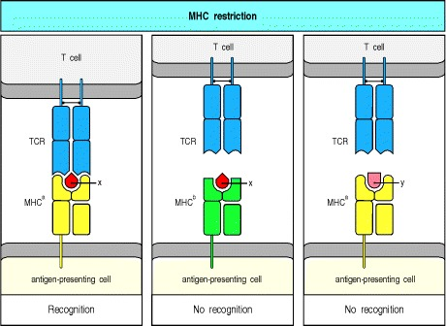
Glavni sustav histokompatibilnosti (MHC) čine molekule na membrani stanica koje omogućuju limfocitima T prepoznavanje antigena
Limfociti prepoznaju antigen “uklopljen” u specifične domaćinove proteine
prepoznavanje antigena omogućava obrambenu reakciju
-visoko polimorfni sustav; klasteri gena
Notes:
T-cell recognition of antigens is MHC restricted
The antigen-specific T-cell receptor (TCR) recognizes a complex of antigenic peptide and MHC. One consequence of this is that a T cell specific for peptide x and a particular MHC allele, MHCª (left panel), will not recognize the complex of peptide x with a different MHC allele, MHC^{b} (center panel), or the complex of peptide y with MHCª (right panel). The co-recognition of peptide and MHC molecule is known as MHC restriction because the MHC molecule is said to restrict the ability of the T cell to recognize antigen. This restriction may either result from direct contact between MHC molecule and T-cell receptor or be an indirect effect of MHC polymorphism on the peptides that bind or on their bound conformation.

Slide 3
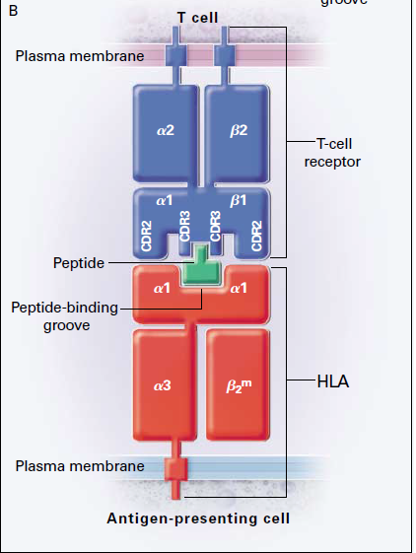
Limfociti T prepoznaju antigen kojeg im moraju prezentirati makrofagi:
strani pepetid “uklopljen” u specifične domaćinove proteine,
tzv. sustav MHC I i II
MHC

Slide 4
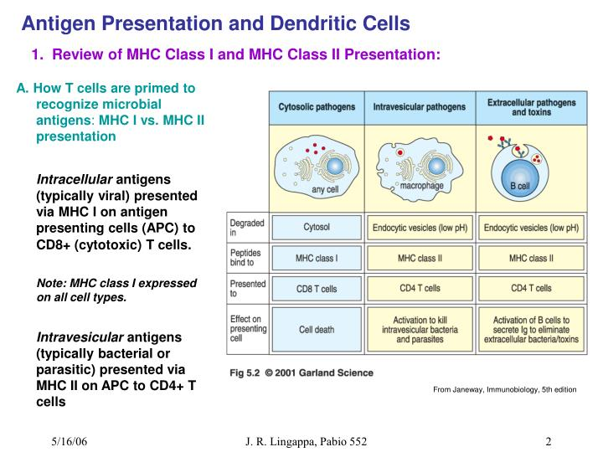
citotoksični
regulacijski i pomoćnički
Različiti limfociti T, ovisno o svojoj ulozi, prepoznaju antigene stranih patogena koji mogu biti ekstracelularni ili intracelularni u sklopu sustava histokompatibilnosti MHC I ili II

Slide 5
Postoje dva tipa molekula MHC, MHC klase I i II.
Slične su strukture: dvije vanjske ekstracelularne domene čine utor u koji se “umeće” peptidni fragment tijekom sinteze
Molekula MHC nastaje u stanici, a zatim se takva molekula s “teretom” peptida prenosi na staničnu površinu gdje prezentira peptid limfocitima T
Receptori antigena limfocita T specifično prepoznaju strani antigeni peptid vezan za molekulu MHC i stanice koje ga prepoznaju mogu na njega odgovoriti.
Osnovna razlika molekula MHC je u izvoru peptida kojeg vežu i prezentiraju. MHC I skupljaju peptide nastale u citosolu, npr. virusne proteine.
MHC II vežu peptide nastale od proteina u intracelularnim vezikulama: patogena koji žive u makrofaginim vezikulama ili su internalizirani putem fagocitičkih stanica ili limfocita B
Kad dođu na površinu, dvije klase MHC prepoznaju različiti T limfociti. MHC I s virusnim peptidima prepoznaju citotoksični limfociti T CD8 koji ubijaju inficiranu stanicu

Slide 6
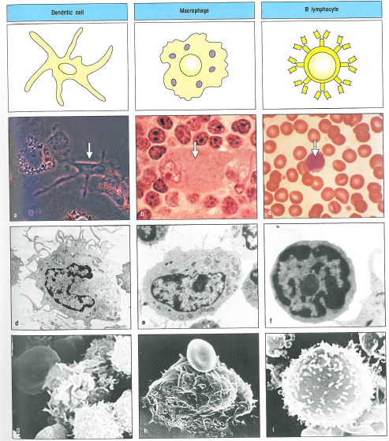
Stanice koje prezentiraju antigene
dendritičke stanice, makrofagi, B limfociti

Slide 7
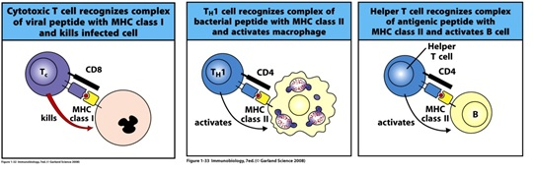
Odgovor na prepoznavanje antigena uklopljenog u MHC
citotoksični T limfocit ubije stanicu
pomoćnički T limfocit aktivira makrofag
pomoćnički T limfocit aktivira B limfocit

Slide 8
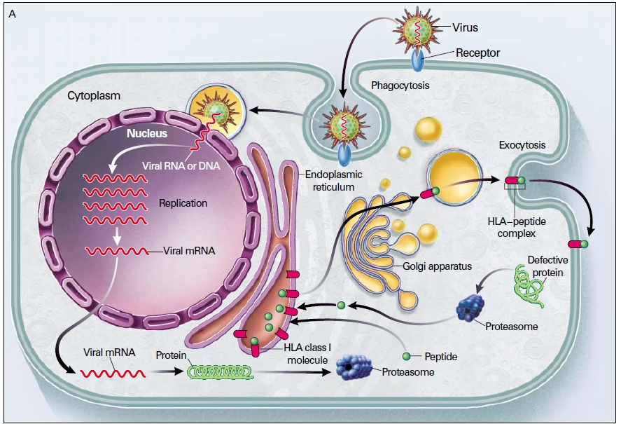
Procesiranje antigena pomoću sustava MHC I
Kralježnjaci koriste strane proteine degradirane u proteasomu da obilježe inficirane stanice za uništenje. Kod neinficirane stanice postoje vlastiti tzv. transporteri udruženi s procesiranjem antigena, TAP1 i TAP2 . Oni čine kanal za transport peptida kroz membranu ER. Peptidi oslobođeni u proteasomu vežu se za citosolnu površinu molekule TAP i prenose se u lumen. Tu ih preuzimaju dvije molekule MHC I, alfa lanac i beta 2 mikroglobulin. U ER se uz pomoć niza šaperona sprječava njihovo prerano slaganje te omogućava “preuzimanje” peptida.
Notes:
Procesiranje antigena
Istrošeni ili defektni proteini u citosolu se degradiraju u peptide u proteasomima. Izabrani se peptidi prenose u ER, gdje se “natovare” na novosintetiziranu MHC I molekulu. HLA-peptidini kompleks e eksportita van kroz Golgi na površinu.. U tkivima s virusom, čestice se odmataju u stanici i DNA/RNA replicira. U citosolu se proizvode proteini., od kojih se neki razgrade u proteasomu i istim putem izlože na površitni stanice.
fragmenti od 9 aminokiselina

Slide 9
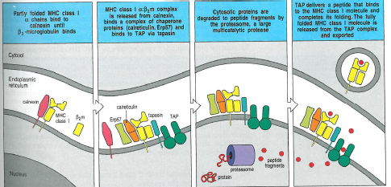
Peptidi virusnih proteina nastalih degradacijom u proteasomu unose se u ER pomoću transportera TAP i vežu za MHC I te prenose na površinu stanice da se prezentiraju limfocitima T

Slide 10
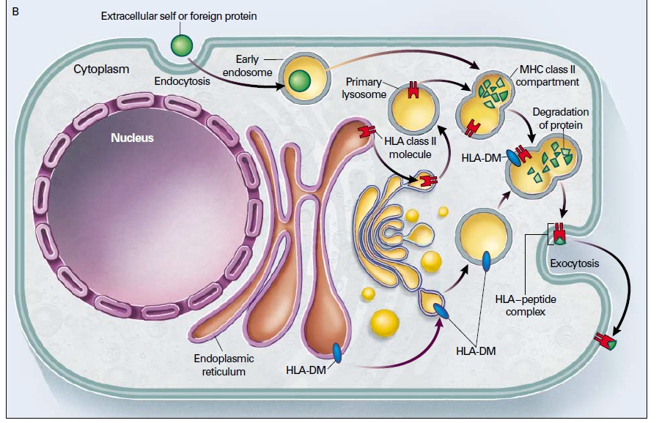
Procesiranje antigena ekstracelularnog proteina
MHC II se pojedinačno proizvode i na luminalnoj strani ER se udružuju zajedno i slažu pomoću šaperona. Udružuju se s proteinom proizvedenim u ER, nepromijenljivim, koji služi kao kalup za njihov žljeb i sprječava prerano vezanje peptida. U vezikuli se spajaju s endosomom s egzogenim proteinom koji se degradira. Specifične molekule, HLA DM uklanjaju proteinski kalup da bi egzogeni peptid sjeo u žljeb.
-procesi u makrofagima, limfocitima B i dendritičnim stanicama jer mogu fagocitirati
-moguće i druge kombinacije antigena i MHC I i II
Notes:
Vlasititi ili strani proteini ulaze u stanicu endocitozom ili fagocitozom i nalaze se u endosomima. MHC II se sintentizira u ER i prenosi preko GA do primarnih lizosoma koji se fuzioniraju s ranim endosomima te čine MHC II kompartiment. Enzimi u tim vezikulama degradiraju proteine u pepeide HLA DM molekule, sintetizirane u ER pomažu u spajanju peptida i MHC II. Tada se prenosi kompleks na površinu stanice
Dok je prvi proces stalno prisutan zbog raznih potrošenih proteina, drugi proces se događa samo u limfocitima B, makrofagima i dendritičnim stanicama jer one vrše fagocitozu i endocitozu.
Postoje i križne reakcije MHC I s vanjskim antigenim i MHC II s unutarnjuim

Slide 11
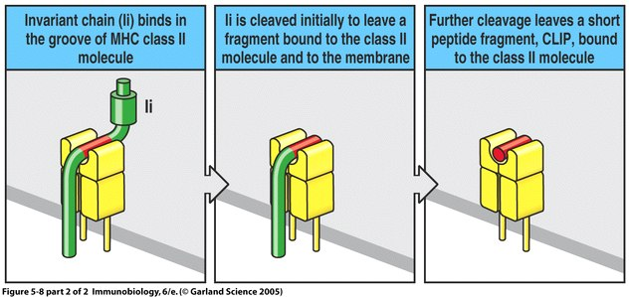
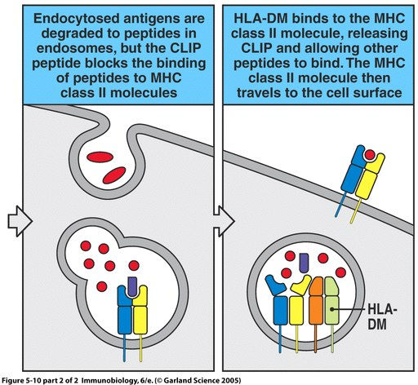
Mehanizmi nastanka kompleksa
MHC II/ekstracelularni peptid

Slide 12
MHC II limfocite T s peptidima patogena iz vezikula prepoznaju pomoćnički limfociti CD4 Th1 i Th2.
Prepoznavanje specifičnog antigena kod efektornih limfocita T pomažu koreceptori koji razlikuju dvije grupe MHC: citotoksični limfociti imaju CD8 koji veže MHC I, a koreceptor CD4 pomaže u prepoznavanju MHC II. Specifičnost je određena već prije susreta s antigenom, diferencijacijom u CD8 ili CD4 limfocite.
Prepozavajući svoje mete, tri su tipa limfocita T stimulirana da oslobađaju drugačiji set efektornih molekula, citokina.
raznolikost MHC sustava nastaje kroz polimorfnost i poligenost

Slide 13
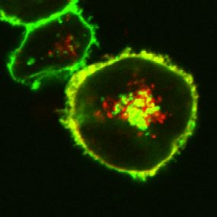
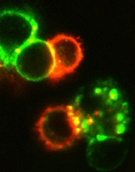
Not surprisingly, this same low molecular weight form of PSA was also found by co-immunoprecipitation experiments to be associated with MHCII proteins on the cell surface (Cobb et al., 2004). Once there, it is recognized by ab T cell receptors on CD4+ T cells. This has been demonstrated with confocal microscopy, where red antigen presenting cells are engaged by green T cells to form the classical immune synapse (yellow)
PSA = red, MHCII = green
PSA - antigen
Our confocal data (Cobb et al., 2004) shows that PSA co-localizes with the lysosomal markers as well as MHCII proteins, demonstrating the fusion of endosomes with lysosomes and exocytic vesicles from the Golgi apparatus carrying the MHCII machinery:
Dr. Cobb was awarded a New Innovator Award from the NIH in 2008

Slide 14
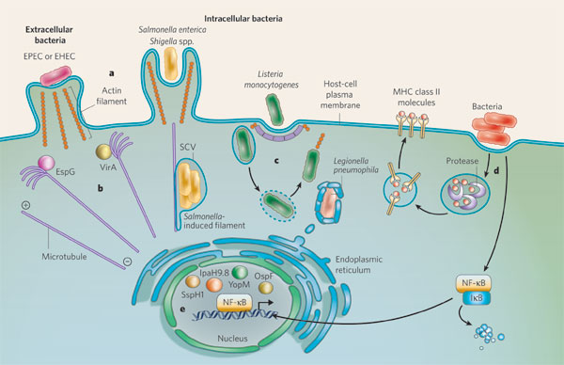
Putevi ekstra i intracelularnih patogena:
-ulaz u stanicu (receptori – trigger, fagocitoza, citoskelet – „zipper”)
-opstanak u ER/vakuolama
-razmnožavanje (citosol)
-izlazak iz stanice
Notes:
Both extracellular bacterial pathogens and intracellular bacterial pathogens initially interact with the plasma membrane of host cells. These pathogens commandeer various common structures and pathways. a, Extracellular pathogens (for example, EPEC and EHEC) routinely manipulate the actin cytoskeleton to generate actin-rich pedestal structures. By contrast, the invasive intracellular pathogens Salmonella enterica and Shigella spp. use this cytoskeletal component to invade the host cell. Another invasive intracellular pathogen, Listeria monocytogenes, uses clathrin-mediated endocytosis for invasion. b, During some bacterial infections, microtubules, another component of the cytoskeleton, are disassembled through the actions of particular effector proteins. Such proteins present during EPEC infection (EspG) and Shigella flexneri infection (VirA) disassemble microtubules in the vicinity of bacterial contact. c, After invasive bacteria have entered the host cell, they occupy a vacuole. The vacuole can offer protection against immune detection and can be a replicative niche (in the case of S. enterica). Alternatively, the bacteria can escape the vacuole and gain the ability to propel themselves through the cytosol (in the case of L. monocytogenes and S. flexneri). Organellar components can also be acquired: for example, Legionella pneumophila, which is usually internalized by phagocytosis, interacts with endoplasmic-reticulum-derived vesicles. d, Bacterial pathogens also have other effector-protein-based mechanisms for evading both the innate immune response and the adaptive immune response. Examples include subverting the presentation of bacterial antigen at the cell surface (adaptive) and interfering with the translocation of the pro-inflammatory transcriptional activator NF-B to the cell nucleus (innate). e, The nucleus is also the destination of several T3SS effectors (for example, S. enterica SspH1, Yersinia spp. YopM and S. flexneri OspF and IpaH9.8), and the effects of this are beginning to come to light.

Slide 15
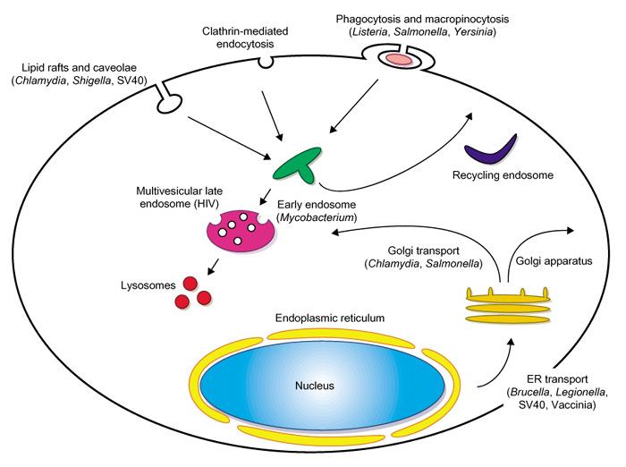
Ulaz patogena u stanicu
Nature Cell Biology 5, 16 - 19 (2003)
Notes:
Depicted are three routes of internalization occurring at the plasma membrane of mammalian cells; phagocytosis, clathrin-mediated endocytosis and non-clathrin-mediated uptake occurring at lipid rafts. Endocytosed material is sorted through sequential interactions with endocytic organelles (early endosome, recycling endosome, multivesicular late endosome and lysosome). Proteins and membrane transported through the secretory organelles (endoplasmic reticulum and Golgi apparatus) are delivered to the plasma membrane and endocytic organelles. Pathogens have specific mechanisms through which they can intercept or interfere with these cellular processes. In parenthesis are pathogens discussed in this report that have the ability to target the indicated cellular event.

Slide 16
Endosomi su centralna stanica vakuolarnog aparata, križanje između ponovne upotrebe membranskih komponenti putem recikliranja i degracije molekula koje se usmjeravaju na lizosome. Zato su bitni kod unosa nutrijenata, signalizacije, adhezije, obrta stanične membrane i obrane od patogenih agenasa
U imunom odgovoru, antigenska prezentacija uključuje endocitozu stranih antigena i njihovo procesiranje u odjeljcima za degradaciju.
Različiti bakterijski patogeni i virusi ulaze u stanicu:
neke bakterije, npr. Listeria i Shigella induciraju vlastitu internalizaciju u stanicu domaćina, ali pobjegnu iz endocitnog sustava u citoplazmu gdje se množe
druge, Mycobacterium ili Leishmania, nakon internalizacije, mijenjaju okoliš vakuole, da se u njima mogu razmnožavati
npr. mikobakterije zadržavaju protein TACO na fagosomu te tako preživljavaju

Slide 17
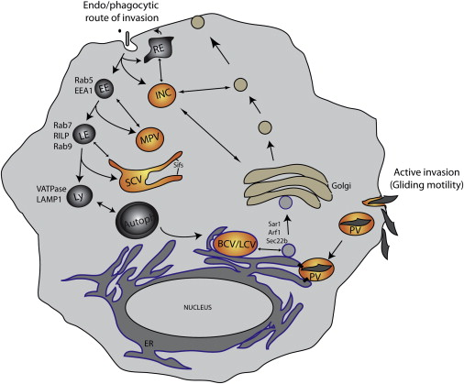
BCV: vakuole brucele
SCV: salmonele
MPV: mikobakterija
LCV: legionele
INC: inkluzije klamidije
PV: toksoplazme
EE: rani endosomi
RE: reciklirajući endosomi
LE: kasni endosomi
Ly: lizosomi
autofag: autofagosomi
Različiti tipovi vakuola koje sadrže patogene i izbjegavaju razgradnju u lizosomima
(izbacuju Rab7, lizosomske proteine, nalikuju ER…)
istovremeno koriste vezikularni promet za dobivanje nutrijenata
koriste citoskelet da se „udalje” s putova lizosoma
Notes:
Interaction of Vacuolar Niches of Intracellular Pathogens with Host Endomembrane System
Bacterial pathogens invade their hosts via the endophagocytic pathway and establish vacuolar niches that share features with one or more host organelles. These niches include the Mycobacteria pathogen vacuole (MPV), Salmonella-containing vacuole (SCV), Brucella-containing vacuole (BCV), and Legionella-containing vacuole (LCV). Others, such as the Chlamydia trachomatis inclusion (INC) and Toxoplasma parasitophorous vacuole (PV), appear devoid of any markers of endocytic traffic. While avoiding fusion with degradative compartments, these organelles retain the ability to selectively intercept host vesicular traffic for nutrient acquisition. EE, early endosomes; RE, recycling endosomes; LE, late endosomes; Ly, lysosomes; Autophag, autophagosomes.

Slide 18
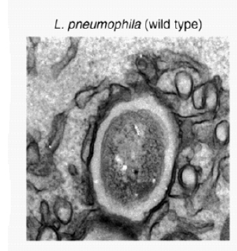
Legionella pneumophilla: intracelularni patogeni mijenjaju domaćinov sustav prometa vezikulama da bi se mogli razmnožavati u stanici
-uzročnik upale pluća – legionarske bolesti
-živi u plućnim makrofagima
-u prirodi u slatkovodnim praživotinjama
-dvije skupine proteina:
jedni su proteini virulentnosti koji omogućavaju injiciranje proteina u domaćina kojim mijenjaju promet – transporteri nalik onima kod nekih plazmida (prije ulaska)
drugi mijenjaju sazrijevanje fagocitne-endocitne vezikule te se ona ne sazrijeva u kasni fagosom i lizosom nego se združuje s ER membranom; nastaje organel okružen ribosomima
interferira s Rab7

Slide 19
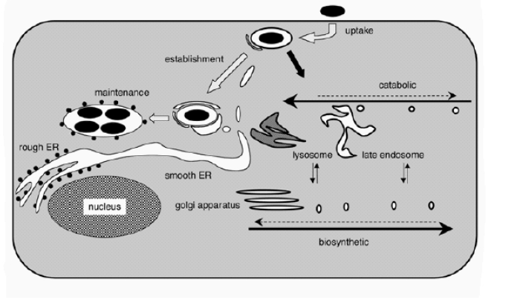
legionela:
Izbjegavanje fuzije fagosoma i lizosoma i nastanak replikativnog organela bogatog nutrijentima odvojenog od endocitičkog puta
Notes:
Evasion of Phagosome Lysosome Fusion and Establishment of a Replicative Organelle by the Intracellular Pathogen Legionella pneumophila - Madame Curie Bioscie...
http://www.ncbi.nlm.nih.gov/books/NBK6111/?report=printable[31.7.2013 12:48:25]
maturation. This first stage event enables bacteria to avoid catabolic degradation by the host and gives L. pneumophila time to remodel a plasma membrane-derived vacuole into a niche capable of sustaining intracellular growth. This involves the attachment
and fusion of vesicles derived from the ER with phagosomes containing L. pneumophila. Upon completion of this second stage, L.pneumophila reside an a nutrient-rich organelle that is isolated from the endocytic pathway.

Slide 20
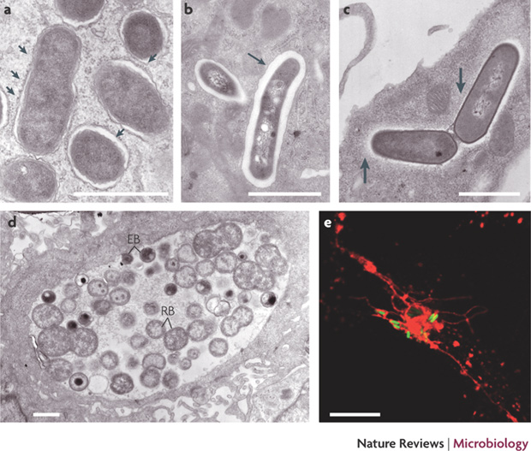
Niše preživljavanja patogenih bakterija
a: brucela:
vakuole okružene ribosomima, fuzija vakuole s membranom ER, nema fuzije s lizosomima
b: mikobakterija u nezrelom fagosomu
c: listerija u citosolu okružena mrežom aktina
d: klamidija u inkluzijama (EB i RB)
e: salmonela (zelena) u vakuolama (crveno)
Notes:
a | Brucella spp. is an intracellular pathogen that can persist for long periods of time in the host and establish a chronic disease. Once internalized, Brucella spp. are localized in a Brucella-containing vacuole that transiently interacts with early endosomes. However, Brucella-containing vacuoles do not fuse with lysosomes and instead fuse with membrane from the endoplasmic reticulun (ER) to establish a vacuole suited for replication. The micrograph shows infection of bone marrow-derived mouse macrophages with Brucella abortus at 30 hours post infection. Each vacuole contains a single bacterium. The vacuolar membrane is studded with ribosomes (indicated by arrowheads). b | Bone marrow-derived mouse macrophages infected with Mycobacterium avium at 1 day post infection. The bacterium resides in an immature phagosome. The phagosome membrane (indicated by the arrow) is closely apposed to the bacterial surface. c | Bone marrow-derived mouse macrophages infected with Listeria monocytogenes at 4 hours post infection. This micrograph shows a dividing bacterium free in the cytosol. A network of actin filaments surrounds the bacterium (indicated by arrows). d | Bone marrow-derived mouse macrophages infected with Chlamydia pneumoniae at 30 hours post infection. The inclusion contains many bacteria. Both the EB (elementary bodies) and RB (reticulate bodies) forms can be found, in the same inclusion. e | Salmonella spp. reside in a vacuole. In HeLa cells up to 10 hours post invasion, wild-type Salmonella spp. use type III secretion system effectors to induce the formation of tubular membranous extensions from the vacuole, which are named Salmonella-induced filaments. The immunofluorescence image shows Salmonella (green) and characteristic Salmonella-induced, filaments extending from the vacuole, visualized using lysosomal-associated membrane protein 1 (red). Scale bar in electron microscopy images is 10μM; scale bar in immunofluorescence image is 1μM. Images courtesy of Chantal de Chastellier and Stéphane Méresse, Centre d'Immunologie de Marseille-Luminy, Paris, France.
Bacterial manipulation of innate immunity to promote infection
Lautaro Diacovich & Jean-Pierre Gorvel
Nature Reviews Microbiology 8, 117-128 (February 2010)

Slide 21
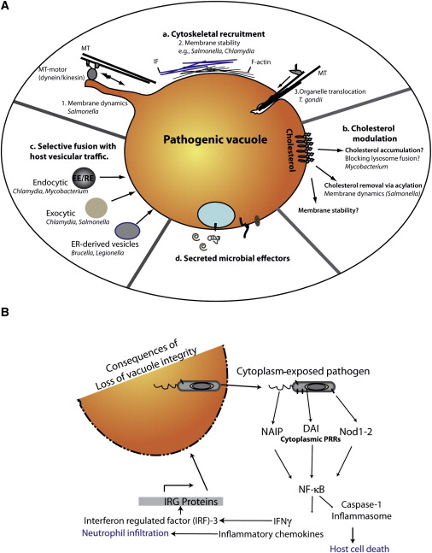
-promjene vakuola:
-mijenjaju domaćinov put prometa vezikulama
-mijenjaju metabolizam
-mijenjaju citoskelet
-luče specifične mikrobne efektore
-izlazak u citoplazmu:
bolji uvjeti razmnožavanja ali i domaćinov obrambeni sustav
-inflamasomi – stanična smrt
Cell and microbe
Volume 5, Issue 6, 18 June 2009, Pages 593–60
Notes:
Integrity of Pathogenic Vacuoles Is Essential for Avoidance of Host Immune Surveillance
(A) Pathogens such as Chlamydia and Salmonella modulate interactions with host cytoskeleton and cytoskeletal motors (a), which may directly influence structural stability as well as membrane dynamics of their vacuoles. In T. gondii, interactions with host microtubules (MTs) mediate acquisition of host membranes via organelle scavenging. Interception of host membrane traffic is also mediated by differential interactions with host fusion machinery (b). Modulation of vacuolar membrane lipids, especially cholesterol (c), may further influence vacuolar stability. Pathogens likely regulate the unique properties and interactions of their vacuoles via secretion of effector proteins (d).
(B) Maintenance of vacuolar integrity is essential to avoid cytoplasmic immune defense pathways that include detection of microbial ligands by pathogen recognition receptors (PRRs). Such recognition is followed by activation of diverse pathways that can trigger not only host cell death and adaptive immune responses, but also direct disruption of pathogenic vacuoles by IRG proteins.

Slide 22
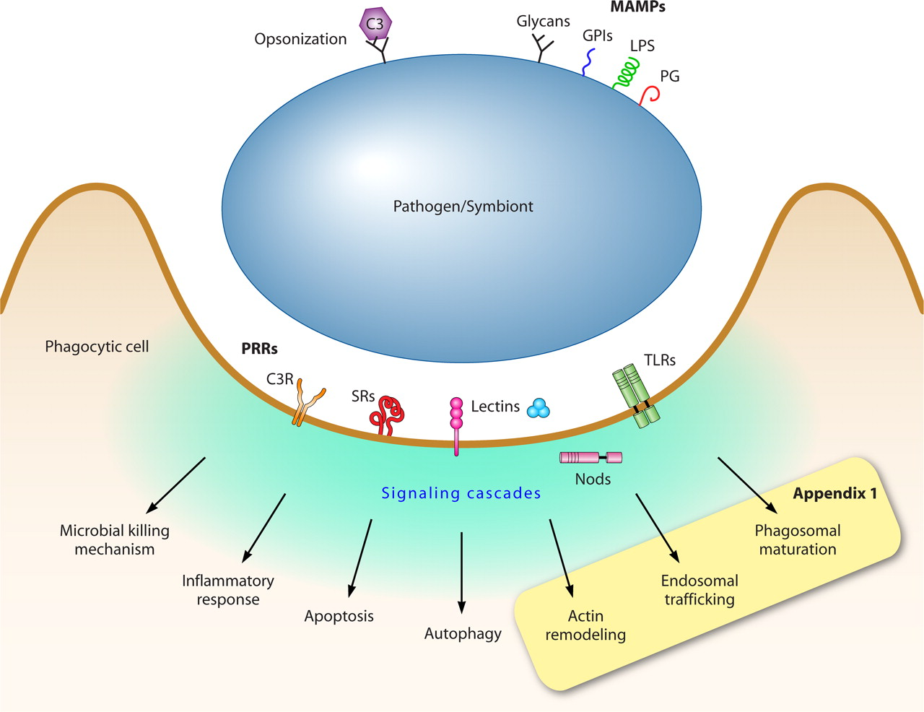
TLR: toll like receptor
NLR: Nod like receptor
Receptori TLR na vanjskoj membrani, ER
NLR u stanici
Prepoznaju bakterijske motive (PAMP)
i pokreću odgovarajuće signalne puteve
Stanični odgovor na patogene
Notes:
Da izbjegne fuziju vakuole s lizosomom, patogen može pobjeći iz nje. Međutim, postoje receptori NLR – Nod like receptors i RLR Rig like receptors u citoplazmi koji prepoznaju uzorke PAMP (pathogen associated molecular pattern) i induciraju proizvodnju proinflamatornih citokina i kemokina. Ove molekule utječu na adaptivni imuni odgovor i okidaju smrt stanice domaćina putem aktivacije inflamasoma. Dodatno, antimikrobni odgovor uključuje formiranje autofagosoma na površini bakterije izložene citoplazmi i njenu fuziju s lizosomom.
Neke bakterije, Listeria i Shigella, koriste pokretanje na osnovi aktina i suprimiraju autofagiju.
-prepoznavanje dlRNA

Slide 23
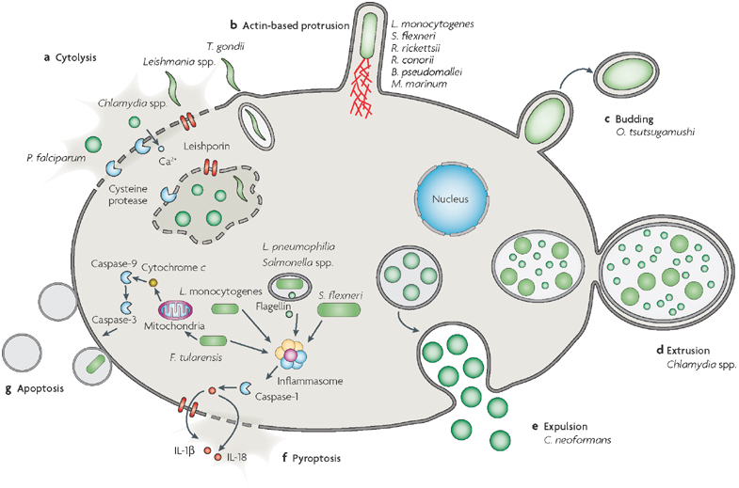
Putevi izlaska patogena iz stanice: citoliza, protruzije, pupanje,
Izbacivanje, apoptoza
Notes:
| The cytolysis, and destructive and sequential rupture, of the vacuole and cell membranes. Putative mechanisms include proteases (Plasmodium falciparum and Chlamydia spp.), pore-forming proteins (PFPs) (Leishmania spp.) and the unique mechanism of Toxoplasma gondii. b | Actin-based protrusion, which is exploited by Listeria monocytogenes, Shigella flexneri, Rickettsia rickettsii, Rickettsia conorii, Burkholderia pseudomallei and Mycobacterium marinum, results in a single bacterium that uses the force that is generated by actin polymerization to protrude from the cell membrane and force engulfment into a neighbouring cell. c | The budding of Orientia tsutsugamushi, in which a single bacterium is encased by plasma membrane. d | The extrusion of Chlamydia spp., in which the large Chlamydia-containing vacuole pinches off and extrudes out of the cell; the extruded vacuole is encased by cytosol and plasma membrane. e | The phagosomal expulsion of Cryptococcus neoformans, in which the large vacuole fuses with the plasma membrane by an undefined exocytic process. f | Proinflammatory pyroptosis is defined by the sensing of bacterial molecules (flagellin of Legionella pneumophila and Salmonella spp. and unknown molecules of S. flexneri, L. monocytogenes and Francisella tularensis) through the host inflammasome. The inflammasome proteolytically activates caspase-1, which leads to interleukin (IL)-1 and IL-18 activation and secretion. Cytokine secretion occurs initially through a caspase-1-dependent pore, and is then released upon necrotic cell lysis. g | Apoptosis is induced by F. tularensis using the intrinsic pathway of activation — cytochrome c release from mitochondria and activation of the initiator caspase-9 and the effector caspase-3. The bacterial molecule (or molecules) that is responsible for apoptotic induction is unknown.

Slide 24
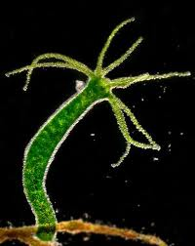
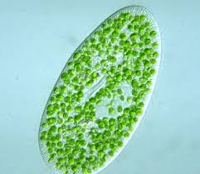
Paramecium + Chlorella
Hydra viridissima
Simbioza: simbiontske alge izbjegavaju razgradnju u lizosomima

Slide 25
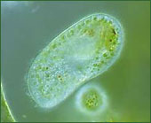
Paramecium bursaria – papučica “pojede” zelene alge
koje u njoj nastave živjeti i fotosintetizirati – primjer sekundarne endosimbioze
Chlorella je smještena u perialgalnu vakuolnu membranu koja nastaje od domaćinove digestivne membrane (prije stapanja s lizosomom), pričvršćenu za površinski dio domaćinove stanice
http://www.morning-earth.org/Graphic-E/SymbiosisCrossKingProtists.html
Notes:
Each symbiotic Chlorella species of Paramecium bursaria is enclosed in a perialgal vacuole (PV) membrane derived from the host digestive vacuole (DV) membrane. Algae-free paramecia and symbiotic algae are capable of growing independently and paramecia can be reinfected experimentally by mixing them. This phenomenon provides an excellent model for studying cell-to-cell interaction and the evolution of eukaryotic cells through secondary endosymbiosis between different protists. However, the detailed algal infection process remains unclear. Using pulse labeling of the algae-free paramecia with the isolated symbiotic algae and chase method, we found four necessary cytological events for establishing endosymbiosis. (1) At about 3 min after mixing, some algae show resistance to the host lysosomal enzymes in the DVs, even if the digested ones are present. (2) At about 30 min after mixing, the alga starts to escape from the DVs as the result of the budding of the DV membrane into the cytoplasm. (3) Within 15 min after the escape, the DV membrane enclosing a single green alga differentiates to the PV membrane, which provides protection from lysosomal fusion. (4) The alga localizes at the primary lysosome-less host cell surface by affinity of the PV to unknown structures of the host. At about 24 h after mixing, the alga multiplies by cell division and establishes endosymbiosis. Infection experiments with infection-capable and infection-incapable algae indicate that the infectivity of algae is based on their ability to localize beneath the host surface after escaping from the DVs. This algal infection process differs from known infection processes of other symbiotic or parasitic organisms to their hosts.

Slide 26
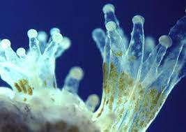
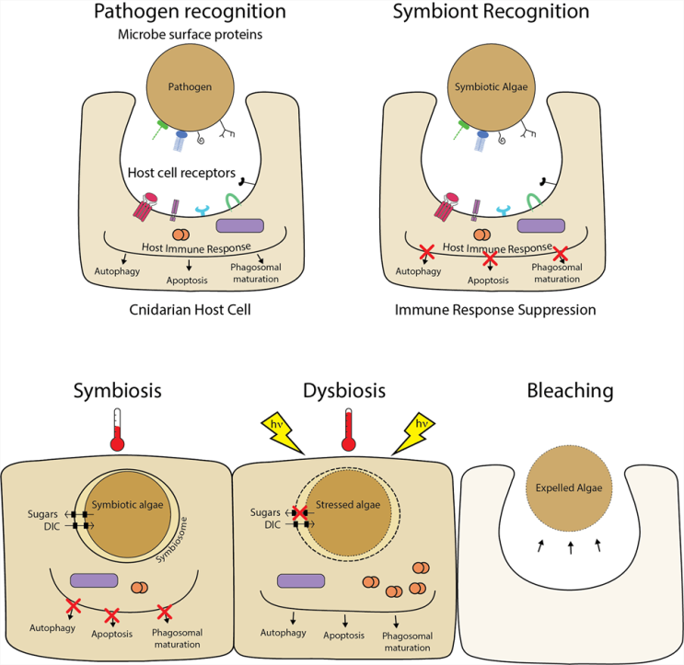
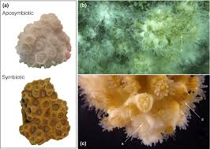
Simbioza algi i koralja
- stres „izbjeljuje” koralje koji gube simbiontske alge
https://aiptasia-resource.org/model-systems-corals/

