Slide 1
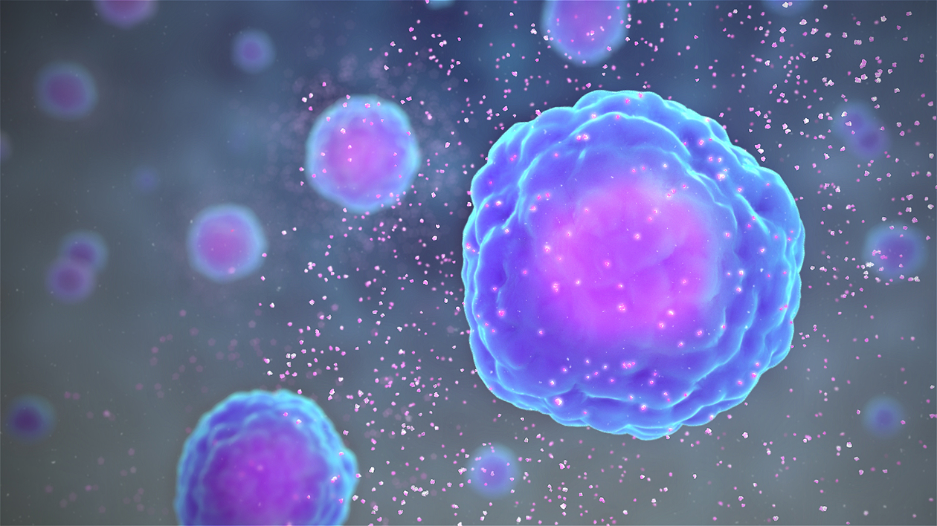
Citokini

Slide 2
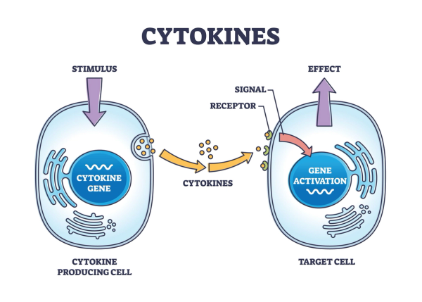
male molekule od oko 30 kDa
djeluju na receptor na ciljnoj stanici
uloga u imunosnom sustavu, imunom odgovoru i upali; imunosni posrednici
precizna regulacija imunosnog odgovora
amplifikacija signala

Slide 3
Tipovi citokina prema funkciji
interleukini (stanična diferencijacija, proliferacija, odgovor na patogene)
interferoni (interferencija s virusnom replikacijom)
faktor stimulacije rasta kolonija (proliferacija i diferencijacija specifičnih krvnih stanica
faktor nekroze tumora TNF (izaziva smrt stanice)
kemokini – kemoatraktanti, stanična migracija
(faktori rasta) – TGF β

Slide 4
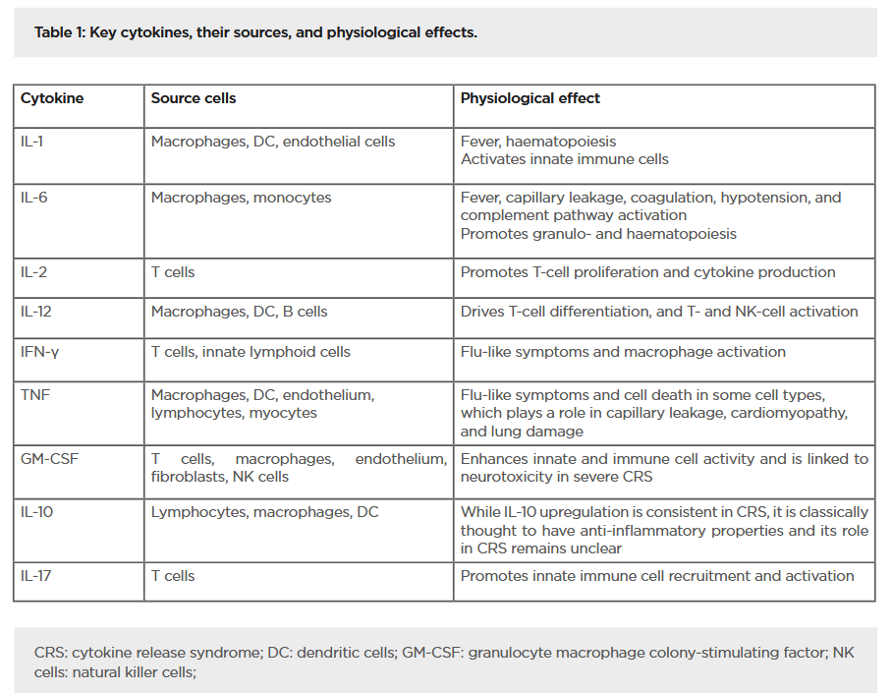

Slide 5
Biološke funkcije citokina
stimulacija razvoja staničnog i humoralnog imunog odgovora
upalni odgovor
regulacija hematopoeze
kontrola stanične proliferacije, diferencijacije i apoptoze
zarastanje rana
efekti:
stanični rast
stanična diferencijacija
stanična aktivnost
stanična smrt
McBride et al. EMJ Innov. 2020

Slide 6
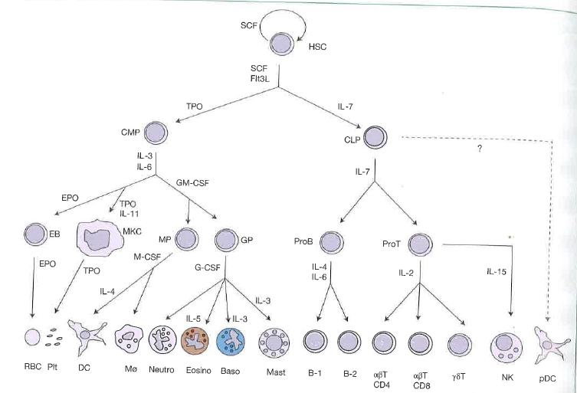
Regulacija diferencijacije hematopoetskih stanica

Slide 7
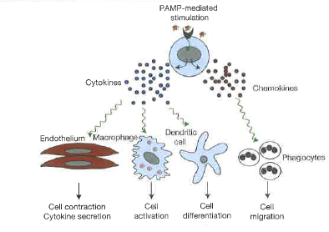
prepoznavanje patogena (makrofagi)
oslobađanje imunomodulatora
citokina i kemokina
Indukcija upalnog procesa
Delves et al. Roitt’s essential Immunology, 2017

Slide 8
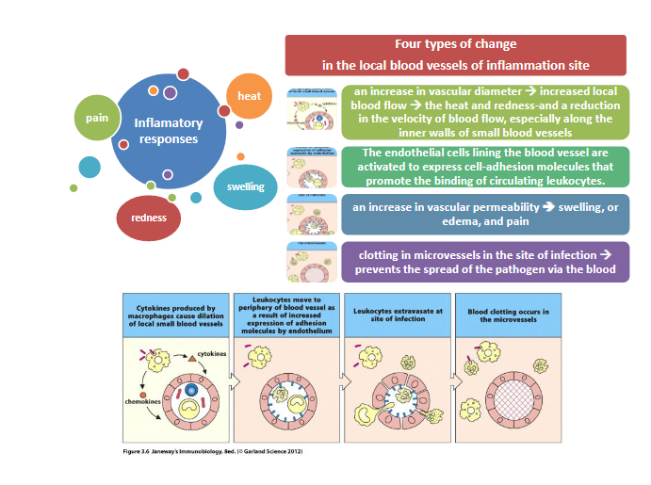
Upala
neutrofili
monociti
otok, crvenilo, toplina, bol – znaci upale – citokini su posrednici

Slide 9
PAMPs
DAMPs
INNATE IMMUNE CELLS
DECODING OF PAMP/DAMP SIGNATURE
CYTOKINE PATTERN 1
CYTOKINE PATTERN 2
CYTOKINE PATTERN 3
TYPE I ADAPTIVE RESPONSE
TYPE II ADAPTIVE RESPONSE
TYPE III ADAPTIVE RESPONSE
uzorak – kombinacija citokina koju oslobađaju stanice urođenog odgovora nosi poruku o tipu patogena i omogućuje odgovarajući odgovor

Slide 10
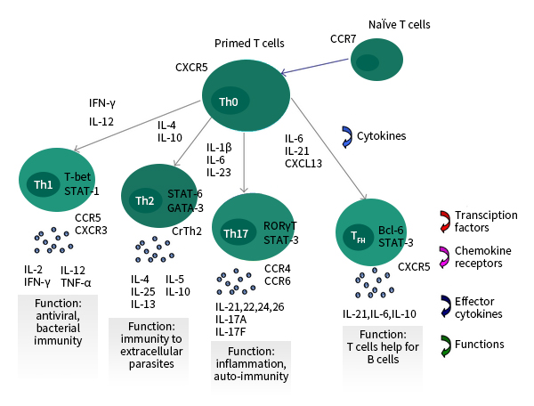
Regulacija imunog odgovora
Sino Biological

Slide 11
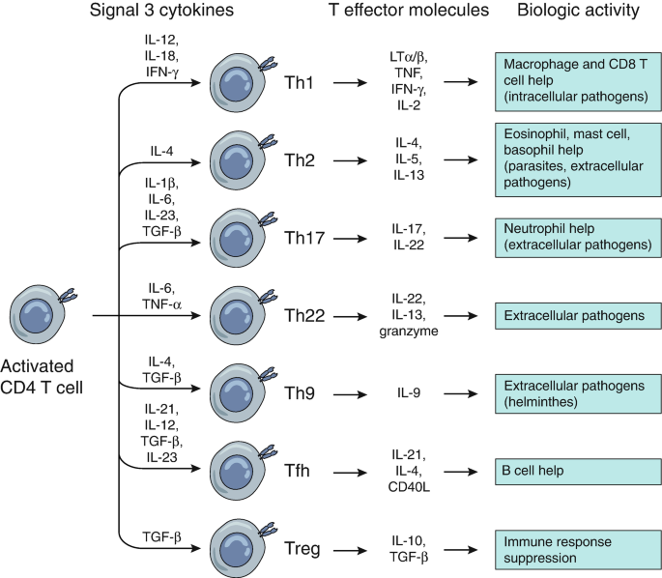
Odgovor T limfocita daljnjim lučenjem citokina kod adaptivnog odgovora, ovisno o tipu patogena i tipu stanice
https://link.springer.com/chapter/10.1007/978-3-030-25553-4_5
Notes:
ILC1, ILC2, ILC3, NK

Slide 12
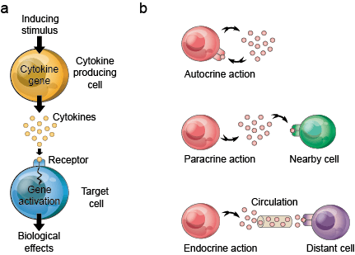
Načini djelovanja citokina
https://clinref.com/blood/cytokine/

Slide 13
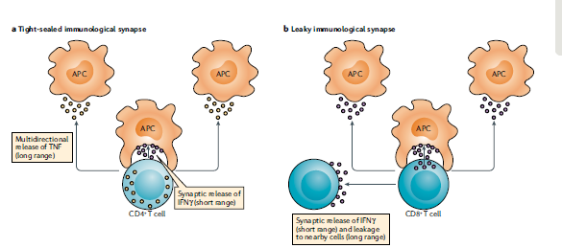
„Imunološka sinapsa” – ciljno djelovanje na stanice

Slide 14
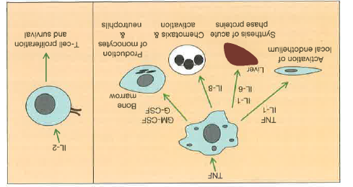
Specifičnost citokina: neki su širokog djelovanja, drugi specifični
Notes:
myokines

Slide 15
Cytokine characteristics:
pleiotropy (different effects on different types of target cells)
redundancy (multiple cytokines have same effect)
synergism (cooperative effect of multiple cytokines)
antagonism (inhibition of one cytokine effect by another)
cascade induction (multiple-step feed forward mechanisms for the amplified production of a particular cytokine)
one cell induces cytokine production in downstream cell, etc.
relatively small number of cytokines produced by a single cell type can coordinately recruit and activate an entire network of immune cells to respond on a way specific for the pathogen
combinatorics

Slide 16
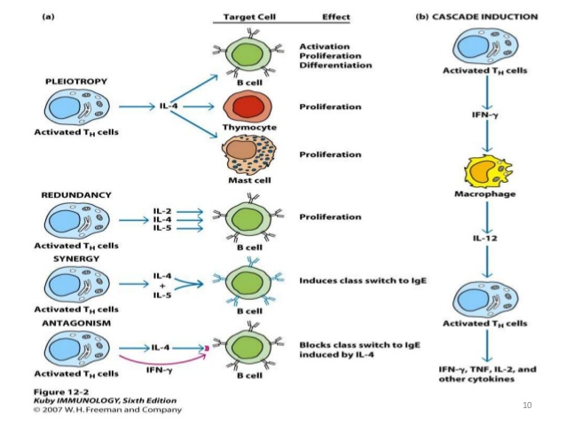
Osnovni principi djelovanja citokina - kombinatorika
https://www.onlinebiologynotes.com/cytokines-properties-receptors/
Notes:
cytokines exhibit induction of following attributes: i ) Pleiotropy: a given cytokine has different biological effects on different target cell. ii) Redundancy: two or more cytokines that mediate similar function. iii) Synergy: combined effect of two cytokine on cellular activity is greater than effect of individual cytokine. iv) Antagonism: the effect of one cytokine inhibit the effect of another cytokine. v) Cascade: when the action of one cytokine on a target cell induce that cell to produce one or more other cytokines, which in turn induce other cell to produce cytokines

Slide 17
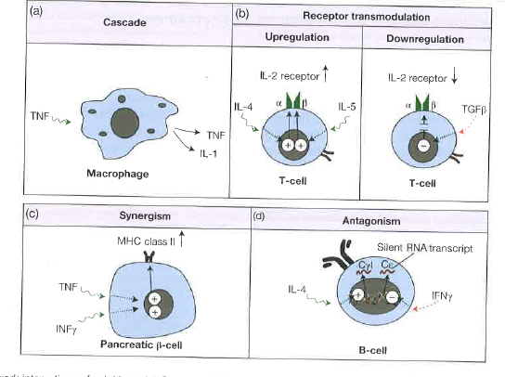
i. e. miRNA
Examples of cytokine regulation
Notes:
miRNA silencing

Slide 18
Regulacija citokina:
kratkotrajna proizvodnja
kao odgovor na antigen ili upalni stimulus
kratak poluživot
(bazalna koncentracija u pM do nM, 1000 x povećanje
ekspresija receptora specifična za pojedine stanice
Notes:
dysregulation TNF alpha in rheumatoid arthritis – administration of recombinant soluble TNF receptor

Slide 19
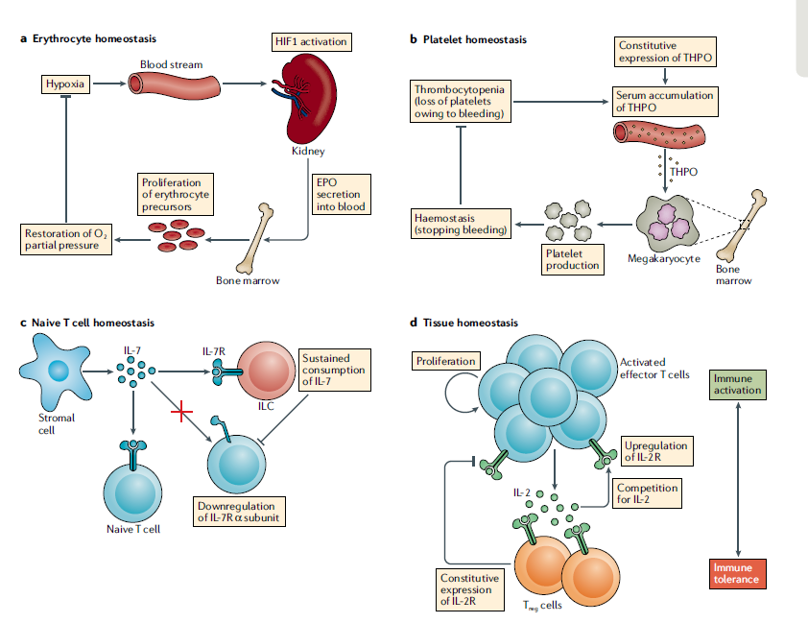
eritropoetin
trombopoetin
jetra
bubreg
IL6
THPO se degradira u trombocitima
Megakariocite potiče na proizvodnju trombocita
Citokini u hematopoezi regulirani povratnim vezama
ILC cells consume IL7 and limit availability of IL7 in lymph nodes
Regulation of homeostasis by cytokines
feed-back loops
Altan-Bonnet and Mukherjee, 2019
Notes:
Homeostasis by cytokine competition. a | Erythrocyte homeostasis. A drop of oxygen partial pressure in the
blood (hypoxia) is detected by kidney cells (through the activation of hypoxia- inducible factor 1 (HIF1)), which triggers
their secretion of erythropoietin (EPO). EPO circulates to the bone marrow to induce the proliferation of erythrocyte
precursors, which restores oxygen partial pressure. b | Platelet homeostasis. The rapid decrease in number of circulating
platelets (thrombocytopenia) during trauma results in the serum accumulation of constitutively expressed thrombopoietin
(THPO), which signals to bone marrow megakaryocytes for platelet release, thereby restoring haemostasis. c | Naive T cell
homeostasis. Innate lymphoid cells (ILCs) are present at low frequencies in lymphoid organs compared with T cells, but,
unlike T cells, they do not adapt their response to IL-7 by downregulating expression of the IL-7 receptor α- subunit
(IL-7Rα). The sustained consumption of IL-7 by ILCs limits the spatial extent and overall availability of IL-7 in lymph nodes.
d | Tissue homeostasis. Activated effector T cells secrete IL-2, which drives their proliferation and upregulation of IL-2
receptor (IL-2R) expression. Regulatory T (Treg) cells constitutively express IL-2R and consume IL-2, which upregulates their
inhibitory functions. Competition between the production and consumption of IL-2 determines the balance between
immune activation and immune tolerance.
Its negative feedback is different from that of most hormones in endocrinology: The effector regulates the hormone directly. Thrombopoietin is bound to the surface of platelets and megakaryocytes by the mpl receptor (CD 110). Inside the platelets it gets destroyed, while inside the megakaryocytes it gives the signal of their maturation and consecutively more platelet production. The bounding of the hormone at these cells thereby reduces further megakaryocyte exposure to the hormone.^{[5]} Therefore, the rising and dropping platelet and megakaryocyte concentrations regulate the thrombopoietin levels. Low platelets and megakaryocytes lead a higher degree of thrombopoietin exposure to the undifferentiated bone marrow cells, leading to differentiation into megakaryocytes and further maturation of these cells. On the other hand, high platelet and megakaryocyte concentrations lead to more thrombopoetin destruction and thus less availability of thrombopoietin to bone marrow.
TPO, like EPO, plays a role in brain development. It promotes

Slide 20
Hemostaza je regulirana mehanizmom povratnih veza
Regulacijski T limfociti troše IL2 i postoji kompeticija s efektornim T limfocitima: tako se uspostavlja ravnoteža između aktivacije i tolerancije u imunom odgovoru

Slide 21
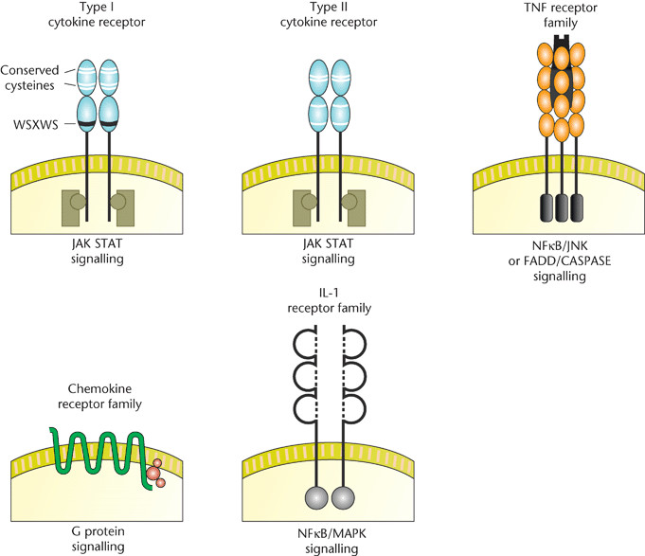
most cytokines
interferons
TNF family
Ig superfamily receptors
for IL-1, M-CSF
inflammation
chemokines
TIR
TGF beta – membrane Ser kinases
Različiti nizvodni putevi citokinskog signaliziranja
Notes:
TIR: TLR int. r.

Slide 22
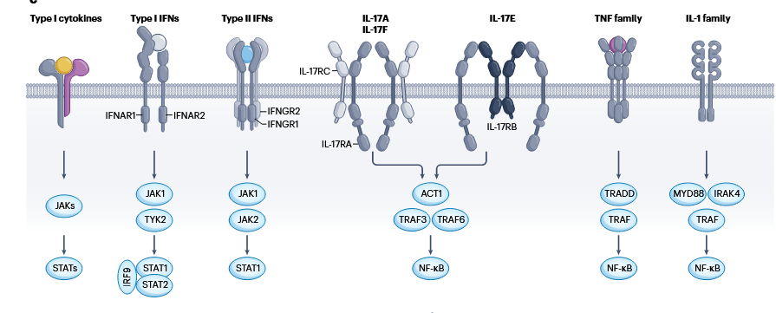
ili kaspaze
Različiti nizvodni putevi signaliziranja citokinima
Notes:
IL-17R:
the longest intracellular part, tlr-like domain, NFKB, MAPK

Slide 23
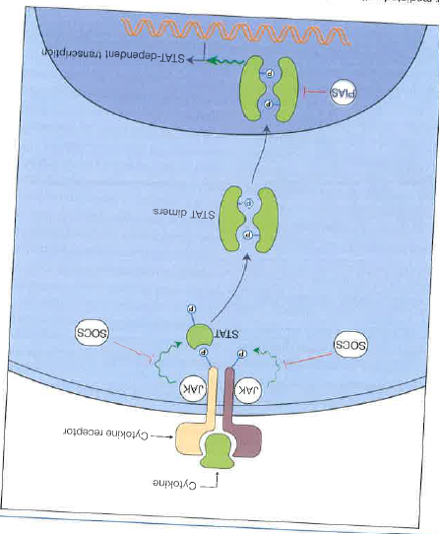
receptori
JAK1, JAK2, JAK3, Tyk2
7 STAT različiti dimeri
neke JAK: Ras-MAPK
SOCS: suppresor of cytokine signaling (8)
blokira ili inducira razgradnju JAK
PIAS: protein inhibitor of activated STAT
Citokinski receptorski put
JAK: nonreceptor tyrosine kinase
https://www.youtube.com/watch?v=drLNeu4Jhdg&list=PLNxPv76KnZ8PsulAwTXDnTqJjb2cKioDJ&index=16

Slide 24
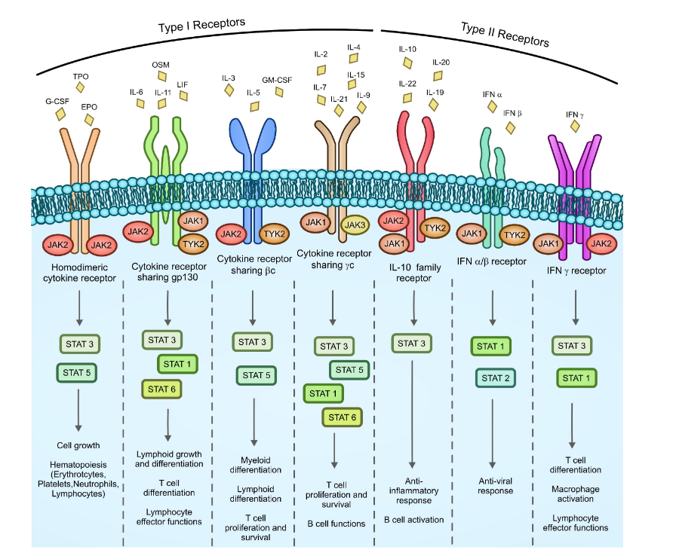
različite kombinacije nizvodnih puteva
Notes:
Cytokine receptor signaling in hematopoietic cells. More than 50 different cytokines
are coded by the human genome. Cytokine receptors are particularly important in maintaining
hematopoietic cell physiological functions. They are divided into two subfamilies (type I and type II
receptors) based on the structure of the extracellular domain. In response to cytokine recognition,
each receptor can bind different combinations of JAKs that, in turn, besides activating the MAPK and
PI3K/AKT pathways (see Figure 2), may phosphorylate different STATs. EPO, erythropoietin; G-CSF,
granulocyte colony-stimulating factor; GM-CSF, granulocyte–macrophage colony-stimulating factor;
IFN, interferon; LIF, leukemia inhibitory factor; OSM, oncostatin M; TPO, thrombopoietin.

Slide 25
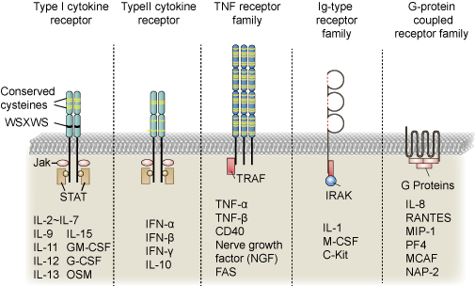

Slide 26
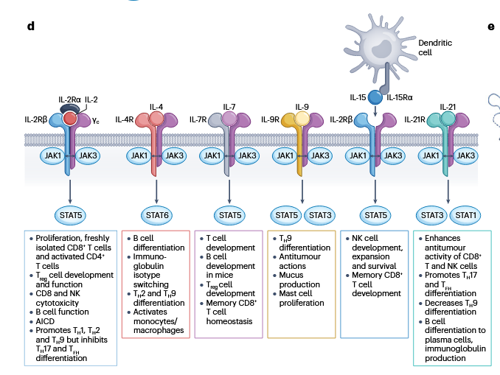
Specifičnost nizvodnog signaliziranja
Nature Reviews Drug Discovery, 2023
Notes:
Cytokine receptors and γc-family cytokines. a, Three-dimensional
structure of human growth hormone (GH) bound to the homodimeric GH
receptor (GHR) (only extracellular domains are included in the solved structure;
image generated in PyMOL using Protein Data Bank (PDB) structure 3HHR
ref. 31). b, Schematics of receptors for type I and type II cytokine receptor chains.
Type I cytokine receptor chains contain two fibronectin III (FN III) domains, with
the N-terminal one containing two sets of conserved cysteines and the more
proximal one a WSXWS motif. There is also a cytoplasmic ‘Box 1’ region for the
binding of JAKs, so that they activate JAK–signal transducer and activator of
transcription ( JAK–STAT) signalling. Type II cytokine receptors also have a FN
III domain, conserved cysteines and a Box 1 motif. c, Schematic of receptors for
a range of cytokines. Receptors for type I cytokines are shown as a heterodimer
of two type I receptor molecules, although some cytokines use homodimers and
some have more complicated structures (for example, IL-2 and IL-15 have extra
sushi-domain-containing proteins, IL-2Rα and IL-15Rα). Also shown are type I and
type II interferon (IFN) receptors (both are type II cytokine receptors); like type I
cytokines, type II cytokines also use JAK–STAT signalling. Also shown are IL-17,
tumour necrosis factor (TNF) and IL-1 family receptors, each of which mediates
the activation of nuclear factor-κB (NF-κB). d, Common γ-chain (γ c) family
cytokines. IL-2, IL-4, IL-7, IL-9, IL-15 and IL-21 share γ c. IL-2 and IL-15 also share
IL-2Rβ, and these two cytokines have distinctive α-chains. γ c cytokines except
IL-15 act primarily in cis, whereas IL-15 is trans-presented by cells expressing
IL-15Rα. All γc cytokines activate JAK1 and JAK3, with JAK3 binding to γ c. For each
cytokine, the principal STAT proteins that are activated are listed, as are the
major biological activities. e, Structure of IL-2 bound to the high-affinity IL-2
receptor (only extracellular domains are in the solved structure, PDB 2B5I; image
generated using PyMOL). AICD, activation-induced cell death; NK, natural killer;
TFH, T follicular helper cell; T H1, T helper 1 cell; Treg cell, regulatory T cell

Slide 27
Mehanizmi na razini receptora i citokina
nesignalizirajući receptori (decoy)
proizvodnja topivih citokinskih receptora
proteoliza (IL1 se proizvodi kao inaktivni prekursor te se treba cijepati kaspazom 1
intracelularni antagonisti
kompeticija između STAT kod istog citokina ili za isti STAT kod signalizacije različitim citokinima
različit afinitet receptora – različita osjetljivost na citokinsku koncentraciju

Slide 28
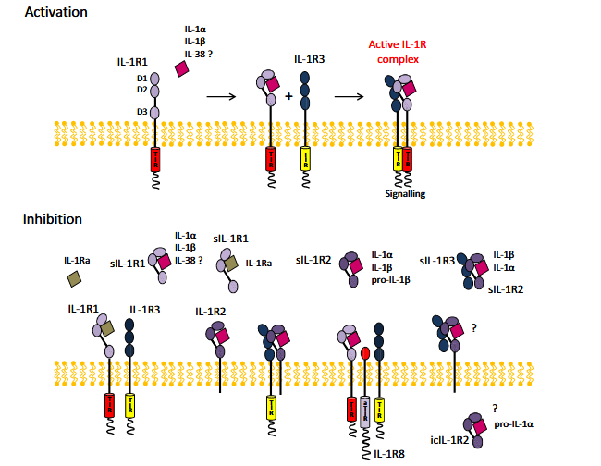
IL-1 receptor family
TIR domain – relation to TLR
dodatna aktivacija receptora
inhibicija solubilnim receptorima, „lažnim” receptorom koji nema aktivirajuće domene
dodatnim molekulama koje inhibiraju signaliziranje
Boraschi et al. Immunol. Rev. 2018
Notes:
The IL- 1R complex. Activation. The agonist cytokines IL-1α and IL-1β bind to the ligand-binding receptor IL-1R1 by taking contact
with the receptor domains D1/D2 and D3. The ligand-induced conformational change of IL-1R1 allows recruitment of the accessory chain
IL-1R3. Signaling is initiated by the approximation of the intracellular TIR domains of the 2 chains. Low-affinity binding of IL-38 to IL-1R1 has
been reported. Inhibition. Several inhibitory mechanisms regulate IL-1- mediated activation. The antagonist ligand IL-1Ra binds IL-1R1 only at
D1/D2 and does not induce the conformational change necessary for recruiting IL-1R3, thereby blocking IL-1R1. IL-1R2 binds efficiently the
agonist ligands at D1/D2 and D3, undergoes conformational change and can also recruit IL-1R3, but cannot initiate signaling because it does not
possess an intracellular TIR domain. IL-1R8, which displays an anomalous TIR domain (aTIR), can interfere with the trimeric complex IL-1- IL-1R1-
IL-1R3 and disrupt signaling. Soluble receptor forms include sIL-1R1, which can bind both agonist and antagonist ligands (binding of IL-1Ra being
actually not an IL-1 inhibitory mechanism but exactly the opposite), sIL-1R2, which captures agonist ligands and pro-IL-1β, and sIL-1R3, which
can form inhibitory complexes with sIL-1R2 bound to IL-1 and probably also with membrane IL-1R2 bound to IL-1. An intracellular form of IL-
1R2 was reported as being able to bind pro-IL-1α. Low-affinity binding of IL-38 to sIL-1R1 has also been reported

Slide 29
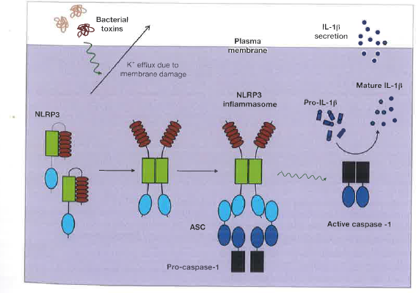
Regulation of IL-1 β secretion

Slide 30
Fine-tuning of cytokine signals
varying cytokine concentration, intermediate and high-affinity receptors differently activated depending on the concentration of i. e. IL-2
differential activation of multiple STATs by a single cytokine (each STAT mediates different action)
competition or cooperation between two different cytokines’ effects as a consequence of different STAT activation (IL-2 versus IL-21: STAT5 vv STAT3)
STATs can form dimers and tetramers, tetramers are more potent
superenhancers can potently enhance cytokine-induced genes, or cell identity of LCR (long control region) or disease associated genes
use of differential metabolic pathways to cross-compete: IL-2 versus IL-21: STAT5 vv STAT3, IL-2 favors aerobic glycolysis, IL-21 fatty acid oxidation
cytokine and chemokine genes in clusters
Nature Reviews Drug Discovery | Volume 22 | October 2023 | 827–854

Slide 31
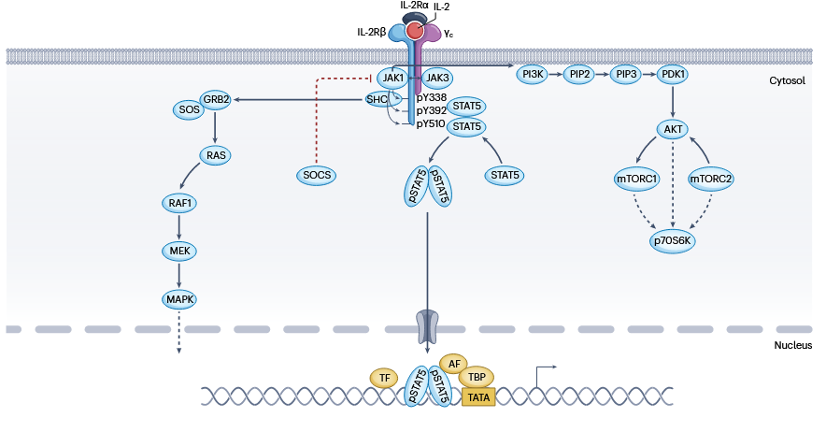
Usporedni signalizacijski putevi aktivirani citokinima
Nature Reviews Drug Discovery | Volume 22 | October 2023 | 827–854
Notes:
| Mechanisms of cytokine signalling, using IL-2 as a representative
cytokine. a, Activation of JAK–signal transducer and activator of transcription
(JAK–STAT), MAPK and PI3K–AKT signalling. IL-2 signalling is shown, with the specific
tyrosines on IL-2Rβ that are phosphorylated, but the principles are applicable to a
broad range of type I cytokines. Tyrosine phosphorylated STAT5 (pSTAT5) proteins
form dimers, translocate into the nucleus, and modulate the transcription of
their target genes. SOCS proteins are negative regulators of cytokine signalling;
they are SH2-domain-containing proteins that can often bind to and inhibit JAK

Slide 32
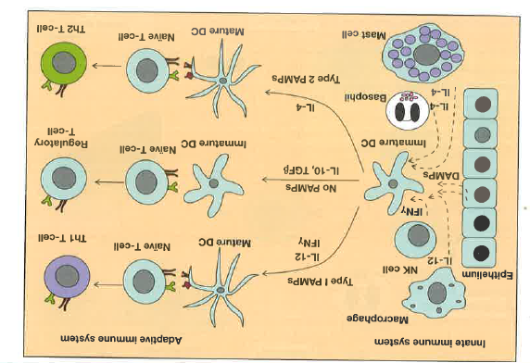
Cytokines are involved in regulation of innate and adaptive immune system
Roitt

Slide 33
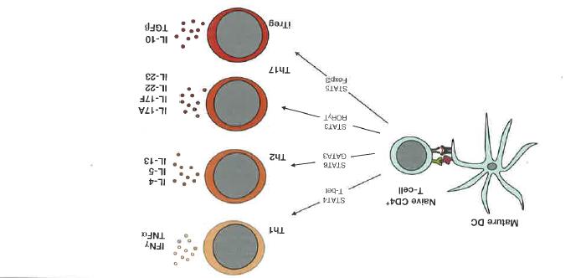
različita kombinacija
citokina
cytokines
Aktivacija različitih transkripcijskih faktora i nizvodno, svaki tip T pomoćnika oslobađa drugu kombinaciju citokina

Slide 34
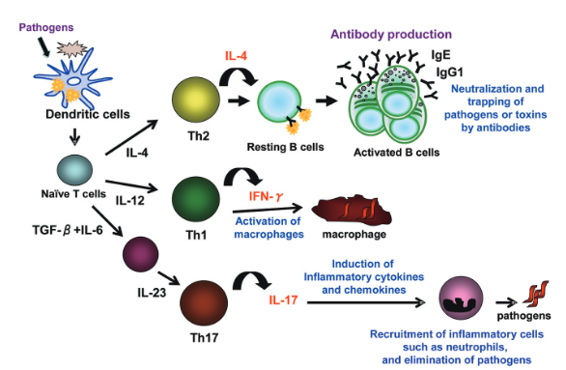
Odgovor prilagođen tipu patogena
Sakata et al. J. Pharmacol. Sci. 2010

Slide 35
Interferoni
citokini s antivirusnim, antiproliferacijskim i imunomodulacijskim efektima
tip I alfa i beta
tip II gama
aktiviraju JAK kinaze
stotine nizvodnih gena

Slide 36
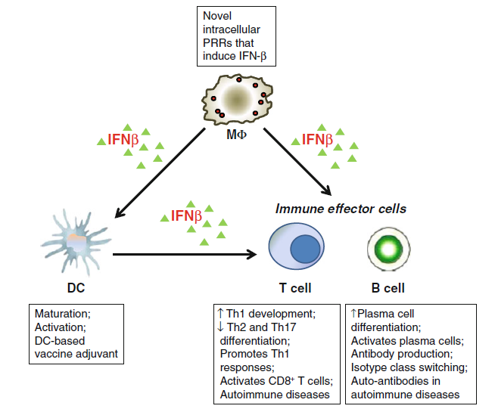
Stanično specifičan odgovor
Sin et al. Immunol. Res. 2012

Slide 37
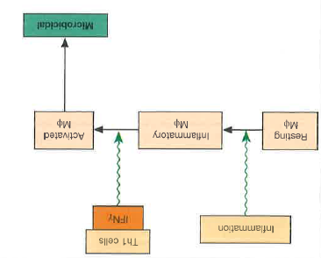
Aktivacija makrofaga koji onda mogu ubijati patogene

Slide 38
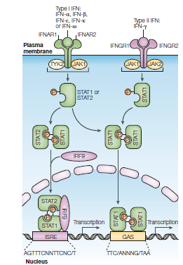
proizvodnja ISRE: gena induciranih interferonom
Leonidas Nature reviews immunology 2005

Slide 39
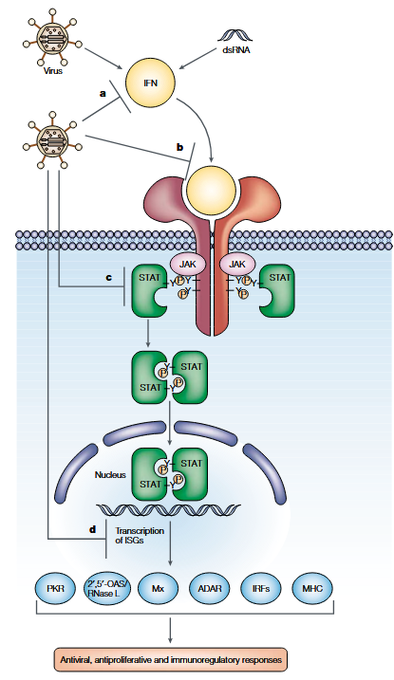
ISG – interferon stimulated genes
OAS oligoadenilate sintetaza
PKR: protein kinaza
Katze et al. Nature reviews Immunology, 2002
Notes:
Overview of the IFN pathway and viral-counteracting strategies. Type I
interferons (IFNs) are a group of antiviral cytokines that are induced during viral infection by viral-
replication products, such as double-stranded (ds)RNA. IFNs exert their biological functions by
binding to specific cell-surface receptors. In turn, this triggers the intracellular IFN signalling
pathway — mainly the JAK–STAT pathway (see BOX 2 figure) — which eventually induces the
expression of a large number of IFN-stimulated genes (ISGs). The ISGs, the workhorses of the
IFN response, set up an antiviral, antiproliferative and immunoregulatory state in the host cells.
However, most, if not all, viruses have evolved a broad spectrum of strategies to block and interfere
with the IFN pathway. Common viral strategies include a | blocking of IFN induction/expression
b | intercepting receptor binding of IFNs through viral decoy IFN receptors c | perturbation of the
intracellular IFN signalling pathway and d | directly downregulating the level of expression of ISGs.
ADAR, RNA-specific adenosine deaminase; IRF, IFN-regulatory factor; JAK, Janus kinase; Mx,
myxovirus-resistance proteins; OAS, oligoadenylate synthetase; PKR, protein kinase; STAT, signal
transducer and activator of transcription

Slide 40
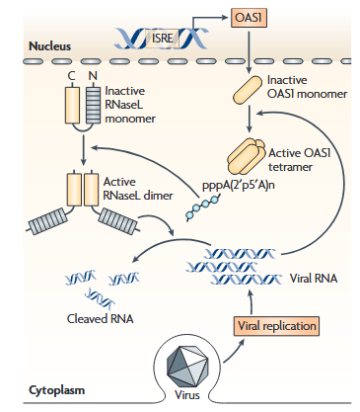
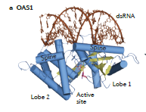
2,5 linked oligoadenylate synthase OAS
aktivirana vezanjem dl RNA
↓
sintetizira 2’ – 5’ oligoadenilat
↓
aktivacija RNAze L
↓
degradacija RNA
Sadler and Williams, Nature reviews Immunology 2008
Notes:
The oAS1–Rnasel antiviral pathway.
2′,5′-oligoadenylate synthetase 1 (OAS1) is expressed at
low constitutive levels and is upregulated by type I
interferons (IFNs). OAS1 protein accumulates in the cell
cytoplasm as an inactive monomer. Following activation
by viral double-stranded RNA (dsRNA), the enzyme
oligomerizes to form a tetramer that synthesizes 2′,5′-
oligoadenylates that, in turn, activate the constitutively
expressed inactive ribonuclease L (RNaseL). The binding of
2′,5′-oligoadenylates to RNaseL triggers the dimerization
of enzyme monomers, through their kinase-like domains,
and this then enables RNAseL to cleave cellular (and viral)
RNAs. ISRE, IFN-stimulated response element.

Slide 41
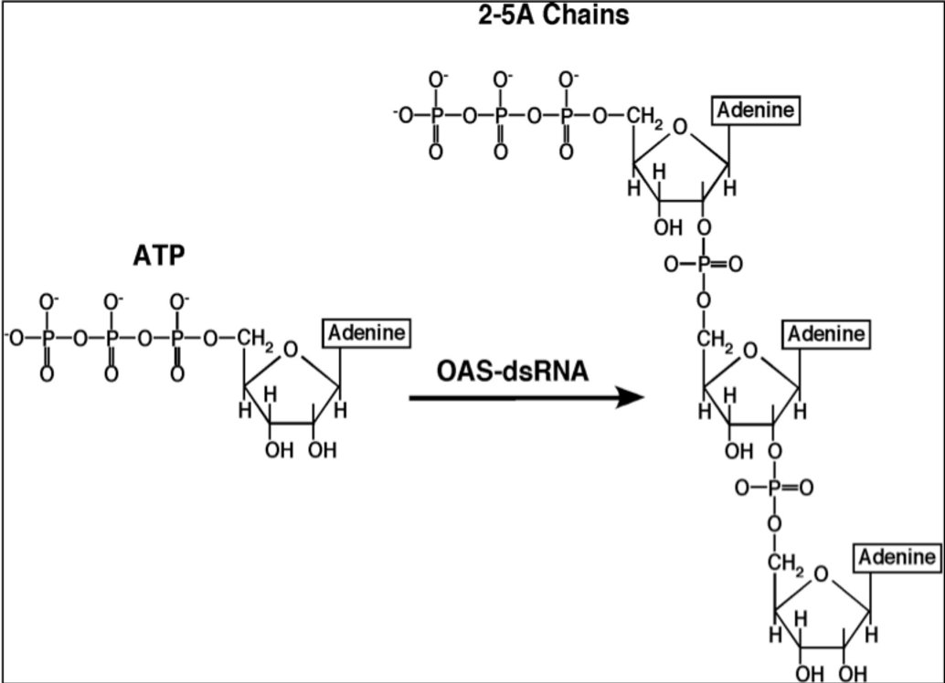
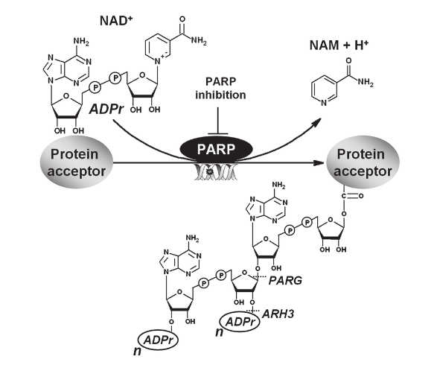

Slide 42
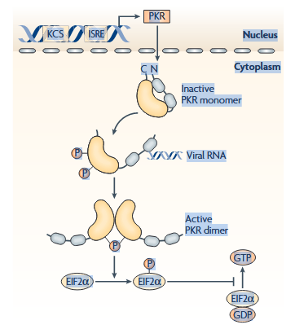
Protein kinaza R: inhibicija sinteze proteina
Sadler and Williams, Nature reviews Immunology 2008
Notes:
mechanism of action of PKR. Protein kinase R
(PKR) is constitutively expressed, and is also induced by type I
interferons (IFNs) under the control of a kinase conserved
sequence (KCS) and IFN-stimulated response element (ISRE)
in the promoter of PKR. The kinase accumulates in the
nucleus and cytoplasm as an inactive monomer, which is
activated directly by viral RNAs, and by several other ligands,
such as ceramide or the protein activator PACT (protein
activator of the IFN-inducible protein kinase). Following
activation, PKR monomers are phosphorylated and dimerize
to form the active enzyme. Activated PKR regulates several
cell signalling pathways through mechanisms that have not
been fully explained, but a crucial function of PKR in viral
defence is the inhibition of translation by phosphorylation of
eukaryotic translation initiation factor 2a (EIF2a).

Slide 43
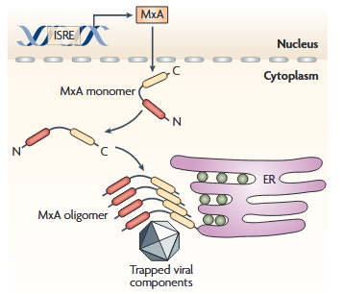
Mx proteini: proteini nalik dinaminu koji oligomeriziraju i asociraju s virusnim komponentama ili kapsidom da ih degradiraju
Sadler Nature Reviews Immunology 2008

Slide 44
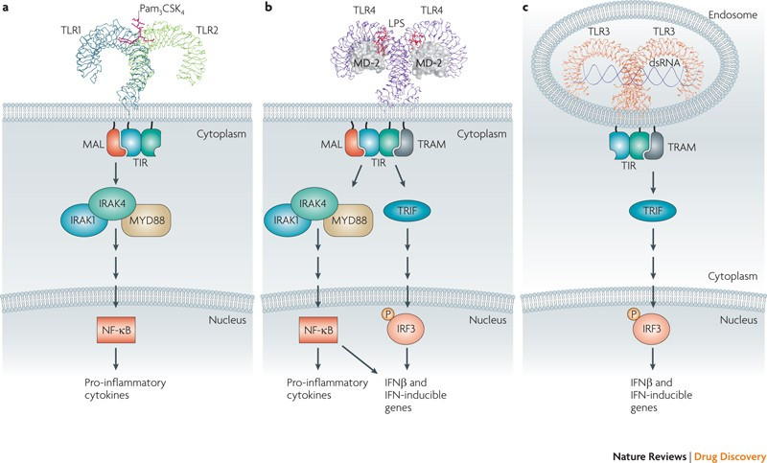
Putevi koji induciraju proizvodnju interferona
IFN, IFIT, TNF
CXCL10, CCL5…
aktivacija TLR – TRIF – IRF3 i NFkB

Slide 45
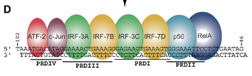
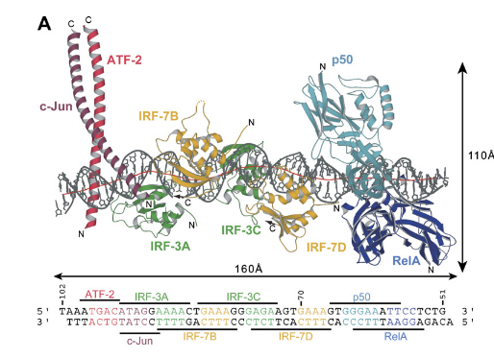
IFN beta pojačivač
vezanje 8 transkripcijskih faktora
Panne et al. Cell 2007

Slide 46
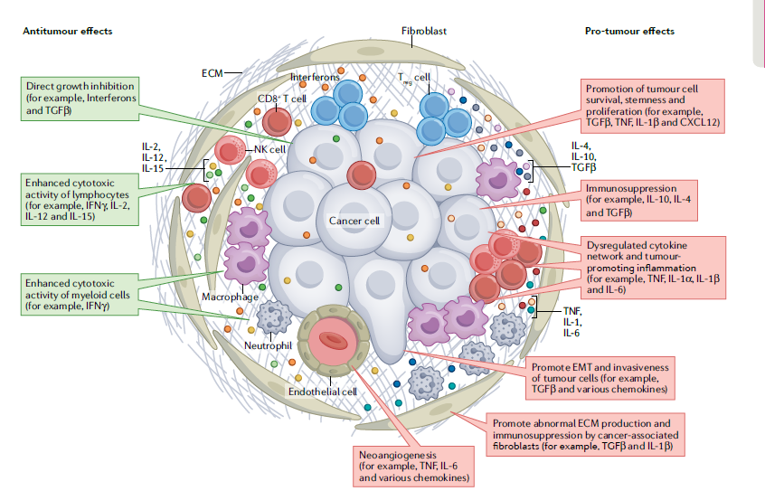
Uloge citokina u tumorskom mikrookolišu

Slide 47
Citokinsko signaliziranje: kombinatorika citokina prenosi poruku
PAMPs
DAMPs
INNATE IMMUNE CELLS
DECODING OF PAMP/DAMP SIGNATURE
CYTOKINE PATTERN 1
CYTOKINE PATTERN 2
CYTOKINE PATTERN 3
TYPE I ADAPTIVE RESPONSE
TYPE II ADAPTIVE RESPONSE
TYPE III ADAPTIVE RESPONSE

Slide 48
Stanični sustavi prepoznavanja mikrobnih
nukleinskih kiselina

Slide 49
-stanica ima sustave da prepozna proteine i nukleinske kiseline patogena
Toll – 2011 Nobelova nagrada J. Hoffmanu
-receptori koji prepoznaju uzorke patogena PRR – senzori za molekularne uzorke povezane s patogenima PAMP
-10 gena TLR – različiti PAMP
(stijenka G+ i G- bakterija, flagelin,
jlRNA, dlRNA, nemetilirana DNA bakterija i virusa)

Slide 50
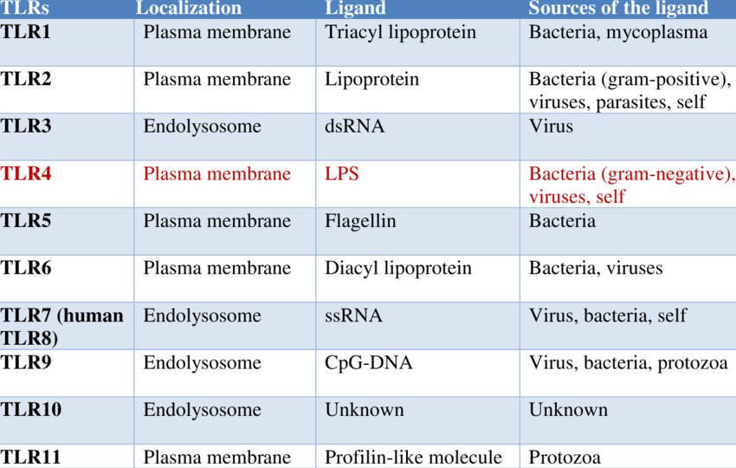
Takeuchi i Akira, 2010)

Slide 51
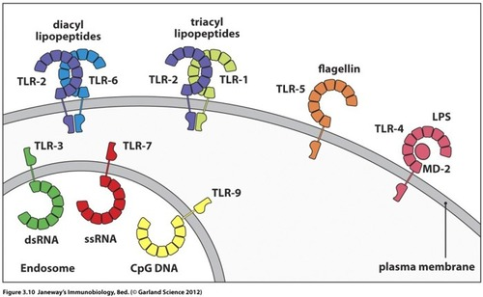
Lokalizacija receptora TLR, na makrofagima, dendritičkim stanicama, epitelnim stanicama…

Slide 52
dimerizacija
pokretanje signalnog puta preko adaptora
indukcija citokina, interferona i dr.

Slide 53
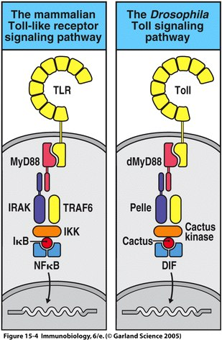
pokretanje signalnog puta preko adaptora MyD88
indukcija citokina, interferona i dr.
MyD88 death domaiin

Slide 54
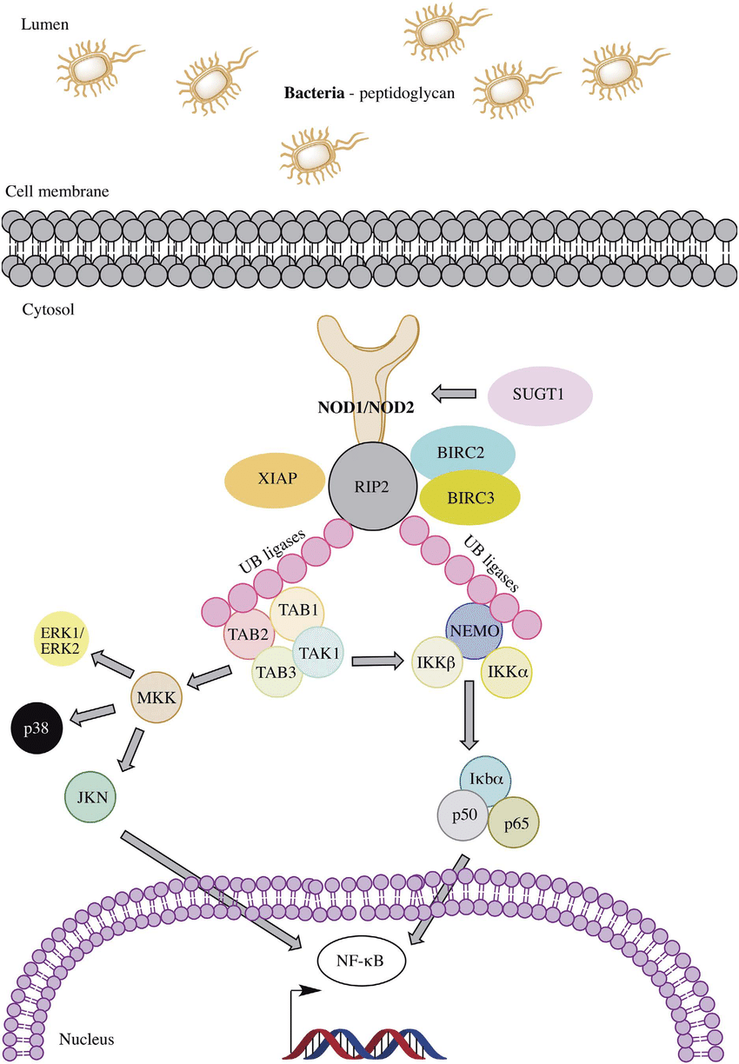
NLR: Nod like receptor
NOD: nucleotide binding oligomerization domain
citoplazmatski senzori mikrobnih molekula ili staničnog oštećenja (npr. produkt peptidoglikana)
induciraju putove NFkappaB
proizvodnja
proupalnih citokina i NO
inflamasome,
stanična smrt

Slide 55
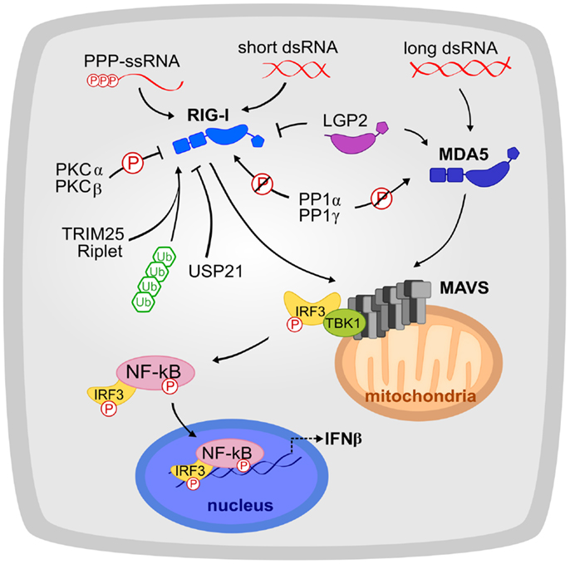
RIG-I retinoic acid inducible gene I: prepoznaje jednolančane RNA bez 7meG na 5’ kraju
MDA-5 (melanoma differentiation associated 5) ili helicard detektira dvolančane RNA
aktivacija mitohondrijskog antivirusnog signalnog proteina MAVS
proizvodnja interferona

Slide 57
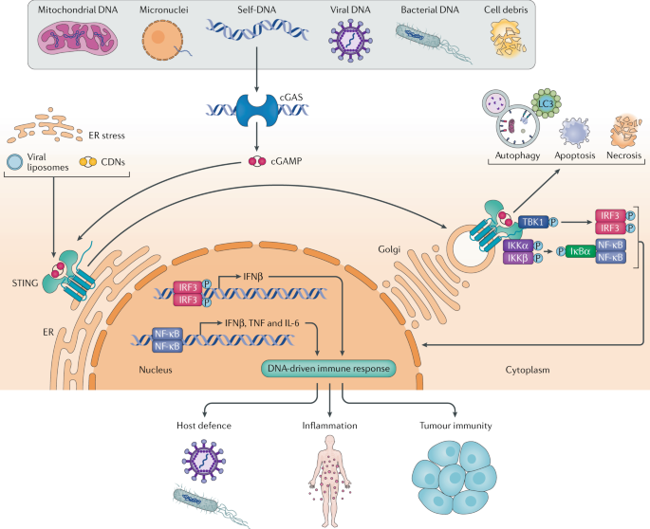
senzor DNA:
STING – stimulator interferonskih gena
usidren u ER, C kraj strši u citoplazmu kao inaktivni homodimer

Slide 58
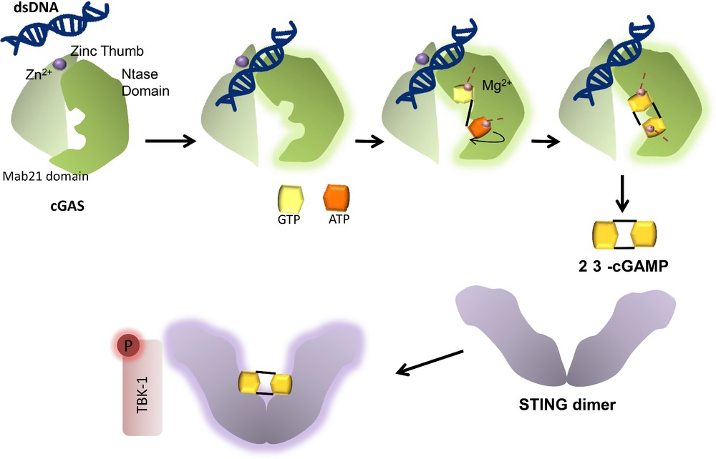
STING prepoznaje cikličke dinukleotide cdiGMP i cdiAMP, bakterijske sekundarne glasnike
ili cGAMP kojeg proizvodi c-GAS
drugi senzori dvolančane DNA: IFI16, DNA PK…

Slide 59
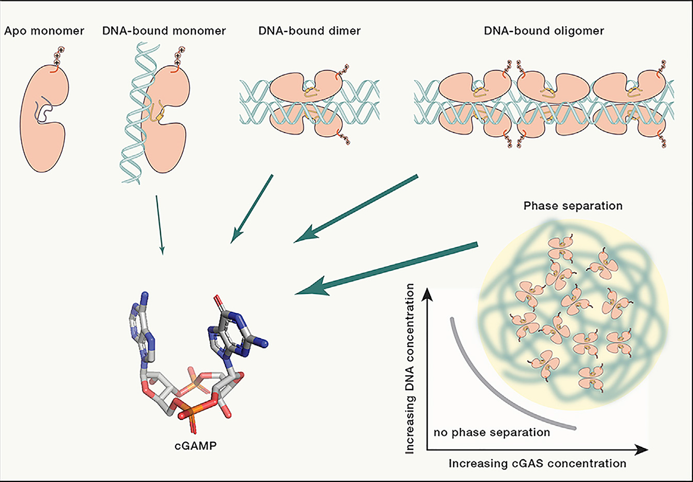
cGAS, ciklička GAMP sintaza inducira nastanak cGAMP, cikličnog GMP-AMP kao senzor dvolančane DNA, ako je dovoljne duljine
citosolna DNA aktivira cGAS i nastaje kap kompleksa cGAS-DNA (liquid-liquid separation phase)
cGAS, ATP i GTP su koncentrirani u kapi i omogućuju nastanak cGAMP koji aktivira STING

Slide 60
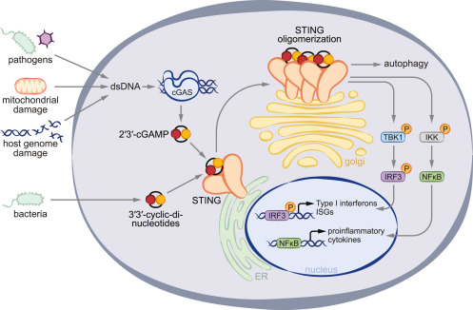

Slide 61
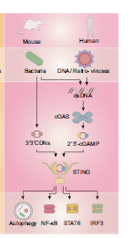
STING aktivira nizvodne putove:
IRF3 (preko TBK1) za transkripciju interferona
NF kappaB
STAT6
LC3 (kad se STING translocira u ERGIC) da započne autofagiju
-apoptoza
-nekroza
-autofagija

Slide 62
c-GAS se nalazi na mjestu gdje može susresti patogenu DNA, a izbjeći vlastitu (citoplazma, posebna mjesta u jezgri)
-nukleosomska struktura stanične DNA
-potrebna količina da nastane separacija faza
-virusi (npr. herpes) pridonosi oslobađanju mitohondrijske DNA te je koncentracija DNA veća
-neki proteini u upali snizuju prag DNA detekcije i povećavaju osjetljivost cGAS
-povećanje Mn+2 kod virusne infekcije, ROS
-regulacija cGAS i STING posttranslacijskim modifikacijama:
omogućuju „mirovanje”
glutamilacija, acetilacija, sumoilacija, ubikvitinacija
nakon podražaja mijenjaju se PTM (npr. s HDAC)
-moguća aktivacija susjednih stanica, putem pukotinastih veza i prijenosa cGAMP pomoću posebnih kanala, moguće eksosomi

Slide 63

virusi razvijaju obranu:
inhibicija signalnih putova:
HSV: UL41 degradira cGAS mRNA
inhibicija enzimskog djelovanja cGAS
inhibicija STING
stabilizacija IkappaB
bakterije: hidroliza cGAMP
degradacija vlastite cdiAMP i cGAMP
izbjegavanje izlaganja DNA
zaštita vlastite DNA
HIV pomoću dineinskog adaptora ide mikrotubulima u jezgru
inhibicija signala izbjegavanje izlaganja DNA

Slide 64
tumori – povećana mogućnost aktivacije cGAS-STING
genomska nestabilnost,
nastanak mikronukleusa,
oslobađanje mitohondrijske dlDNA
antitumorsko djelovanje:
povećanje imunosnog odgovora
poticanje sekretornog fenotipa vezanog za starenje
protumorsko djelovanje:
olakšana invazija metastatskih stanica
nekanonski put NFkappaB;
upalni citokini povećavaju metastaziranje i kemorezistenciju

Slide 65
Literatura
Cheng Z, Dai T, He X, Zhang Z i sur: The interactions between cGAS-STING pathway and pathogens. Signal Transduction and Targeted Therapy, 2020
Singh H, Koury J, Kaul M: Innate immune sensing of viruses and its consequences for the central nervous system. Viruses 13, 2021
Murphy K, Weaver C: Janeway’s immunobiology. 9 ed. Garland Science Taylor and Francis Group. 2017

