Slide 1
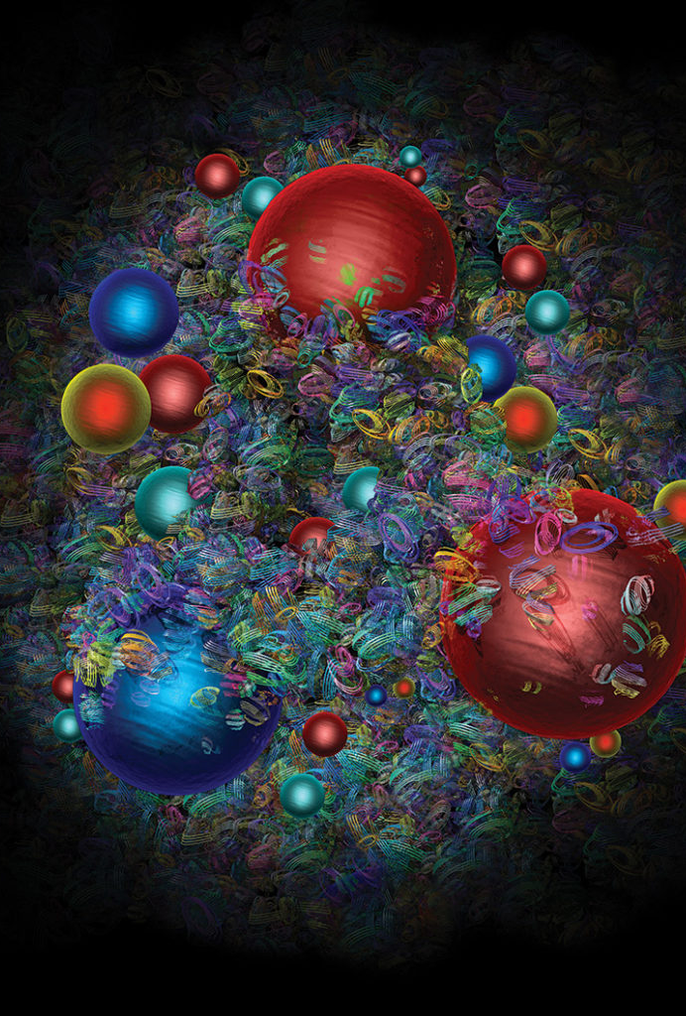
Perturbativni račun partonskih distribucija ovisnih o poprečnom impulsu
Boris Šarić

Slide 2
Sadržaj
Duboko neelastično raspršenje (DIS)
Partonski model
Semi-inkluzivno duboko neelastično raspršenje (SIDIS)
Partonske distribucije ovisne o poprečnom impulsu (TMD-ovi)
Ilustracija perturbativnog računa

Slide 3
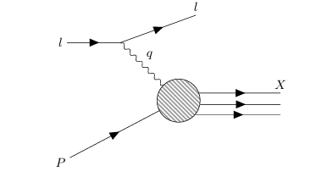

DIS
$e^{−}\left(l\right)+h\left(P\right)→e^{−}\left(l^{′}\right)+X$
$q=l−l^{′}$
Režim
      $$Q≡\sqrt{−q^{2}}≫\frac{1}{R}$$
Bjorkenov x
$x=\frac{Q^{2}}{2P⋅q}$
Udarni presjek
$\frac{dσ}{dE^{′}dΩ}=\frac{α^{2}E^{′}}{Q^{4}E}L_{μν}W^{μν}$

Slide 4
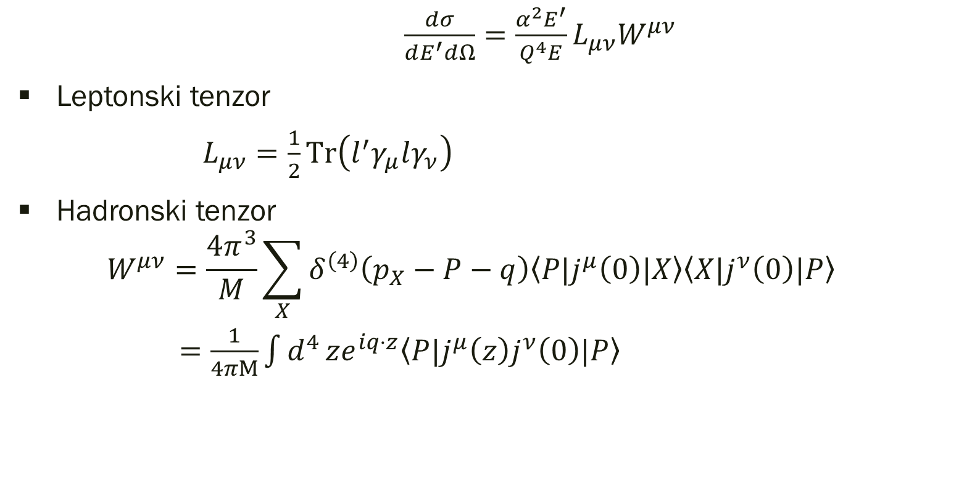
$\frac{dσ}{dE^{′}dΩ}=\frac{α^{2}E^{′}}{Q^{4}E}L_{μν}W^{μν}$
Leptonski tenzor
$L_{μν}=\frac{1}{2}\text{Tr}\left(l^{′}γ_{μ}lγ_{ν}\right)$
Hadronski tenzor
  $$W^{μν}=\frac{4π^{3}}{M}\sum_{X}{δ^{\left(4\right)}\left(p_{X}−P−q\right)\left\langle P{|j}^{μ}\left(0\right)|X\right\rangle \left\langle X{|j}^{ν}\left(0\right)|P\right\rangle }$$
  $=\frac{1}{4πM}\int{d^{4}}ze^{iq⋅z}\left\langle P{|j}^{μ}\left(z\right)j^{ν}\left(0\right)|P\right\rangle$

Slide 5
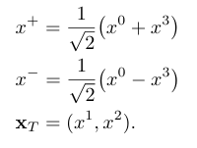
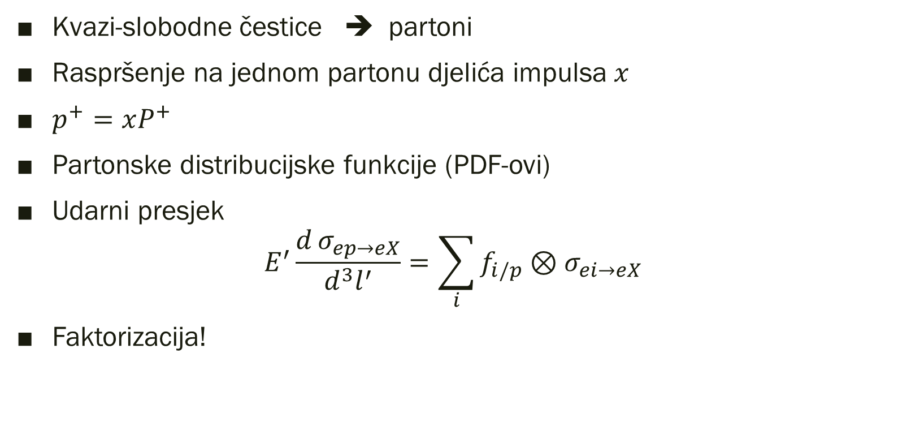
Partonski model
Kvazi-slobodne čestice ➔ partoni
Raspršenje na jednom partonu djelića impulsa $x$
$p^{+}=xP^{+}$
Partonske distribucijske funkcije (PDF-ovi)
Udarni presjek
$$E^{′}\frac{d σ_{ep→eX}}{d^{3}l^{′}}=\sum_{i}{f_{i/p}}⊗σ_{ei→eX}$$
Faktorizacija!

Slide 6
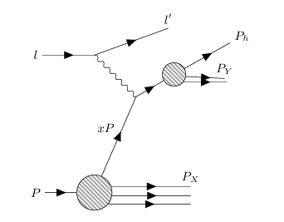
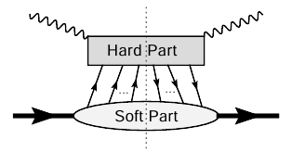

SIDIS
Udarni presjek je osjetljiv na dvije skale : $Q_{1}≫Λ_{QCD}∼\frac{1}{R}$i${ Q}_{2}≪Q_{1}$
$z= \frac{P⋅P_{h}}{P⋅q}$
Teorija: $P$ i $P_{h}$ kolinearni, $q$ima poprečnu komponentu
Eksperiment: $P$ i $q$ kolinearni, $P_{h}$ ima poprečnu komponentu
Tretman?

Slide 7

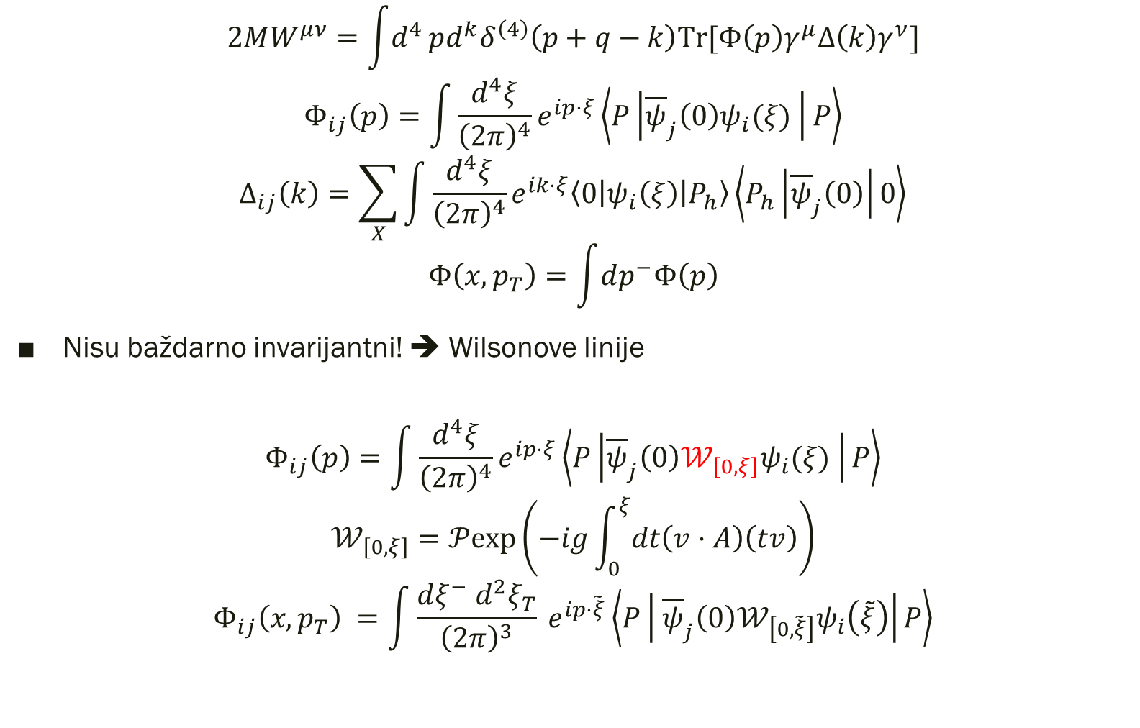
$$2MW^{μν}=\int{d^{4}}pd^{k}δ^{\left(4\right)}\left(p+q−k\right)\text{Tr}\text{[}Φ\left(p\right)γ^{μ}Δ\left(k\right)γ^{ν}\text{]}$$
$$Φ_{ij}\left(p\right)=\int{\frac{d^{4}ξ}{{\left(2π\right)}^{4}}e^{ip⋅ξ}\left\langle P\left|{\overline{ψ}}_{j}\left(0\right)ψ_{i}(ξ) \right|P\right\rangle }$$
$$Δ_{ij}\left(k\right)=\sum_{X}{\int{\frac{d^{4}ξ}{{\left(2π\right)}^{4}}e^{ik⋅ξ}\left\langle 0\left|ψ_{i}\left(ξ\right)\right|P_{h}\right\rangle \left\langle P_{h}\left|{\overline{ψ}}_{j}\left(0\right)\right|0\right\rangle }}$$
$$Φ\left(x,p_{T}\right)=\int{dp^{−}Φ\left(p\right)}$$
Nisu baždarno invarijantni! ➔ Wilsonove linije
$$Φ_{ij}\left(p\right)=\int{\frac{d^{4}ξ}{{\left(2π\right)}^{4}}e^{ip⋅ξ}\left\langle P\left|{\overline{ψ}}_{j}\left(0\right){𝒲_{\left[0,ξ\right]}ψ}_{i}(ξ) \right|P\right\rangle }$$
$$𝒲_{\left[0,ξ\right]}=𝒫\text{exp}\left(−ig\int_{0}^{ξ}{dt\left(v⋅A\right)\left(tv\right)}\right)$$
$$Φ_{ij}\left(x,p_{T}\right) =\int{\frac{dξ^{−} d^{2}ξ_{T}}{{\left(2π\right)}^{3}}} e^{ip⋅\tilde{ξ}}\left\langle P\left| {\overline{ψ}}_{j}\left(0\right){𝒲_{\left[0,\tilde{ξ}\right]}ψ}_{i}\left(\tilde{ξ}\right)\right|P\right\rangle$$

Slide 8
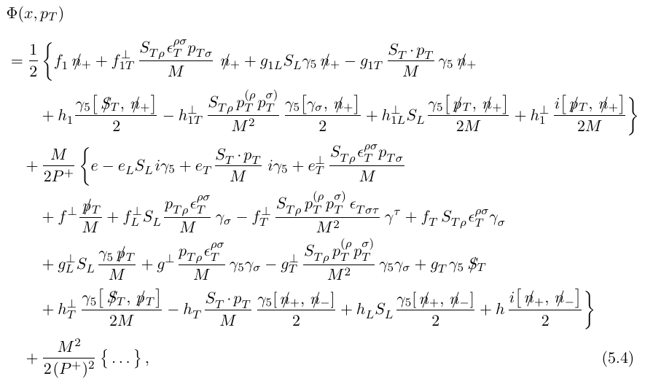

Slide 9
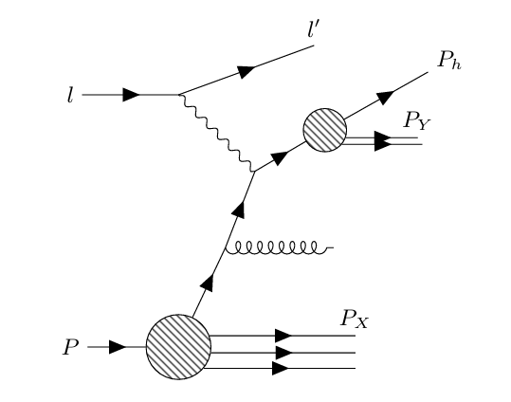

Slide 10
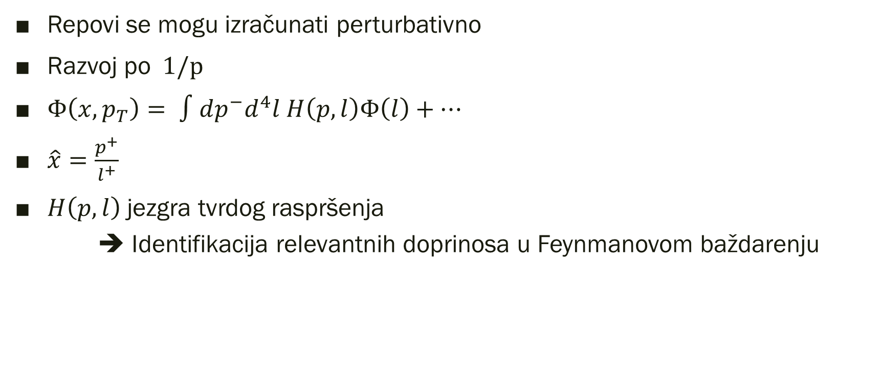
Perturbativni račun
Repovi se mogu izračunati perturbativno
Razvoj po$1/p$
$Φ\left(x,p_{T}\right)= ∫dp^{−}d^{4}l H\left(p,l\right)Φ\left(l\right)+…$
$\hat{x}=\frac{p^{+}}{l^{+}}$
$H\left(p,l\right)$ jezgra tvrdog raspršenja
    ➔ Identifikacija relevantnih doprinosa u Feynmanovom baždarenju

Slide 11
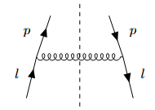
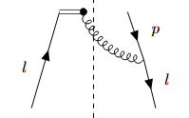
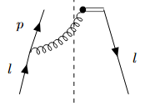
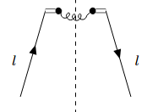

$$Φ_{ij}\left(x,p_{T}\right) =\int{\frac{dξ^{−} d^{2}ξ_{T}}{{\left(2π\right)}^{3}}} e^{ip⋅\tilde{ξ}}\left\langle P\left| {\overline{ψ}}_{j}\left(0\right){𝒲_{\left[0,\tilde{ξ}\right]}ψ}_{i}\left(\tilde{ξ}\right)\right|P\right\rangle$$
$𝒲_{\left[0,ξ\right]}=𝒫\text{exp}\left(−ig\int_{0}^{ξ}{dt\left(n_{−}⋅A\right)\left(tn_{−}\right)}\right)$
$=𝒫\text{exp}\left[−ig\int_{0}^{∞}{dt}\left(n_{−}⋅A\right)\left(tn_{−}\right)\right]×$ $𝒫\text{exp}\left[+ig\int_{0}^{∞}{dt}\left(n_{−}⋅A\right)\left(tn_{−}+ξ\right)\right]$
$≈\left[1−ig\int_{0}^{∞}{dt}\left(n_{−}⋅A\right)\left(tn_{−}\right)\right]×\left[1+ig\int_{0}^{∞}{dt}\left(n_{−}⋅A\right)\left(tn_{−}+ξ\right)\right]$
$$1=\sum_{r}{\int{\frac{d^{4}q}{{\left(2π\right)}^{4}}}\left|q,r\right\rangle } \left\langle q,r\right|$$

Slide 12
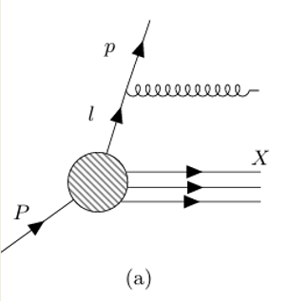

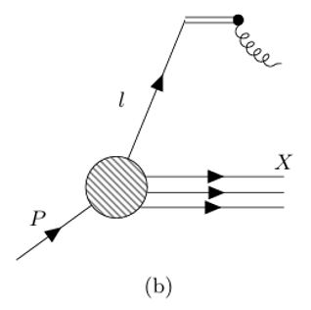


Slide 13
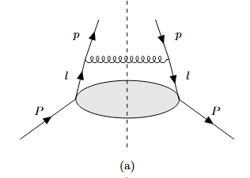
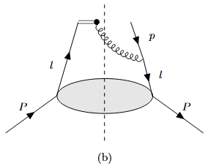
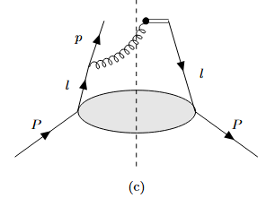
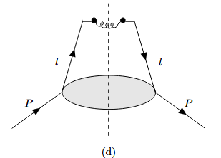
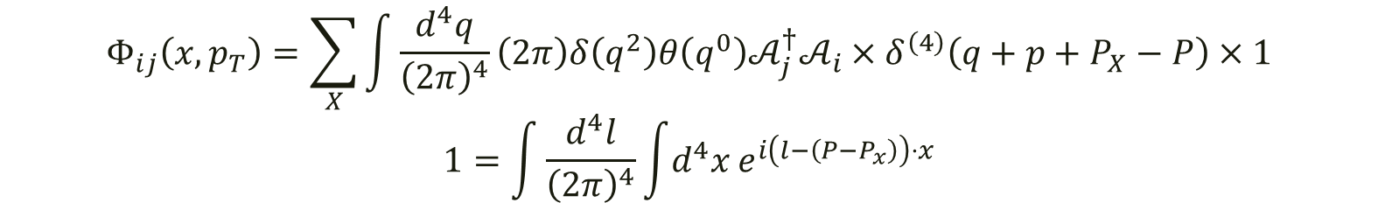
$$Φ_{ij}\left(x,p_{T}\right)=\sum_{X}{\int{\frac{d^{4}q}{{\left(2π\right)}^{4}}}\left(2π\right)δ\left(q^{2}\right)θ\left(q^{0}\right)𝒜_{j}^{†}𝒜_{i}}×δ^{\left(4\right)}\left(q+p+P_{X}−P\right)×1$$
$$1=\int{\frac{d^{4}l}{{\left(2π\right)}^{4}}}\int{d^{4}x}e^{i\left(l−\left(P−P_{x}\right)\right)⋅x}$$

Slide 14



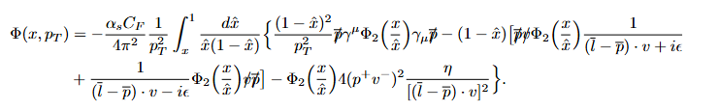

Slide 15

$$f_{1}\left(x,p_{T}\right)=\frac{α_{s}}{2π^{2}}\frac{1}{p_{T}^{2}}\left[\frac{\text{L}\left(η^{−1}\right)}{2}f_{1}\left(x\right)−C_{F}f_{1}\left(x\right)+\left({\text{P}}_{qq}⊗f_{1}\right)\left(x\right)\right]$$
$$\text{L}\left(η^{−1}\right)=2C_{F}\text{ln}\frac{1}{\left|η\right|}−3C_{F}$$
$$\int_{x}^{1}{\frac{d\hat{x}}{\hat{x}}}{\text{P}}_{qq}\left(\hat{x}\right)f_{1}\left(\frac{x}{\hat{x}}\right)=\left({\text{P}}_{qq}⊗f_{1}\right)\left(x\right)$$
$${\text{P}}_{qq}\left(\hat{x}\right)=C_{F}\left[\frac{1+\hat{x^{2}}}{{\left(1−\hat{x}\right)}_{+}}+\frac{3}{2}δ\left(1−\hat{x}\right)\right]$$
No ovo nije potpuni izraz

Slide 16
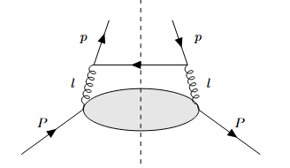



Slide 17
Zaključak
Informacije o 3D strukturi protona daju nam procesi s opservablama ovisnima o dvije skale
Kolinearne partonske distribucije poopćene na TMD-ove
Repove TMD-ova moguće je računati perturbativno (primjer nepolariziranog kvarka u nepolariziranom protonu)

Slide 18
Izvori
[1] R. Boussarie, M. Burkardt, M. Constantinou, et al. Tmd handbook (2023), arXiv:2304.03302 [hep-ph]
[2] M. Schlegel, Time-reversal odd effects in semi-inclusive deep-inelastic scattering, Ph.D. thesis, Ruhr U., Bochum (main) (2006)
[3] J. Collins, Foundations of Perturbative QCD, Vol. 32 (Cambridge University Press, 2011)
[4] M. D. Schwartz, Quantum Field Theory and the Standard Model (Cambridge University Press, 2013)
[5] A. Bacchetta, D. Boer, M. Diehl, and P. J. Mulders, Matches and mismatches in the descriptions of semi-inclusive processes at low and high transverse momentum, Journal of High Energy Physics 2008, 023–023 (2008).

