Slide 1
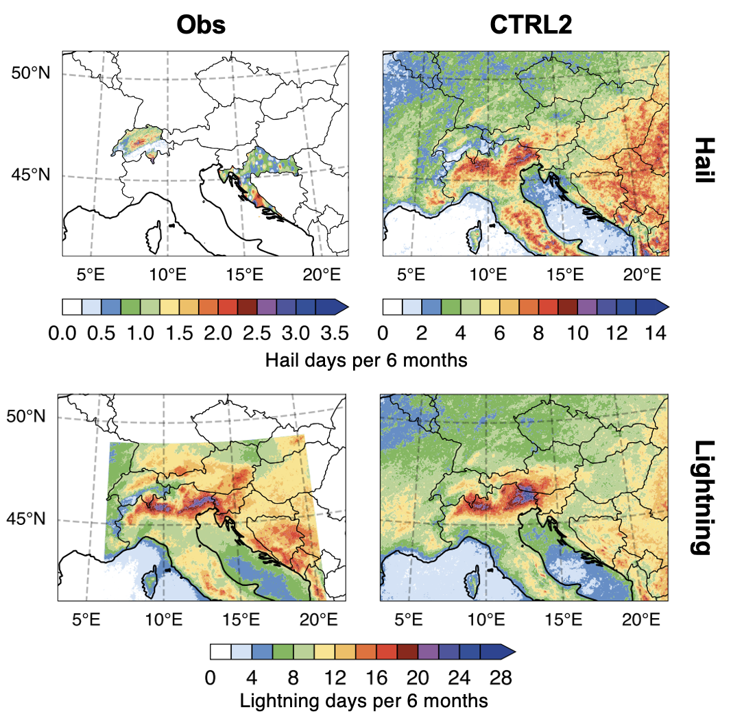
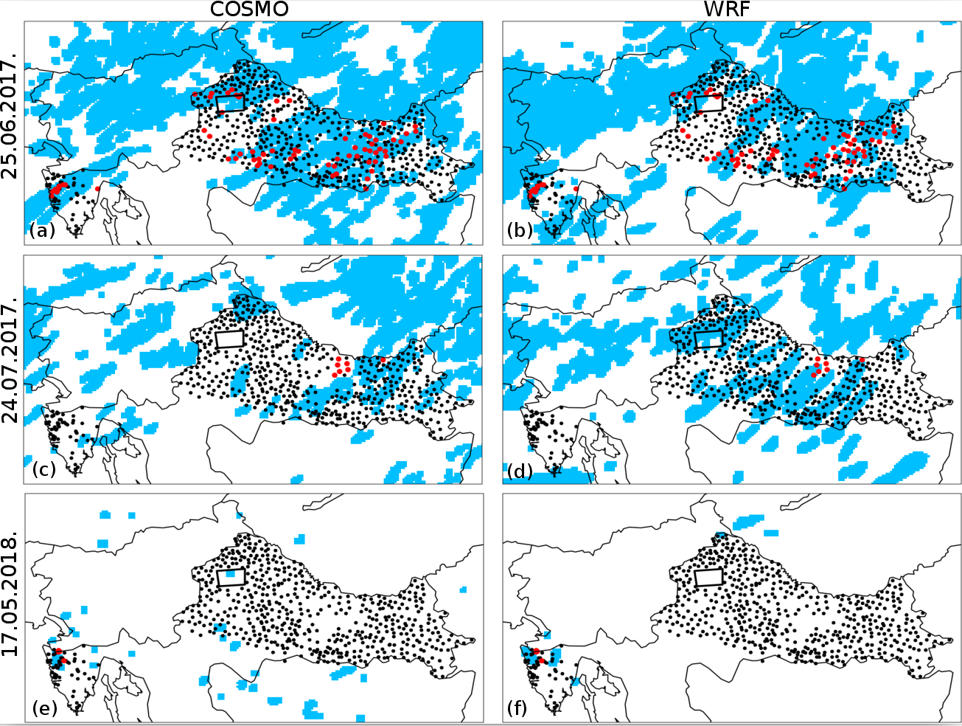
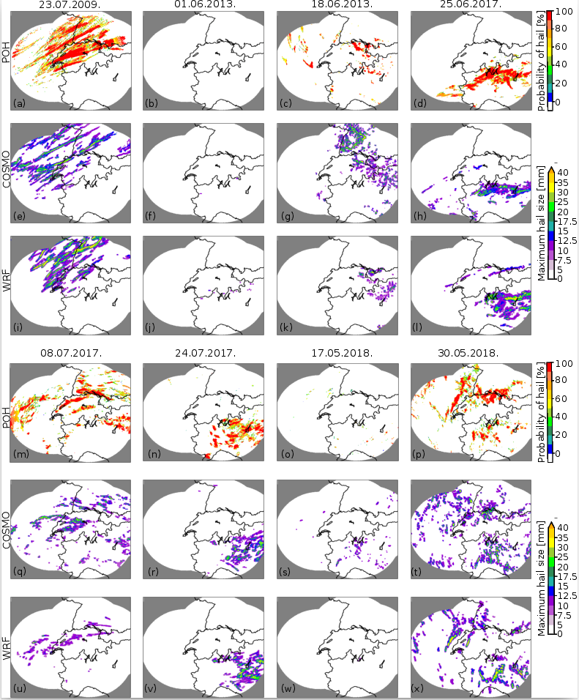
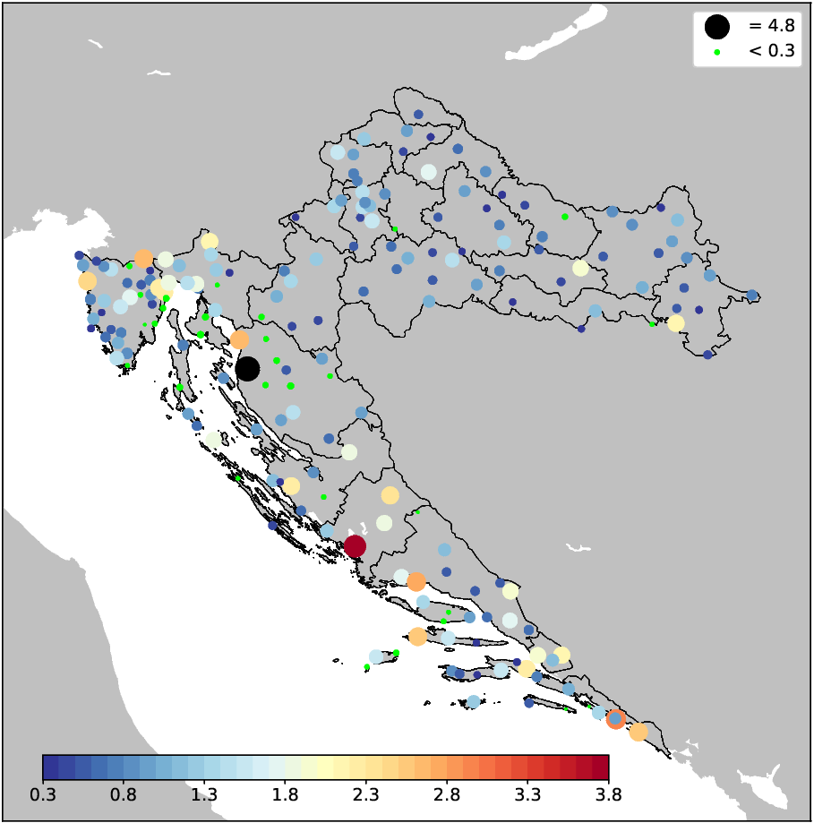







Severe Weather over the Alpine-Adriatic region in a Changing Climate (SWALDRIC)
Schär, C.¹, Temprado Vergara, J.¹, Demory, M-E.¹, Cui, R.¹, Telišman Prtenjak, M.², Malečić, B.², Jelić, D.²,
Večenaj, Ž.², Grisogono, B.², Babić, K.², Belušić Vozila, A.³, Strelec Mahović, N.⁴ ,
Horvath, K.⁴, Güttler, I.⁴,Mikuš Jurković, P.⁴, Ban, N.¹, Fuhrer, O.⁵, Schwierz, C.⁵,
Schroeer, K.⁵, Romppainen, O.⁵, Lapillonne, X.⁵,
¹ Swiss Federal Institute of Technology in Zürich, Switzerland
² University of Zagreb, Faculty of Science, Department of Geophysics, Zagreb, Croatia
³ Croatia Control Ltd, Zagreb, Croatia
⁴ Meteorological and Hydrological Service, Zagreb, Croatia
⁵ Federal Office of Meteorology and Climatology MeteoSwiss, Zürich, Switzerland
Triggering and evolution Severe Weather over the Alpine-Adriatic region in a early morning hail over the Croatian coast – convection-permitting modeling study
, Croatia
Aim & Motivation
Aim & Motivation
Aim & Motivation
Aim & Motivation
Aim & Motivation
Aim & Motivation
Evolution of convection
The SWALDRIC project will investigate severe weather events over Europe, with a specific focus on the Alpine and Adriatic region. The main goals of the project are to better understand severe weather events, to evaluate their representation in weather and climate models, and to investigate their response to climate change. Key elements of the project are: the exploitation of a unique Croatian hail-pad data set, the exploration and intercomparison of a wide range of different atmospheric (weather and climate) modeling systems, and the use of kilometer-scale pan-European decade-long simulations using the first regional climate modeling framework able to run entirely on Graphics Processing Units (COSMO-GPU).
Specific goals:
Climate analysis of hail data.
Examination of the relationship between lightning jumps and hail.
Determination of weather types/wind regimes that favour the formation of hail.
Simulation of hail events using the WRF-HAILCAST model.
Examination of the ability of CRMs in reproducing hail cases.
Analysis of severe weather events in a future climate.
02.05.2014 Case Overview
Key results
Figure 2: Simulated and recorded hail during the three cases with hail in Croatia. The shaded blue area represents simulated hail swaths (maximum hailstone diameter larger of equal to 5 mm) from 00 to 24 UTC on the day hail was observed. The position of hailpads is indicated with black dots. Impacted hailpads are marked with red circles. The position of a densely populated hailpad polygon is marked with a black rectangle and the stations within the polygon are colored only if the hail was observed at that specific station. Fields produced by (a, c, e) COSMO-crCLIM and (b, d, f) WRF are presented.
Both models show a generally good agreement between observed and simulated hail as most of impacted hailpads lie in the area of simulated hail. However, both models exhibit a certain number of false alarms, i.e. hail is not observed, but the model simulated hail. Notably, some of these false alarms could be attributed to the limited spatial information on hail occurrence provided by the hailpad network.
Figure 1: Observed (left column) and simulated (right column) hail (upper panel) and lightning (lower panel) days from April to September during 2009 and 2018. The simulated hail is compared against radar-based observations over Switzerland and from observation logs in Croatia. The simulated lightning is compared against LINET lightning observations. Both HAILCAST and LPI are able to reproduce the spatial patterns of observed hail and lightning activity, respectively. However, HAILCAST tends to overestimate the number hail days per 6 months over the area of Switzerland and Croatia. On the other hand, LPI is able to reproduce the observed frequencies of lightning days over the Alpine-Adriatic region, although local differences are still present.
Figure 3: Daily maximums of the hailstone diameter simulated by (e)-(h); (q)-(t) COSMO-crCLIM and (i)-(l); (u)-(x) WRF and daily maximums of (a)-(d); (m)-(p) POH radar product.
Figure shows the simulated and observed hail swaths during eight hail days over the Alpine region. Simulated hail swaths are obtained by utilizing WRF and COSMO-crCLIM models with embedded HAILCAST. Both models are successful in producing hail swaths comparable to those observed, both in the context of the area affected by hail and the shapes of the observed hail swaths.
Notably there is not an exact match between simulated and observed fields, as, some deviations are present. Interestingly, in most of the analyzed cases, WRF produces smaller hail swaths than COSMO-crCLIM. On the other hand, WRF simulates more grid points having maximum hailstone diameters greater than 35 mm.
Total project financing value: 387.323,00 CHF (195.505,00 CHF from the Croatian side)
The project is funded by the Swiss National Science Foundation and Croatian Science Foundation.
Project implementation period: 1.3.2019-30.11.2022
Figure 4: Hail frequency per station. The hail frequency distribution is not homogeneous. Their values fill the space of 0 - 3.8 days with hail per year except for the station Zavižan which records values of 4.8 days with hail per year. Next largest location affected by hail is the city of Šibenik with a frequency of 3.8 (days with hail per year), and the rest of the coastal stations record high amount of hail compared to continental part of Croatia. We can also notice several very small circles (in green) that mark stations with a hail frequency of less than 0.3 hail days per year.

